Slide 1
DFG Funding Opportunities for Researchers in the Doctoral and Early Postdoc Phase
Margret Heinze / Research in Europe / Eberswalde, April 2023

Slide 2
Topics
1 | The DFG – About Us
2 | DFG Funding Opportunities for Doctoral Researchers
3 | DFG Funding Opportunities for Researchers in the Early Postdoc Phase
4 | Advice and Links

Slide 3
The DFG – About Us
www.dfg.de/en/dfg_profile
The German Research Foundation (DFG) is the largest independent and self-governing research funding organisation in Germany.
It serves all branches of science and the humanities by
funding projects in knowledge-driven research,
supporting the transfer of knowledge.
It takes particular care to promote
international cooperation,
early career researchers,
gender equality and diversity.
Annual budget approx. € 3 billion
DFG Funding Opportunities
4/17/2024

Slide 4
Eligibility
procedures-researchcareers@dfg.de
Researchers
who have completed their scientific training, i.e. who hold a doctorate and
who (would like to) work in Germany.

Slide 5
Topics
1 | The DFG – About Us
2 | DFG Funding Opportunities for Doctoral Researchers
3 | DFG Funding Opportunities for Researchers in the Early Postdoc Phase
4 | Advice and Links

Slide 6
DFG Funding Opportunities for Research Careers
students
doctoral researchers
early
postdocs
advanced
postdocs
appoint-able
professorship
for individuals/
investigators
Walter Benjamin Programme
Emmy Noether Programme
Heisenberg Programme
own
proposal
for
projects/
themes
Individual Research Grant
incl. Temporary Position for Principal Investigators
job application
for open positions
Student Assistant
PhD Position
PhD Position
Postdoc Position

Slide 7
Positions in DFG-Funded Projects
Thousands of positions for doctoral researchers in DFG-funded projects
A university or research institute in Germany employs you
Duration of funding depends on project (typically 3 years)
Position: E13-E14 TvöD/TV-L 65%-100%
Application: to the project’s PI
www.gepris.dfg.de
Individual projects (Einzelförderung)
Research Units (Forschungsgruppen)
Priority Programmes (Schwerpunkt-programme)
Research Impulses (Forschungsimpulse)
Collaborative Research Centres (Sonderforschungsbereiche)
Research Training Groups (Graduiertenkollegs)

Slide 8
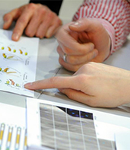
Research Training Groups
Graduiertenkollegs
Goal: qualification of doctoral researchers within the framework of a focused research programme and a structured training strategy
Established by universities
Clear research focus, often interdisciplinary programme
In general 10-13 researchers as supervisors
Thought-out supervision strategy
Integration into matching research environment
Tailored qualification programme, often also including soft skills offers

Slide 9
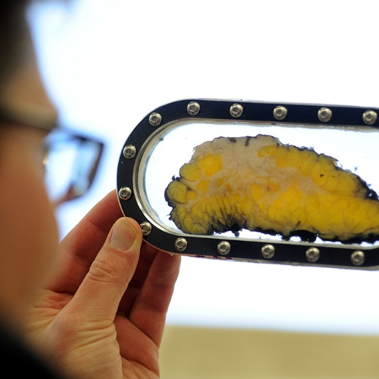
Research Training Groups
Graduiertenkollegs
Positions for all doctoral researchers
Team spirit: scientific exchange with other doctoral researchers, scientists and researchers
Constant improvement of the programme through direct feedback
Funds for scientific networking:
International Summer Schools & conferences
Invitation of guest scientists
Research stays abroad
Equal opportunities and dedicated support for doctoral researchers with children

Slide 10
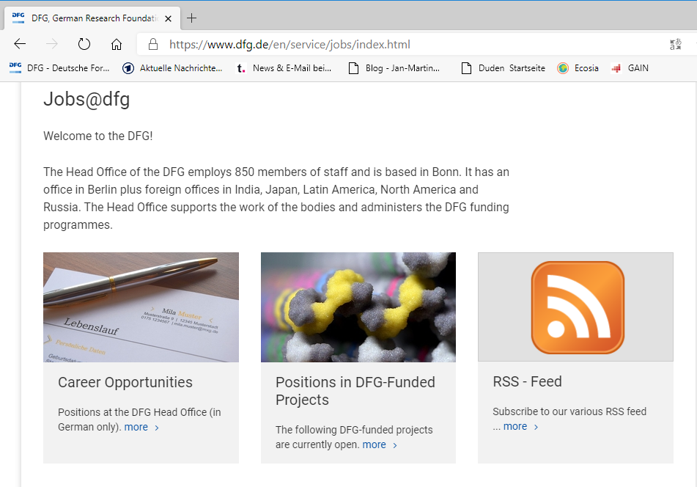
Research Training Groups
How to apply
Apply directly to the Research Training Group (The DFG is not involved in the selection process.)
Look for open positions on jobs@dfg
Search for the RTGs Website/Twitter account
Doctoral researchers with external funding can be associated ➔ Access to RTG qualification measures, meetings etc.

Slide 11
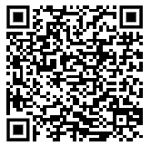
Research Training Groups
Examples in your region
Potsdam
GRK 2130: Minor Cosmopolitanisms
(Other) institutions in Brandenburg participating in Research Training Groups:
GRK 2473: Bioactive Peptides – Innovative Aspects of Synthesis and Biosynthesis
GRK 2445: Temporalities of Future in Latin America: Dynamics of Aspiration and Anticipation
GRK 2227: Identity and Heritage
Online talk (for professors/PIs, in German):
Information on the Programme Research Training Groups at UAS
19.4.24 (tomorrow), 10:00-11:30

Slide 12
Topics
1 | The DFG – About Us
2 | DFG Funding Opportunities for Doctoral Researchers
3 | DFG Funding Opportunities for Researchers in the Early Postdoc Phase
4 | Advice and Links

Slide 13
DFG Funding Opportunities for Postdocs
www.dfg.de/en/research_funding/research_careers www.dfg.de/en/research_funding/programmes www.dfg.de/en/research_funding/individual_grants_programmes
early
postdocs
advanced
postdocs
appoint-able
professorship
for individuals/
investigators
Walter Benjamin Programme
Emmy Noether Programme
Heisenberg Programme
own
proposal
for
projects/
themes
Individual Research Grant
incl. Temporary Position for Principal Investigators
job application
for open positions
Postdoc Position
in a DFG-funded project

Slide 14
Walter Benjamin Programme
www.dfg.de/en/research_funding/programmes/individual/walter_benjamin www.dfg.de/en/research_funding/faq/faq_walter_benjamin
https://youtu.be/wLe8xCMSpLA
Aim: Promoting autonomy and mobility in an early postdoc phase
Requirements:
Mobility: move to a new host institution, either abroad or in Germany – or combining stays at different places
Career support: host researcher advises you on your research career and introduces you to academic networks
Option to go abroad

Slide 15
Walter Benjamin Programme
www.dfg.de/en/research_funding/programmes/individual/walter_benjamin www.dfg.de/en/research_funding/faq/faq_walter_benjamin www.dfg.de/en/research_funding/programmes/individual/research_fellowships/calculator
Duration: Funding for up to two years
Allowance for project costs: 250 €/month → host needs to provide all additional project costs
In Germany
Position: E13 TVöD/TV-L
(or position for temporary substitutes for clinicians)
You are employed by your host institution
Abroad
Fellowship: 1,750 €/month +X + foreign allowance + cost of living allowance + child allowance (if applicable) + possibility of 6-months return grant
→ use the award calculator on the DFG website

Slide 16
Benefits for Parents
www.dfg.de/en/research_funding/programmes/individual/walter_benjamin www.dfg.de/en/research_funding/faq/faq_walter_benjamin
Position in Germany:
Support through Bundeselterngeld- und Elternzeitgesetz (BEEG)
Fellowship abroad:
child allowance + € 400 per month for the first child + € 100 per month for each additional child
The fellowship can be extended by max. 12 months or costs for childcare can be reimbursed
Extension and reimbursement of childcare costs can be combined

Slide 17
International Destinations of Walter Benjamin Fellows in 2021
Further Information
Online Info Talk
16.05., 16:00-17:30
Walter Benjamin Programme (English)
DFG Head Office – International Affairs Poland Contact Person: Dr. Annina Lottermann

Slide 18
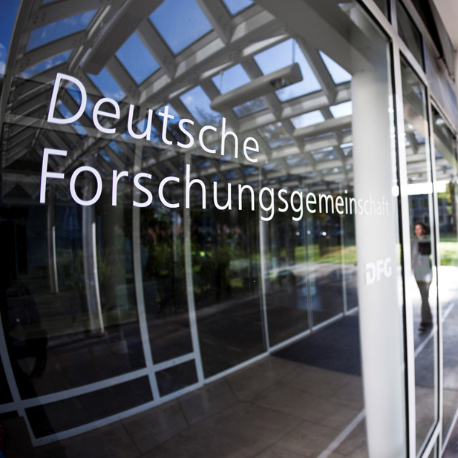
Links
Prospects Research Career Series
16.05.24, 16:00-17:30 Walter Benjamin Programme (English)
Orientation for early-career researchers: www.dfg.de/research_careers
Research Training Groups: www.dfg.de/en/research_funding/programmes/coordinated_programmes/research_training_groups
GEPRIS: database with all DFG-funded projects: gepris.dfg.de/en
DFG “Principles of Effective Career Support in Academia”: www.dfg.de/en/research_funding/research_careers/career_support
General questions about research careers: info-researchcareers@dfg.de
Individual Grants Programmes – A How-To Guide: www.dfg.de/en/research_funding/individual_grants_programmes
Video: Faces: The Walter Benjamin Programme of the DFG

Slide 19
For more information
on the DFG: www.dfg.de
on DFG-funded projects: http://gepris.dfg.de/en
on over 25,000 German research institutes: www.gerit.org

