Slide 1
Who can help? Information sources and support structures for research proposal writing
Jakob Wegener, officer for EU research funding, HNEE

Slide 2
Writing a research proposal is a collaborative exercise It consists of …
Having an idea
Proof-reading, providing feedback
Handling formal requirements and submission platforms
Providing research infra-structure
Writing a DoA
Calcula-ting a budget
Finding a funding program
Finding research partners

Slide 3
As a scientist, you are responsible for some parts of this task only …
Having an idea
Proof-reading, providing feedback
Handling formal requirements and submission platforms
Providing research infra-structure
Provide funding for the writing phase
Writing a DoA
Calcula-ting a budget
Finding a funding program
Finding research partners
(The fun parts mostly)))

Slide 4
….So, who can help with the rest?
You
KoWi
Research support staff of your institution
National Contact Points/funding agencies
Federal and state ministries, EU
EUK/Enterprise Europe
Foto: Thissen/Wegener

Slide 5
Help with… finding the right funding program
„Förderdatenbank des Bundes“
Screenshot from foerderdatenbank.de

Slide 6
Help with… finding the right funding program
„Förderdatenbank des Bundes“
Very complete with regard to German national/regional funding sources
Not so complete with regard to international programs
Search language is German

Slide 7
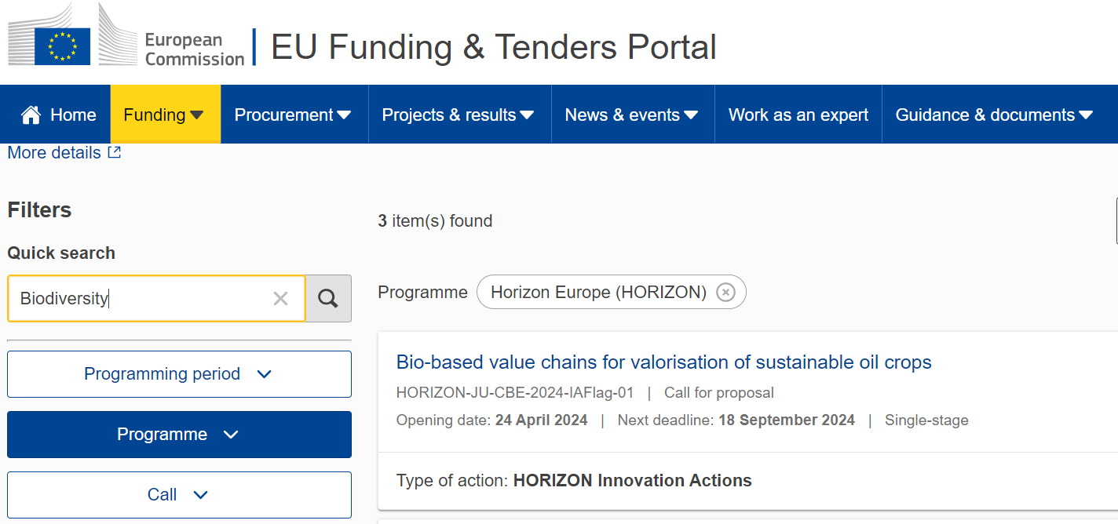
Help with… finding the right funding program
EU Funding and Tenders-Portal
Screenshot from ec.europa.eu/info/funding-tenders

Slide 8
Help with… finding the right funding program
EU Funding and Tenders-Portal
Complete with regard to Horizon Europe „standard“ calls
Not always up-to-date with regard to partnerships / joint undretakings
Also contains all reference documents for Horizon-applicants, and serves as submission platform
Screenshot from ec.europa.eu/info/funding-tenders

Slide 9
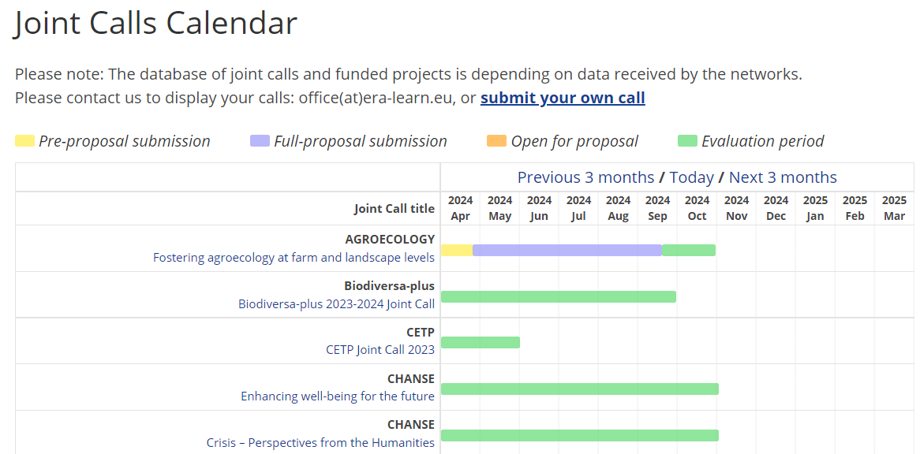
Help with… finding the right funding program
ERA LEARN – Platform (for „Joint Calls“ of consortia of national funding agencies)
Screenshot from era-learn.eu

Slide 10
Help with… finding the right funding program
professional training
Past experiences
The research support staff of your institution!
cooperation requests
Newsletters
Funders‘ websites
advice
You
Research manager

Slide 11
Help with… funding the preparation of your proposal (examples)
Example 1: Writing proposals for Interreg B can be funded through „Bundesprogramm Transnationale Zusammenarbeit“ (max. 25.000 €)

Slide 12
Help with… funding the preparation of your proposal (examples)
Example 2: Coordinators of Horizon cluster-projects can get support for writing/consortium formation through BMBF* (50.000 €, up to 12 months)
*Funding programme „Anschubfinanzierung“

Slide 13
Help with… finding consortium partners
Your greatest help:
The topic text
Your second greatest help:
Your scientific friends
In subject-specific calls, sticking to the call requirements is crucial
Distorting a proposal to make space for your friends‘ contribution is generally a bad idea

Slide 14
Help with… finding consortium partners
Partner search tools come at different levels of engagement
Online databases
One-time networking events
Networking projects
(E.g. partner search-tool of the EU F&T-Portal)
(E.g. organized by National Contact Points or regional ministies)
(E.g. COST-actions, Staff Exchanges)

Slide 15
Help with… finding consortium partners
For finding partners outside of Academia: Enterprise Europe

Slide 16
Help with… proposal writing & submission
For national calls and European co-funded actions: call the funding agency!
Before you start writing… to check whether your idea fits the scope of the call
While you write… to inquire about formal requirements, budgeting rules, annexes

Slide 17
Help with… proposal writing & submission
For (most) EU-calls/topics (Horizon, LIFE, CERV, …)
Call the national contact points!
Pillar II: one NCP per cluster
Other pillars and non-Horizon-Programs: individual NCPs

Slide 18
Help with… proposal writing & submission
For EU-funded projects, KoWi is always at your side!
Giving advice
Proofreading proposals
Hosting your consortium meeting
Training the research support staff of your organization….
Local research manager
You

Slide 19
Help with… proposal writing & submission
For EU-funded projects in Brandenburg, there‘s also EUK!
Giving advice + organizing workshops/events (like the present one)
Proofreading proposals
Training the research support staff of your organization

Slide 20
Help with… proposal writing & submission
The research support staff of your organization is paid to help you – for as long as it takes!

Slide 21
A word about commercial consultancy firms
The deal: consultancy against project participation (work package „management“)
Can help with partner search & topic analysis
Can manage projects efficiently
Possibly a good option for small organizations wishing to coordinate
Photo: Wegener
Is it a symbiosis?

Slide 22
Conclusion: You are at the centre of a support universe!
(although it may not always feel that way)
Photo: Thissen/Wegener

Slide 23
Conclusion: You are at the centre of a support universe!
(although it may not always feel that way)
Photo: Thissen/Wegener

Slide 24
Thanks for your attention!

