Slide 1



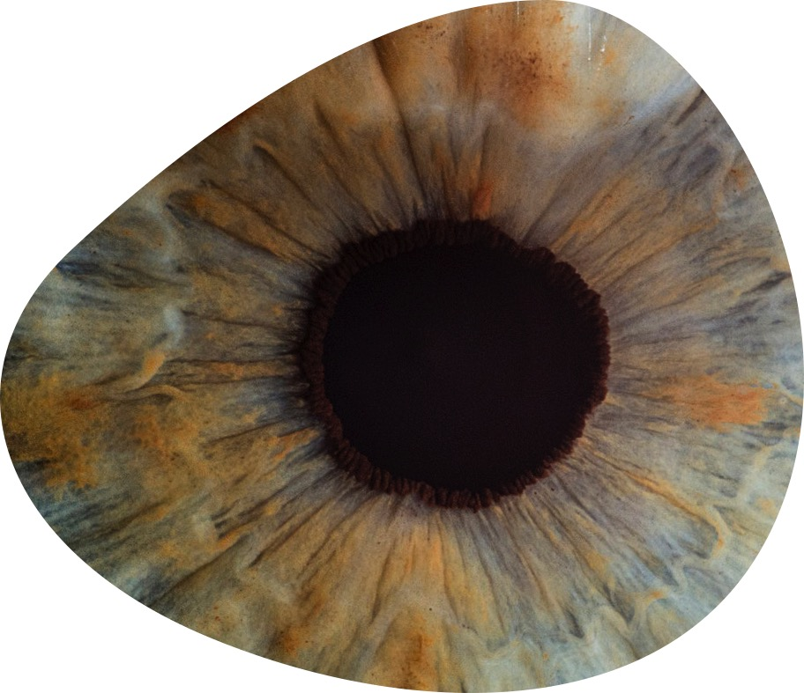

The Leibniz
Association
Pursuing your Career at a
Leibniz Institute
Research in Europe
April 18th, 2024

Slide 2
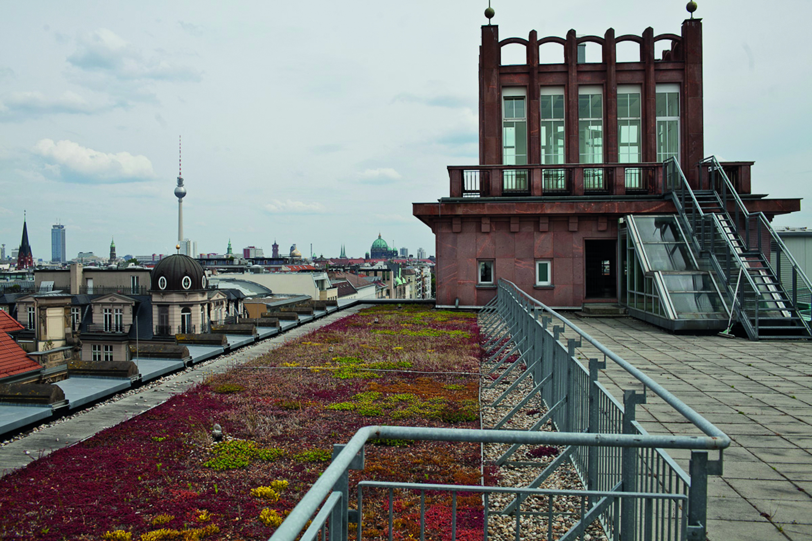
The Leibniz Association at a glance
96 institutes
18 infrastructure facilities
8 research museums
Founded 1995
An association of 96 independent institutes, including 18 infrastructure facilities and 8 research museums
Financial volume € 2,2 billion (2022)
Around 21,000 employees, including 12,000 scientists
Evaluation every 7 years
Strong regional roots in every German federal state
April 18th, 2024

Slide 3



Non-university research in Germany

Slide 4
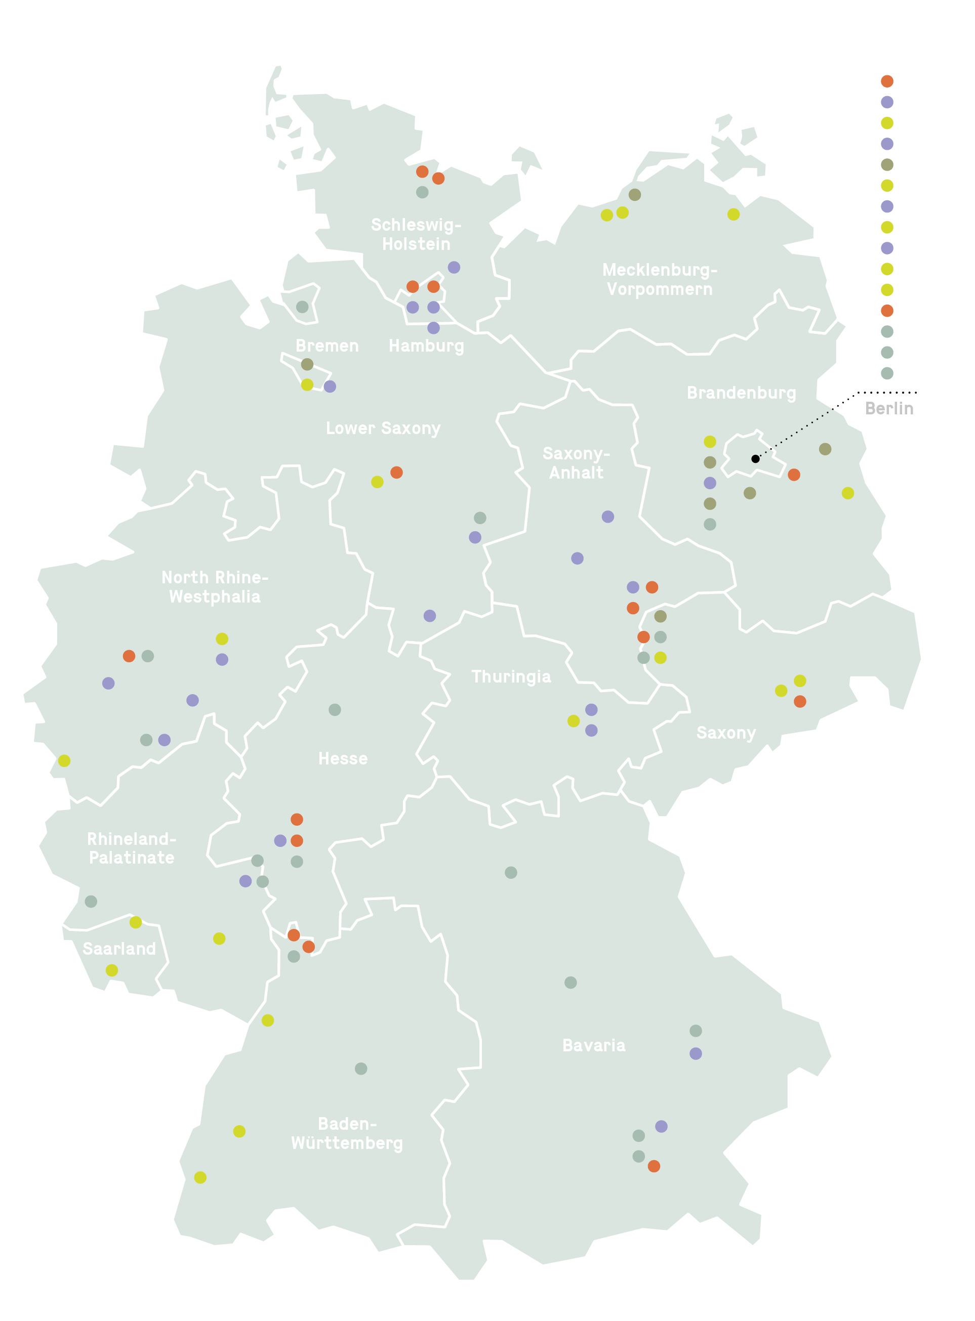
The sections of the Leibniz Association
Section A — Humanities and Educational Research
(23 institutions)
Section B — Economics, Social Sciences,
Spatial Research
(18 institutions)
Section C — Life Sciences
(24 institutions)
Section D — Mathematics, Natural Sciences
and Engineering
(23 institutions)
Section E — Environmental Research
(8 institutions)

Slide 5
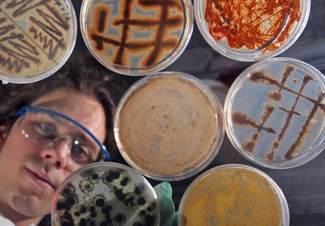
Research Topics – Research Institutes: a few examples
Leibniz Institute for Agricultural Engineering and Bioeconomy (ATB)
Leibniz Institute of Freshwater Ecology and Inland Fisheries (IGB)
Leibniz Institute of Vegetable and Ornamental Crops (IGZ)
Leibniz Institute for Zoo and Wildlife Research (IZW)
Leibniz Institute of Plant Genetics and Crop Plant Research (IPK)
Leibniz Institute for the Analysis of Biodiversity Change (LIB)
Potsdam Institute for Climate Impact Research (PIK)
Senckenberg Society for Nature Research (SGN)
Leibniz Centre for Agricultural Landscape Research (ZALF)
Leibniz Centre for Tropical Marine Research (ZMT)

Slide 6


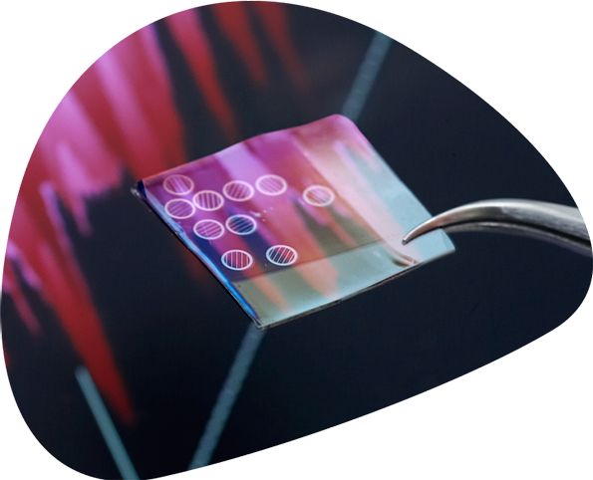


Research Infrastructures in the Leibniz Association
~ 169 Research Infrastructures in
~ 76 Institutes
Data archives
Surveys, cohorts
and panels
Research
libraries
Scientific
collections
Large-scale equipment

Slide 7

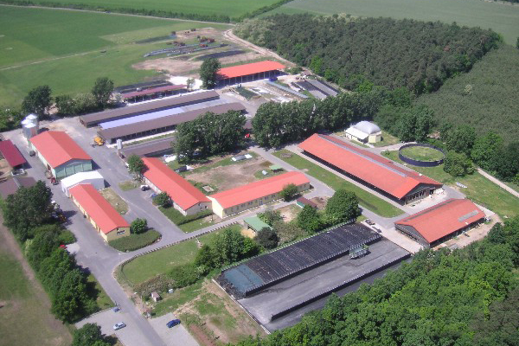
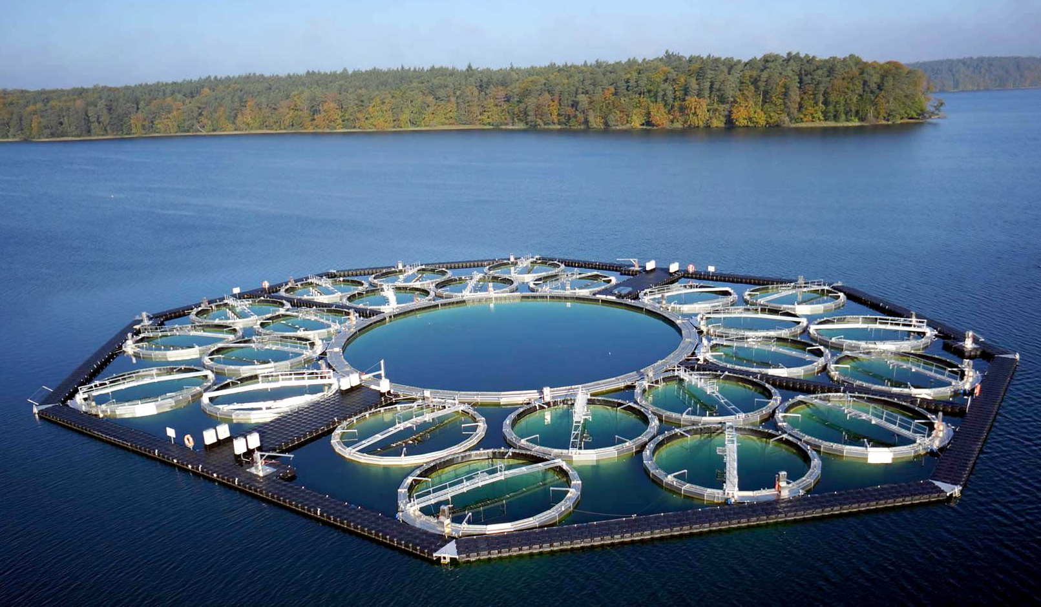
Research Infrastructures at the Leibniz Association
The LakeLab Stechlin | Leibniz Institute of Freshwater Ecology and Inland Fisheries (IGB)
InnoFarm for Sustainable Bioeconomy I Leibniz Institute for Agricultutral Engineering and Bioeconomy (ATB)

Slide 8
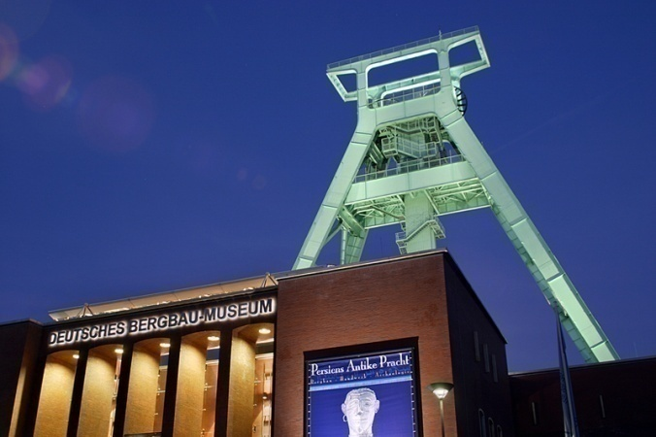
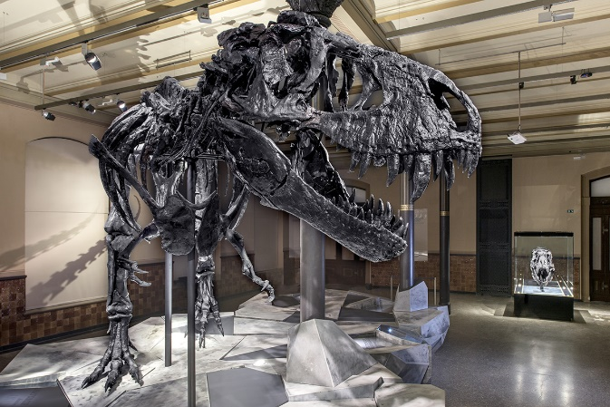
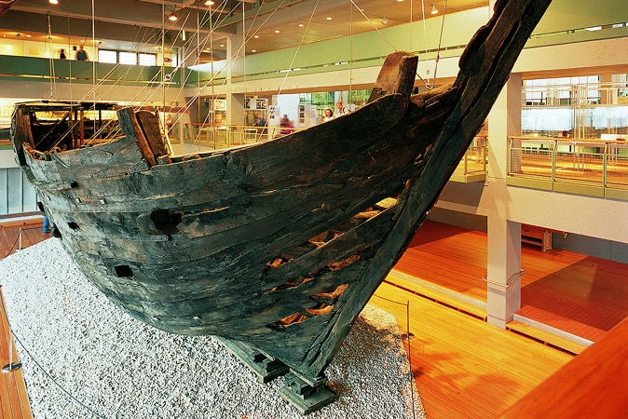
Leibniz Research Museums
Research – Collection – Knowledge Transfer
Deutsches Bergbau-Museum Bochum (DBM) – Leibniz Research Museum for Geo-resources, Bochum
Deutsches Museum (DM), Munich
German Maritime Museum (DSM) - Leibniz Institute for Maritime History, Bremerhaven
Germanisches Nationalmuseum (GNM), Nürnberg
Leibniz Institute for the Analysis of Biodiversity Change (LIB), Museum Koenig Bonn and Museum of Nature Hamburg
Museum für Naturkunde - Leibniz Institute for Research on Evolution and Biodiversity (MfN), Berlin
Senckenberg Society for Nature Research (SGN) - Leibniz Institution for Biodiversity and Earth System Research, Frankfurt am Main, Görlitz, Dresden

Slide 9
Strategic networking
Leibniz Research Alliances
Health
technologies
Value of the Past
Advanced
Materials Safety
INFECTIONS in an Urbanizing World
Resilient
Ageing

Slide 10
Collaboration with Universities
Joint appointments of institute directors, heads of department and Junior Research Groups
Promotion of institutionalised and regional collaboration and creation of internationally visible research hubs within Leibniz ScienceCampi
Opportunity to collaborate in a transdisciplinary research environment at Leibniz Graduate Schools
Funding for joint research projects through the Leibniz Competition
(Leibniz Collaborative Excellence, Leibniz Programme for Women Professors)

Slide 11
Career Support
Leibniz Mentoring
For female postdoc researchers heading towards a management position or professorship
Leibniz PhD Network
Specialist and interdisciplinary networking for PhD students
Leibniz Dissertation Award
Categories: ‘Humanities & Social Sciences’ and ‘Natural & Technical Sciences’
Leibniz ScienceCampi and Leibniz Graduate Schools
Doctorates in an excellent research environment across disciplinary boundaries
Leibniz Postdoc Network
Specialist and interdisciplinary networking for postdoc researchers
Leibniz Competition
Leibniz Collaborative Excellence and
Leibniz Programme for Women Professors
Postdoc Retreats
Two-day networking and training retreat for Leibniz Institute researchers in the orientation phase shortly before or after their doctorate
11

Slide 12
Leibniz Competition
Leibniz Junior Research Groups:
The programme supports postdoctoral researchers with an excellent track record who are keen to take on a professorship or similar academic role.
Leaders of JRG can pursue their own research projects, and establish themselves in their respective fields on their way to a full professorship or tenured position.
The funding of up to €1.7 million over five years covers personnel and material costs.
Leibniz Programme for Women Professors:
The funding programme attracts highly qualified female academics in all disciplines to the Leibniz Association as jointly appointed professors.
Selected candidates are promoted by means of a permanent associate, full professorship, or one with a tenure track option.

Slide 13
And how do I get in?
Find a Leibniz Institute
that suits your research interests by checking out our website www.leibniz-association.eu and/or browsing through the respective Sections
Identify a suitable PI
at the Leibniz Institute of your choice
Contact the PI directly
introduce yourself, send a CV and describe your research interests
Identify funding opportunities
you may be eligible for funding by the institutes, 3rd party funding or funding by your own organization - If you are a hot candidate, the PI will help you find funding for you!
Best of luck and see you soon at a Leibniz Institute!

Slide 14

See you soon!
Dr. Benedikt Fausch
Public and International Affairs
fausch@leibniz-gemeinschaft.de
Leibniz Association
Chausseestrasse 111
10115 Berlin, Germany
info@leibniz-gemeinschaft.de
www.leibniz-association.eu

