Slide 1
Career opportunities at Germany's biggest research organization for postdocs
Lia Lang
Scientific Careers and Talent Manager, Strategie Department, Helmholtz Head Office
HNEE / Research in Europe / April 18, 2024

Slide 2
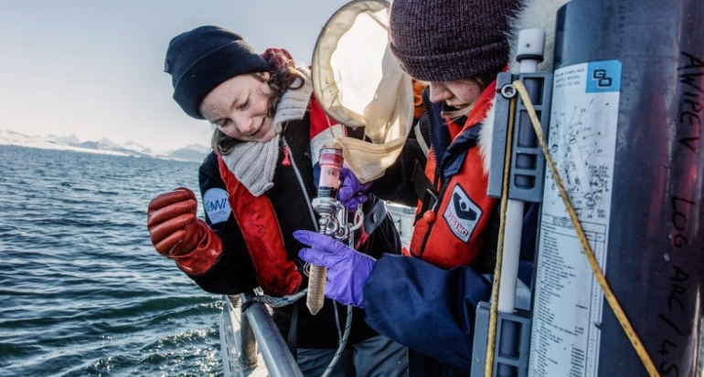
Helmholtz research mission & strategy
Systems solutions for grand challenges based on:
Scientific excellence
Interdisciplinarity
Long-term research programs
Helmholtz provides a highly attractive environment for talents and brilliant minds
Profound expertise in large-scale research infrastructure
Helmholtz as a prime strategic partner at the local, national and international level
Transfer of knowledge into economy and society
HZI (HIPS)

Slide 3
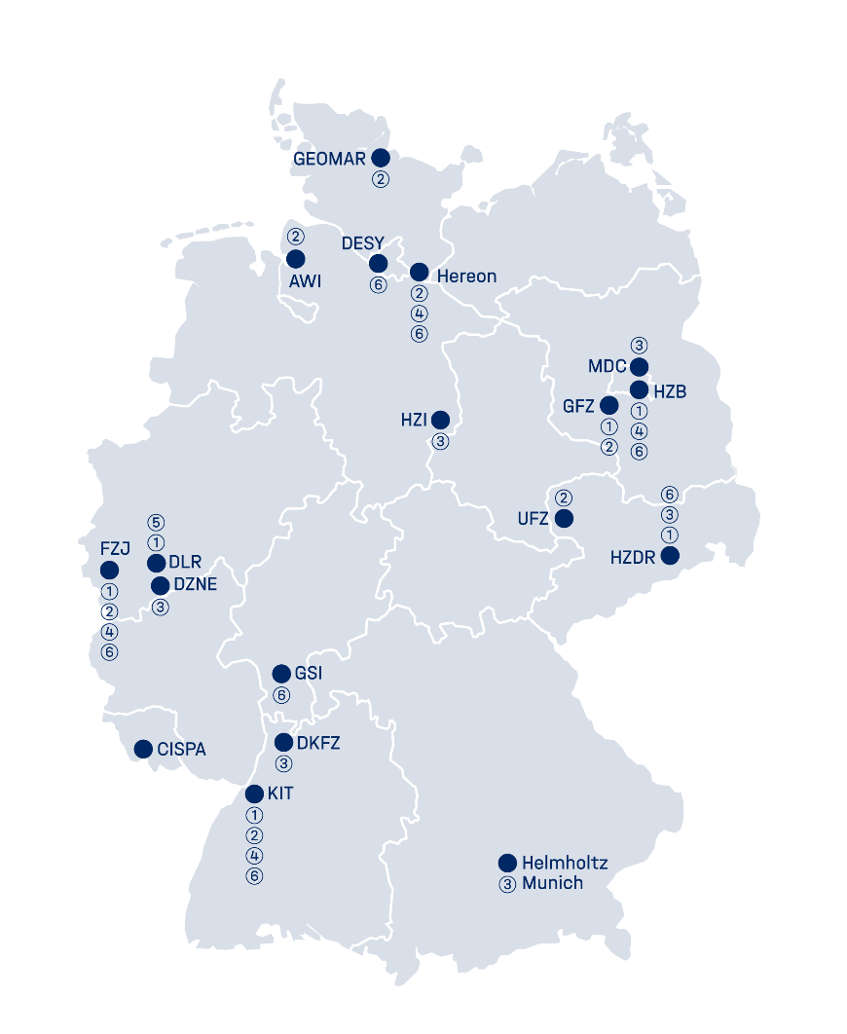
Helmholtz research centers
18 centers in 6 Research Fields
Alfred-Wegener-Institut Helmholtz-Zentrum für Polar- und Meeresforschung (AWI)
CISPA – Helmholtz Center for Information Security
Deutsches Elektronen-Synchrotron DESY
Deutsches Krebsforschungszentrum (DKFZ)
Deutsches Zentrum für Neurodegenerative Erkrankungen (DZNE)
German Aerospace Center (DLR)
Forschungszentrum Jülich (FZJ)
GEOMAR Helmholtz-Zentrum für Ozeanforschung Kiel
GSI Helmholtz Center for Heavy Ion Research
Helmholtz Munich
Helmholtz-Zentrum Berlin für Materialien und Energie (HZB)
Helmholtz Center Dresden Rossendorf (HZDR)
Helmholtz Center for Infection Research (HZI)
Helmholtz Center for Environmental Research – UFZ
Helmholtz-Zentrum Hereon
GEOMAR Helmholtz Center for Ocean Research Kiel
Helmholtz Center Potsdam – German Research Center for Geosciences GFZ
Karlsruhe Institute of Technology (KIT)
Max Delbrück Center for Molecular Medicine in the Helmholtz Association (MDC)
Research Fields:
(1) Energy, (2) Earth and Environment
(3) Health, (4) Information
(5) Aeronautics, Space and Tansport, (6) Matter

Slide 4
The six research fields
of the Helmholtz Association
Notes:
In the Research Field Earth and Environment, seven Helmholtz centers are working together to gain a better understanding of the earth system. They explore the complex processes that determine our natural foundations of life – from the highest atmosphere to the Earth’s deepest crust, from the past to the future, from the land surface to the oceans to the most remote polar regions. (AWI, Jülich, GEOMAR, UFZ (Helmholtz center for environmental research, HERION, GFZ (German research center for geoscience), KIT)

Slide 5
Helmholtz research centers
18 centers in 6 Research Fields
Alfred-Wegener-Institut Helmholtz-Zentrum für Polar- und Meeresforschung (AWI)
CISPA – Helmholtz Center for Information Security
Deutsches Elektronen-Synchrotron DESY
Deutsches Krebsforschungszentrum (DKFZ)
Deutsches Zentrum für Neurodegenerative Erkrankungen (DZNE)
German Aerospace Center (DLR)
Forschungszentrum Jülich (FZJ)
GEOMAR Helmholtz-Zentrum für Ozeanforschung Kiel
GSI Helmholtz Center for Heavy Ion Research
Helmholtz Munich
Helmholtz-Zentrum Berlin für Materialien und Energie (HZB)
Helmholtz Center Dresden Rossendorf (HZDR)
Helmholtz Center for Infection Research (HZI)
Helmholtz Center for Environmental Research – UFZ
Helmholtz-Zentrum Hereon
GEOMAR Helmholtz Center for Ocean Research Kiel
Helmholtz Center Potsdam – German Research Center for Geosciences GFZ
Karlsruhe Institute of Technology (KIT)
Max Delbrück Center for Molecular Medicine in the Helmholtz Association (MDC)
Research Fields:
(1) Energy, (2) Earth and Environment
(3) Health, (4) Information
(5) Aeronautics, Space and Tansport, (6) Matter

Slide 6
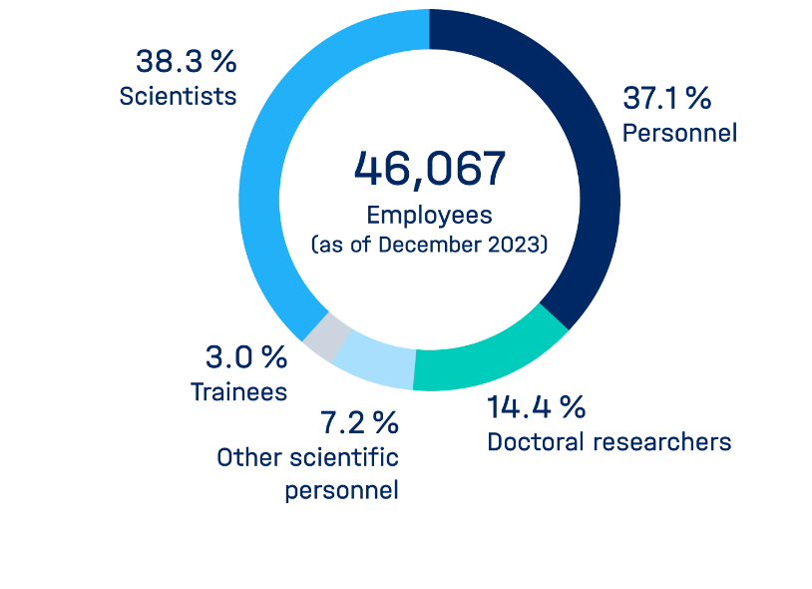
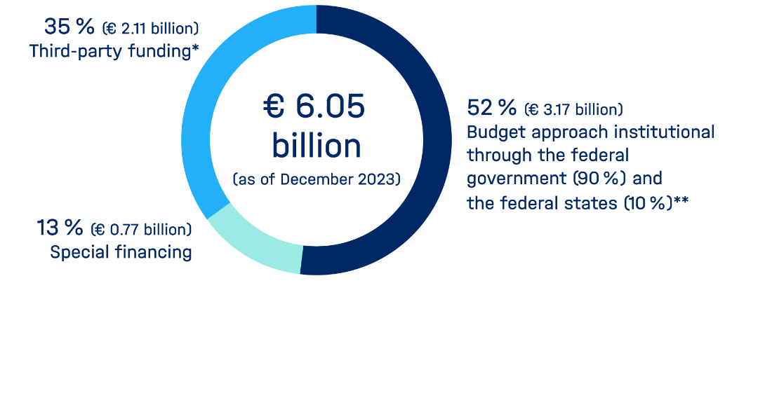
Facts and figures
Personnel & budget 2023
* Including project sponsorships
** As of 2016, the German federal government alone is financing the pact increase so that the federal government's share is over 90%.

Slide 11
The Helmholtz Investigator Group program
Funded candidates are further qualified for leadership positions in science.
Early independence:
Budget min. € 300,000 per year for 5 years
Option for an early university professorship
tenure position in case of a positive midterm evaluation
Excellent additional training:
Personnel development plan/potential tenure track
Leadership training with the Helmholtz Academy
Target group:
Top talent 2-6 years after earning a doctoral degree (academic age) with min. 6 months working experience abroad

Slide 12
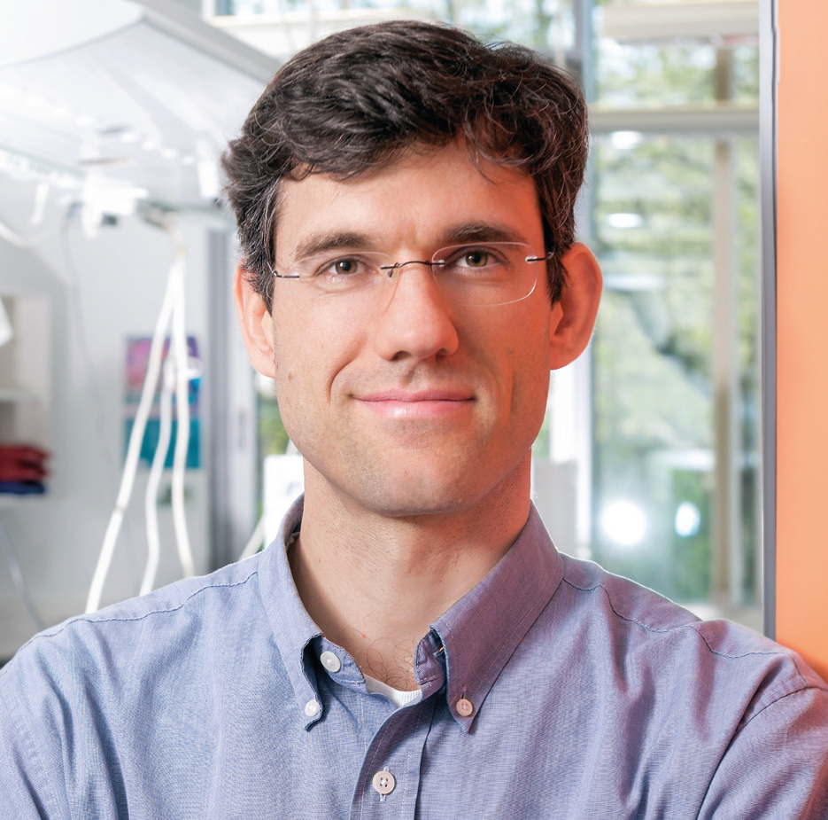
Helmholtz Investigator Groups
Application procedure
Please contact one of the 18 Helmholtz Centers. The Centers pre-select the applications and guarantee half of the funding of your group
The Helmholtz Centers support you in writing a full application and nominate you to the Head Office of the Helmholtz Association
The Head Office conducts a scientific review process consisting of written assessments and a personal presentation in Berlin
Annual Call for application opens in December
https://www.helmholtz.de/en/career/careers-at-helmholtz/helmholtz-young-investigator-groups/

Slide 13
Funding of first-time professorial appointments of excellent female scientists
Who can apply? What does the funding package include?
Target group
Female scientists who
are about to become a scientific leader in their field and demonstrate outstanding scientific performance
will be appointed for the first time to the W2 or W3 professorship level from a junior professorship, investigator group leadership position, or another post-doctoral position (current position should correspond to the level “R3 – Established Researcher”) or are currently in a fixed-term, Helmholtz-external professorship
Notes:
The program
-supports women seeking their first appointment to a W2- or a W3-level professorship* in cooperation with a partner university in Germany
-supports highly qualified candidates early in their careers and helps them to establish themselves as professors
-offers long-term career perspectives: only permanent appointments are funded
-aims at rising stars from both Germany and abroad whose research profile is complementary with the applying Helmholtz Center and research program

Slide 14
Funding of first-time professorial appointments of excellent female scientists
Target group
Female scientists who
are about to become a scientific leader in their field and demonstrate outstanding scientific performance
will be appointed for the first time to the W2 or W3 professorship level from a junior professorship, investigator group leadership position, or another post-doctoral position (current position should correspond to the level “R3 – Established Researcher”) or are currently in a fixed-term, Helmholtz-external professorship
Funding
permanent appointment
200,000 Euro per year for position and staff, relevant equipment
Helmholtz Center and partner university are expected to provide additional financial resources
Notes:
The program
-supports women seeking their first appointment to a W2- or a W3-level professorship* in cooperation with a partner university in Germany
-supports highly qualified candidates early in their careers and helps them to establish themselves as professors
-offers long-term career perspectives: only permanent appointments are funded
-aims at rising stars from both Germany and abroad whose research profile is complementary with the applying Helmholtz Center and research program

Slide 15
Funding of first-time professorial appointments of excellent female scientists
Target group
Female scientists who
are about to become a scientific leader in their field and demonstrate outstanding scientific performance
will be appointed for the first time to the W2 or W3 professorship level from a junior professorship, investigator group leadership position, or another post-doctoral position (current position should correspond to the level “R3 – Established Researcher”) or are currently in a fixed-term, Helmholtz-external professorship
Funding
permanent appointment
200,000 Euro per year for position and staff, relevant equipment
Helmholtz Center and partner university are expected to provide additional financial resources
Application
Candidates must apply directly to the respective Helmholtz Center
Further information and current call: https://www.helmholtz.de/en/research/current-calls-for-applications/
Notes:
The program
-supports women seeking their first appointment to a W2- or a W3-level professorship* in cooperation with a partner university in Germany
-supports highly qualified candidates early in their careers and helps them to establish themselves as professors
-offers long-term career perspectives: only permanent appointments are funded
-aims at rising stars from both Germany and abroad whose research profile is complementary with the applying Helmholtz Center and research program

Slide 16
Funding of first-time professorial appointments of excellent female scientists
Target group
Highly distinguished female scientists
who are recognized leaders in their respective research field
who have an outstanding international reputation
who are currently conducting research at institutions abroad (this may include female researchers of German nationality who have been employed abroad in the last years)
whose research profile is complementary with the applying Helmholtz Center and the research program
Notes:
The program
-aims at exceptionally qualified, experienced, international recognised female scientists from abroad, i.e. outside Germany
-creates excellent research conditions on a long-term basis and offers opportunity to work at the upper management level in the Helmholtz Centers
-creates reliable career prospects by granting permanent W3 appointments with partner universities in Germany
-has a Dual Career option
-strengthens strategic cooperation with the partner universities and the internationalization of the Helmholtz Association
-establishes and expands strategically relevant topics through targeted recruitment

Slide 17
Funding of first-time professorial appointments of excellent female scientists
Target group
Highly distinguished female scientists
who are recognized leaders in their respective research field
who have an outstanding international reputation
who are currently conducting research at institutions abroad (this may include female researchers of German nationality who have been employed abroad in the last years)
whose research profile is complementary with the applying Helmholtz Center and the research program
Funding
permanent appointment
600,000 Euro per year for position and staff, relevant equipment
Helmholtz Center and partner university are expected to provide additional financial resources
Notes:
The program
-aims at exceptionally qualified, experienced, international recognised female scientists from abroad, i.e. outside Germany
-creates excellent research conditions on a long-term basis and offers opportunity to work at the upper management level in the Helmholtz Centers
-creates reliable career prospects by granting permanent W3 appointments with partner universities in Germany
-has a Dual Career option
-strengthens strategic cooperation with the partner universities and the internationalization of the Helmholtz Association
-establishes and expands strategically relevant topics through targeted recruitment

Slide 18
Funding of first-time professorial appointments of excellent female scientists
Target group
Highly distinguished female scientists
who are recognized leaders in their respective research field
who have an outstanding international reputation
who are currently conducting research at institutions abroad (this may include female researchers of German nationality who have been employed abroad in the last years)
whose research profile is complementary with the applying Helmholtz Center and the research program
Funding
permanent appointment
600,000 Euro per year for position and staff, relevant equipment
Helmholtz Center and partner university are expected to provide additional financial resources
Application
Candidates must apply directly to the respective Helmholtz Center
Further information and current call: https://www.helmholtz.de/en/research/current-calls-for-applications/
Notes:
The program
-aims at exceptionally qualified, experienced, international recognised female scientists from abroad, i.e. outside Germany
-creates excellent research conditions on a long-term basis and offers opportunity to work at the upper management level in the Helmholtz Centers
-creates reliable career prospects by granting permanent W3 appointments with partner universities in Germany
-has a Dual Career option
-strengthens strategic cooperation with the partner universities and the internationalization of the Helmholtz Association
-establishes and expands strategically relevant topics through targeted recruitment

Slide 19
Research Grants for Doctoral Researchers and Postdocs
Helmholtz Visiting Researcher Grant
What is it?
Financial support for…
… self-organized, fully funded short-term research stays at one of the 18 Helmholtz centers
… projects with a strong link to data/information science, e.g. climate modelling, computational biology, biochemistry, remote sensing
→ Expand your research portfolio
→ Kick of new collaborations
Apply your data science skills

Slide 20
Research Grants for Doctoral Researchers and Postdocs
Helmholtz Visiting Researcher Grant
Who can apply?
Doctoral and postdoctoral researchers, and also experienced Master degree holders (from universities, research organizations, industry worldwide)
Project needs to have a strong link to the (applied) data and information science
Open to all nationalities from German and from international institutions
Duration: 1 to 3 months
Application Deadline: 15 March and 15 October (every year)
Notes:
2,860€ per month (plus subsidies)

Slide 21
Let´s keep in touch!
LinkedIN: Lia Lang ☺

Slide 23
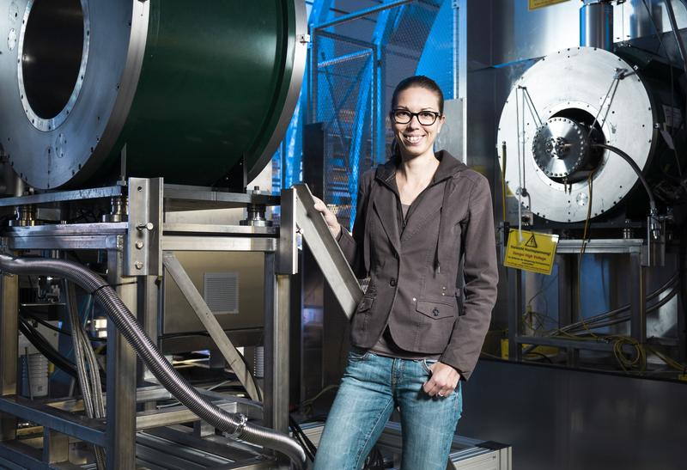
Talent management at Helmholtz
Career development is a cornerstone of our strategy. Helmholtz is a place to grow to your full potential.
More than 40 graduate schools / research schools; approx. 8.700 graduate students
Helmholtz Career Development Centers as career counselling units for postdocs at the Helmholtz Centers
Funding for 261 young investigator groups since 2003
Tenure options in cooperation with Universities
More than 70 first-time professorial appointments of highly talented female scientists
Almost 60 Helmholtz Distinguished Professorships for leading international female scientists
Qualification of more than 800 staff members in the Helmholtz Leadership Academy
Alumna Prof. Dr. Kathrin Valerius conducts research in experimental astroparticle physics.
Notes:
Frau Valerius ist Principal Investigator am Karlsruhe Tritium Neutrino Experiment „KATRIN“.
Vom Wirtschaftsmagazin CAPITAL 2019 gelistet in den „Top 40 unter 40“.
Vom IVF gefördert als NWG von 2014‒2020 und bei ihrer Erstberufung als Professorin von 2020‒2025.
[https://idw-online.de/de/news728268]

Slide 24
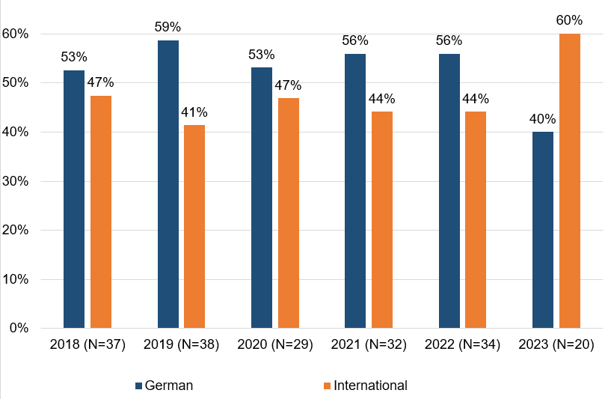
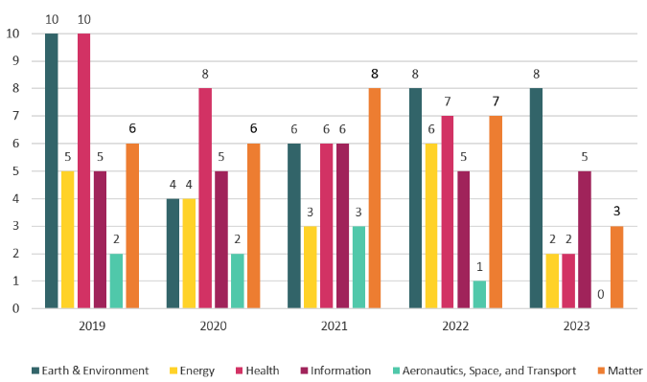
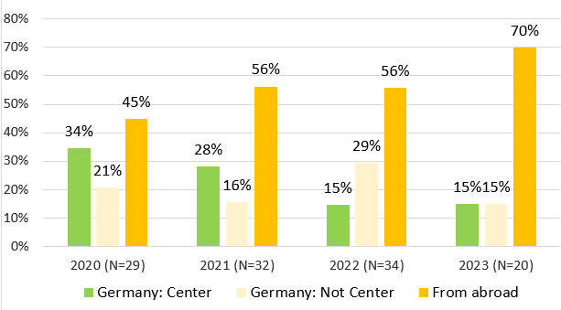
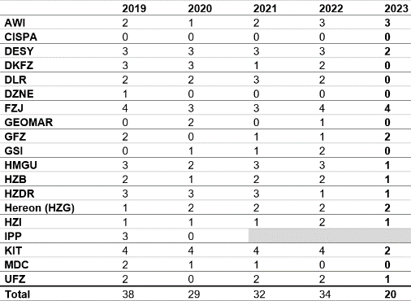
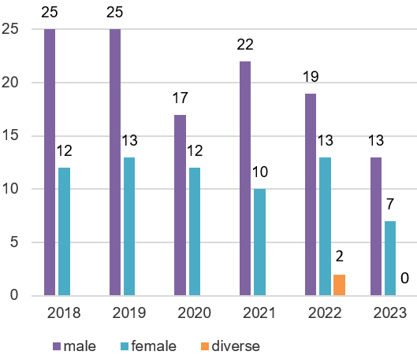
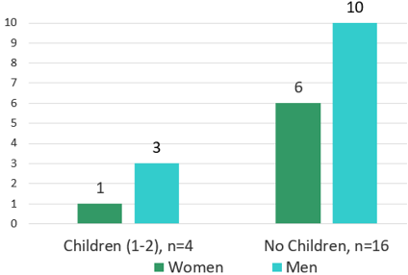
Nomination data – 21. Helmholtz Investigator Groups Program (2023)
Recruiting of international „rising stars“ for Germany
95 applications of candidates
20 nominations of centers
Country of origin
Current place of employment
Nominations by center
Gender
Applicants with children

