Slide 1
DFG Funding Opportunities for Advanced Postdocs
Margret Heinze KOWI Research in Europe| HNE Eberswalde | 18/04/2024

Slide 2
DFG Funding Opportunities for Postdocs
Information presented on the following slides are valid on 18th April, 2024. Please check www.dfg.de/en for updates and current regulations.
Margret Heinze KOWI Research in Europe | HNE Eberswalde | 18/04/2024

Slide 3
Topics
1 | The DFG – About Us
2 | DFG Funding Opportunities
3 | Review Process and Advice
4 | Links and Resources

Slide 4
The DFG – About Us
www.dfg.de/en/dfg_profile
The German Research Foundation (DFG) is the largest independent and self-governing research funding organisation in Germany.
It serves all branches of science and the humanities by
funding projects in knowledge-driven research,
supporting the transfer of knowledge.
It takes particular care to promote
international cooperation,
early career researchers,
gender equality and diversity.
Annual budget approx. € 3 billion
DFG Funding Opportunities
4/17/2024

Slide 5
Amount of Research Funding Awarded by Programme in 2022 (in €m and %)
www.dfg.de/en/dfg_profile/facts_figures/statistics

Slide 6
Amount of Research Funding Awarded by Scientific Discipline for Each Calendar Year 2019 to 2022 (in €m and %)
www.dfg.de/en/dfg_profile/facts_figures/statistics

Slide 7
Funding Rates* in the Individual Grants Programmes by scientific discipline 2019 to 2022 (in %)
www.dfg.de/en/dfg_profile/facts_figures/statistics/processing_times_success_rates
* The funding rate (or success rate) was calculated by dividing the number of awards by the number of proposals reviewed.
Source: New Individual grants

Slide 8
Eligibility
procedures-researchcareers@dfg.de
Researchers
who have completed their scientific training, i.e. who hold a doctorate and
who (would like to) work in Germany.

Slide 9
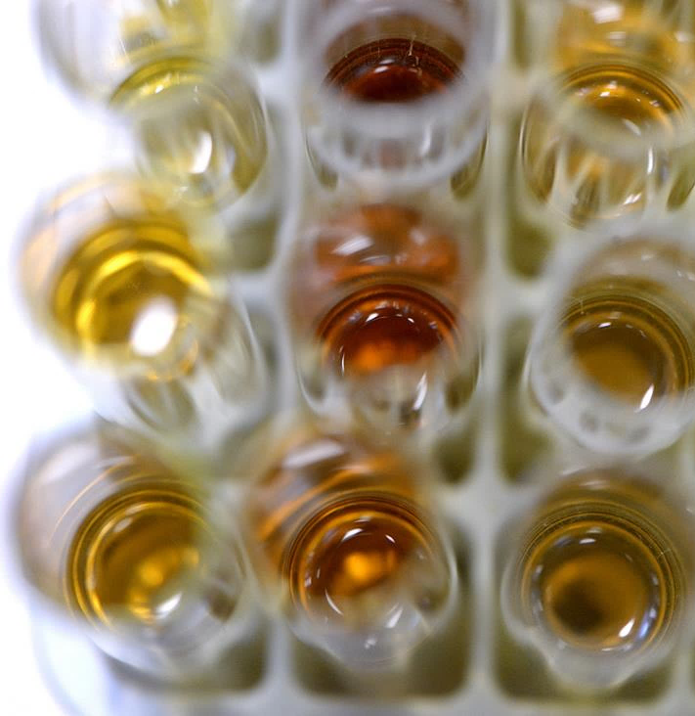
Funding Principles
www.dfg.de/en/research_funding/research_careers/career_support
https://youtu.be/yNdFVV3jAII
Open, bottom-up choice of research topics
Knowledge-driven research in any field of science and the humanities
No age restrictions
Individual career phases and family-related career breaks are considered in the review process
Unbiased review process based on scientific criteria
10 Principles of Effective Career Support in Academia
No deadlines*
*excl. Priority Programmes, international calls etc.
DFG Funding Opportunities
9
4/17/2024

Slide 10
Topics
1 | The DFG – About Us
2 | DFG Funding Opportunities
3 | Review Process and Advice
4 | Links and Resources

Slide 11
DFG Funding Opportunities for Postdocs
www.dfg.de/en/research_funding/research_careers www.dfg.de/en/research_funding/programmes www.dfg.de/en/research_funding/individual_grants_programmes
early
postdocs
advanced
postdocs
appoint-able
professorship
for individuals/
investigators
Walter Benjamin Programme
Emmy Noether Programme
Heisenberg Programme
own
proposal
for
projects/
themes
Individual Research Grant
incl. Temporary Position for Principal Investigators
job application
for open positions
Postdoc Position
in a DFG-funded project

Slide 12
DFG Funding Opportunities for Postdocs
www.dfg.de/en/research_funding/research_careers www.dfg.de/en/research_funding/programmes www.dfg.de/en/research_funding/individual_grants_programmes
early
postdocs
advanced
postdocs
appoint-able
professorship
for individuals/
investigators
Walter Benjamin Programme
Emmy Noether Programme
Heisenberg Programme
own
proposal
for
projects/
themes
Individual Research Grant
incl. Temporary Position for Principal Investigators
job application
for open positions
Postdoc Position
in a DFG-funded project

Slide 13
Individual Research Grant
www.dfg.de/en/research_funding/programmes/individual/research_grants www.dfg.de/en/research_funding/faq/faq_temporary_positions
Travel
Goal: offer you an opportunity to pursue your research project in Germany
Most common funding programme of the DFG
Flexible project structure, flexible use of fundTemporary Position for PI:
Your host institution becomes your employer
Funding duration: generally for up to three years
Publication costs
Instrumentation
Consumables
Basic Module
Position for a temporary substitute
Temporary position for PI
Public relations
Replacements
Mercator-Fellow
Project specific workshops

Slide 14
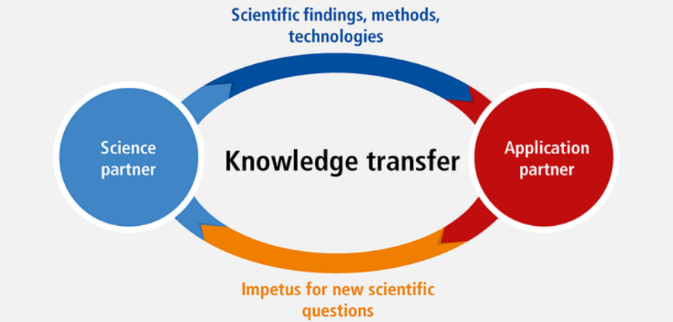
Individual Research Grant
www.dfg.de/en/research_funding/programmes/individual/research_grants www.dfg.de/en/research_funding/faq/faq_temporary_positions www.dfg.de/en/research-funding/funding-initiative/knowledge-transfer
Online info talk (in German): DFG Funding for Researchers at Universities of Applied Sciences
13.05.24, 13:30 – 15:00
23.08.24, 13:00 – 14:30
Variants:
Subproject of a Research Unit (Forschungsgruppe)
Project in a Priority Programme (Schwerpunktprogramm)
Transfer projects
After DFG-funded preliminary project
In collaboration with application partner(s): cooperation agreement
Contact DFG head office in advance

Slide 15
DFG Funding Opportunities for Postdocs
www.dfg.de/en/research_funding/research_careers www.dfg.de/en/research_funding/programmes www.dfg.de/en/research_funding/individual_grants_programmes
early
postdocs
advanced
postdocs
appoint-able
professorship
for individuals/
investigators
Walter Benjamin Programme
Emmy Noether Programme
Heisenberg Programme
own
proposal
for
projects/
themes
Individual Research Grant
incl. Temporary Position for Principal Investigators
job application
for open positions
Postdoc Position
in a DFG-funded project

Slide 16
DFG Funding Opportunities for Postdocs
www.dfg.de/en/research_funding/research_careers www.dfg.de/en/research_funding/programmes www.dfg.de/en/research_funding/individual_grants_programmes
early
postdocs
advanced
postdocs
appoint-able
professorship
for individuals/
investigators
Walter Benjamin Programme
Emmy Noether Programme
Heisenberg Programme
own
proposal
for
projects/
themes
Individual Research Grant
incl. Temporary Position for Principal Investigators
job application
for open positions
Postdoc Position
in a DFG-funded project

Slide 17
Emmy Noether Programme
www.dfg.de/en/research_funding/programmes/individual/emmy_noether www.dfg.de/en/research_funding/faq/faq_emmy_noether
Goal
Path to early academic independence
Eligibility for professorial appointment by leading one’s own independent junior research group
Requirements:
Outstanding postdocs with 2-4 years of postdoc experience (medicine: up to 6 years; possible extensions for parents)
Substantial international research experience
Excellent research project

Slide 18
Emmy Noether Programme
www.dfg.de/en/research_funding/programmes/individual/emmy_noether www.dfg.de/en/research_funding/faq/faq_emmy_noether
Funding for six years
Your host institution in Germany becomes your employer
Funding includes
position: E15 TVöD/TV-L (or position for temporary substitutes for clinicians)
project funds
family allowance possible
Notes:
Uni gets 94.500 gross p.a. to pay you

Slide 19
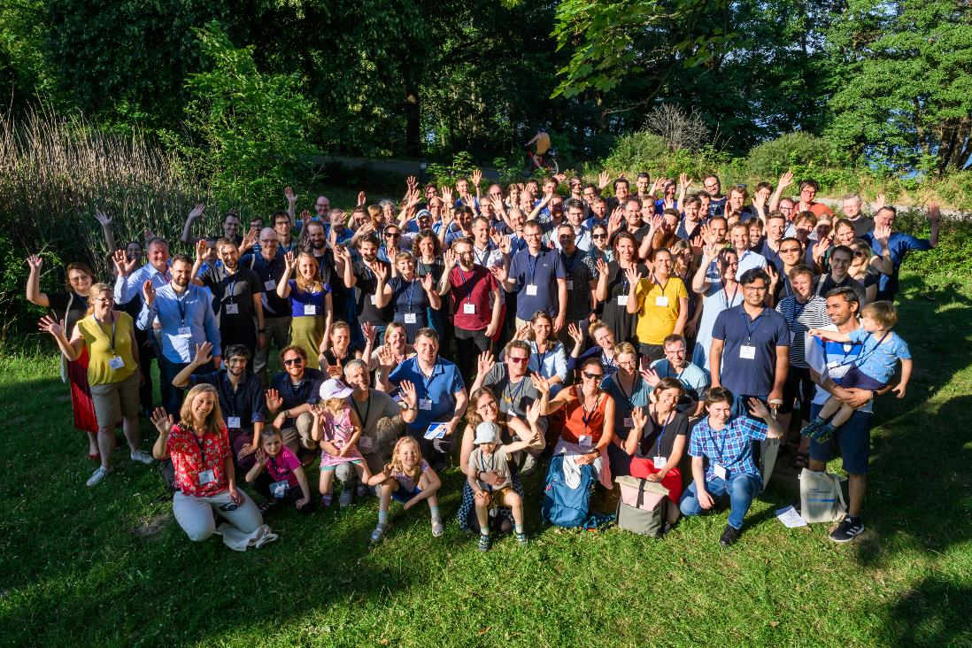
Annual Emmy Noether Meetings
https://youtu.be/rMw8FHwKcTs
www.dfg.de/foerderung/programme/einzelfoerderung/emmy_noether/jahrestreffen/2023 (in German)

Slide 20
DFG Funding Opportunities for Postdocs
www.dfg.de/en/research_funding/research_careers www.dfg.de/en/research_funding/programmes www.dfg.de/en/research_funding/individual_grants_programmes
early
postdocs
advanced
postdocs
appoint-able
professorship
for individuals/
investigators
Walter Benjamin Programme
Emmy Noether Programme
Heisenberg Programme
own
proposal
for
projects/
themes
Individual Research Grant
incl. Temporary Position for Principal Investigators
job application
for open positions
Postdoc Position
in a DFG-funded project

Slide 21
Heisenberg Programme
www.dfg.de/en/research_funding/programmes/individual/heisenberg www.dfg.de/en/research_funding/faq/faq_heisenberg
Goal: Enabling outstanding researchers to prepare for a senior academic role while continuing their research work
Requirement “Berufbarkeit” evaluated in review process
(achievements equivalent to a) habilitation
Researchers from abroad
Requirement: Researchers who are eligible for professorial appointment
Junior professors
(positive evaluation)
Emmy Noether Group leaders, or comparable
Positions in private-sector research

Slide 22
Heisenberg Programme
www.dfg.de/en/research_funding/programmes/individual/heisenberg www.dfg.de/en/research_funding/faq/faq_heisenberg
Funding: for up to five years
Choice of individual funding after the proposal is approved:
Fellowship (abroad) € 4,450
Position E-15 TVöD/TV-L in Germany
Position for temporary substitutes for clinicians
Professorship W2 or W3 → host must establish permanent professorship
+ € 1,000 per month (flexible research funds)
May be combined with Research Grant Proposal

Slide 23
DFG Funding Opportunities for Postdocs
www.dfg.de/en/research_funding/research_careers www.dfg.de/en/research_funding/programmes www.dfg.de/en/research_funding/individual_grants_programmes
early
postdocs
advanced
postdocs
appoint-able
professorship
for individuals/
investigators
Walter Benjamin Programme
Emmy Noether Programme
Heisenberg Programme
own
proposal
for
projects/
themes
Individual Research Grant
incl. Temporary Position for Principal Investigators
job application
for open positions
Postdoc Position
in a DFG-funded project

Slide 24
Positions in a DFG-Funded Project
https://gepris.dfg.de www.dfg.de/en/dfg_profile/head_office/careersite/positions_dfg_funded_projects
Positions for doctoral and postdoctoral researchers in DFG-funded projects:
Duration of funding depends on the project
Employer: A university or research institute in Germany
Position: E13-E14 TvöD/TV-L
Apply to the project’s PI
www.gepris.dfg.de
Individual projects
Research Impulses
Research Units
Priority Programmes
Collaborative Research Centres
Research Training Groups
Notes:
Public/federal wage system: unis get 80.100 € gross p.a.

Slide 25
DFG Funding Opportunities for Postdocs
www.dfg.de/en/research_funding/research_careers www.dfg.de/en/research_funding/programmes www.dfg.de/en/research_funding/individual_grants_programmes
early
postdocs
advanced
postdocs
appoint-able
professorship
for individuals/
investigators
Walter Benjamin Programme
Emmy Noether Programme
Heisenberg Programme
own
proposal
for
projects/
themes
Individual Research Grant
incl. Temporary Position for Principal Investigators
job application
for open positions
Postdoc Position

Slide 26
Topics
1 | The DFG – About Us
2 | DFG Funding Opportunities
3 | Review Process and Advice
4 | Links and Resources

Slide 27
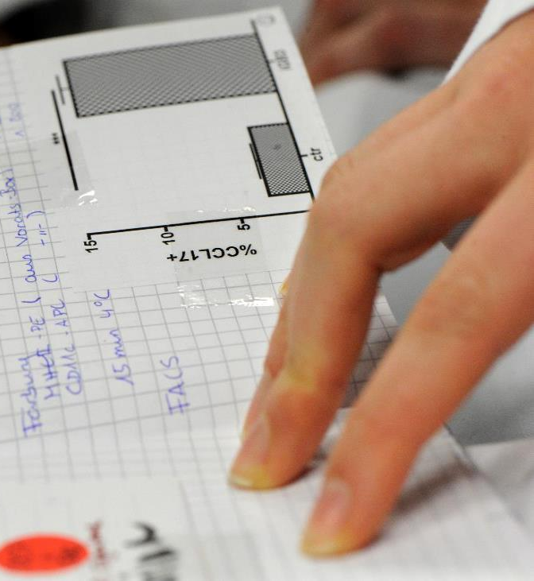
Preparing Your Proposal
www.dfg.de/en/dfg_profile/head_office
Carefully read and follow the guidelines and proposal instructions
Necessary information can be found on the DFG website
Guidelines, FAQ and contacts
Questions? Ask for help
For questions on eligibility: procedures-researchcareers@dfg.de
For general questions on programmes for research careers: info-researchcareers@dfg.de
All DFG contacts: www.dfg.de/en/dfg_profile/head_office
DFG Funding Opportunities
4/17/2024

Slide 28
Preparing Your Proposal
Decide on the proposal language: English or German
Put yourself in the reviewers’ shoes
Address the review criteria
Write the proposal self-explanatory
Seek honest criticism from colleagues
Plan on a feasible timeline:
Preparation of additional documents
the time to decision is ca. six months
DFG Funding Opportunities
4/17/2024

Slide 29
Preparing Your CV
www.dfg.de/formulare/53_200_elan/53_200_en_elan.rtf www.dfg.de/en/research_funding/individual_grants_programmes/tips_proposals www.dfg.de/en/research_funding/individual_grants_programmes/proposal_information
DFG CV template
Mention time away from research relating e.g. to family, dependent care or illness; no details required
Convince reviewers of your qualification
Include prizes, fellowships and awards
List up to ten peer-reviewed publications
Include further results/activities within and outside the research system
DFG Funding Opportunities
4/17/2024

Slide 30
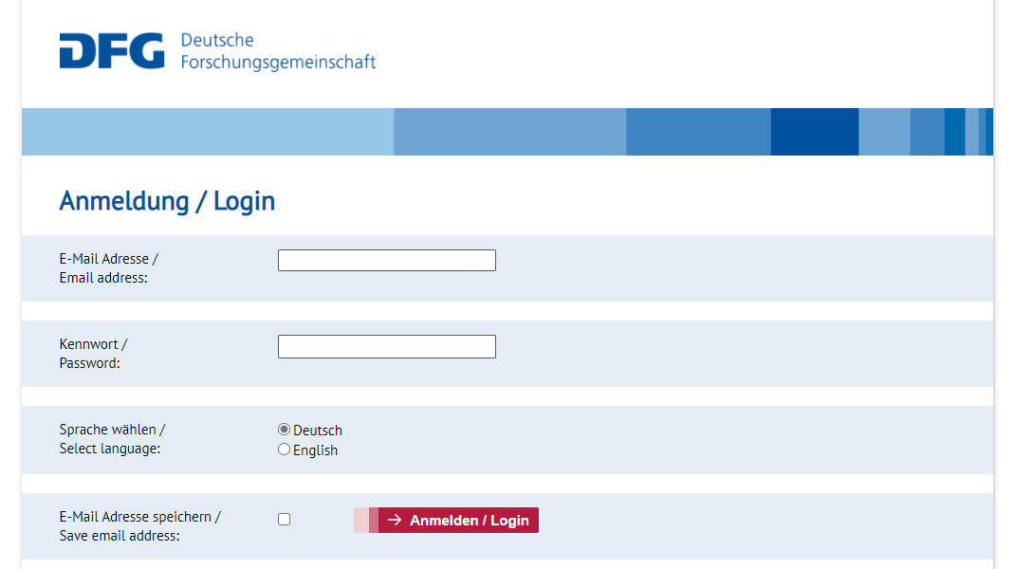
Submitting Your Proposal via elan
https://elan.dfg.de www.dfg.de/en/research_funding/individual_grants_programmes/proposal_information
DFG Funding Opportunities
4/17/2024

Slide 31
Review Process in the Individual Grants Programme
www.dfg.de/en/research_funding/individual_grants_programmes/arriving_decision
Proposal
DFG Head Office
formal examination
inquiries
reviewer selection
Written Reviews
Reviewers
project quality
applicants’ qualifications
aims and work programme
working environment
add. Criteria, e.g., grant budget
draft of funding recommendation
Assessment
Review Board
confidential
assessment of reviewer selection
proposal and reviews
comparative merit and funding volume
communication of funding recommendation
Decision
Joint Committee
cross-subject comparison
decision letter with reviewers’ comments
Notification

Slide 32
Topics
1 | The DFG – About Us
2 | DFG Funding Opportunities
3 | Review Process and Advice
4 | Links and Resources

Slide 33
Cooperation with Poland
www.dfg.de/en/research-funding/funding-opportunities/prizes/copernicus-award https://www.dfg.de/en/research-funding/funding-opportunities/programmes/international-cooperation/initiation-international-collaboration www.dfg.de/en/research-funding/funding-opportunities/programmes/international-cooperation/joint-proposal-weave-process
Bilateral research projects under the weave lead agency process projects (with the Polish National Science Centre, NCN)
Copernicus Award for outstanding achievements in German-Polish research cooperation (DFG and Foundation for Polish Science FNP)
Fellowship in Poland with the Walter Benjamin Programme
Grant Programme “Initiation of international cooperation”
Contact person at the DFG head office International Affairs – Poland
Dr. Annina Lottermann
DFG Funding Opportunities
4/17/2024

Slide 34
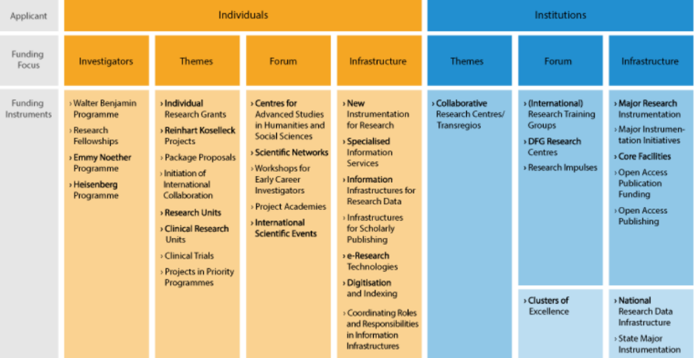
Amount of Research Funding Awarded by Programme in 2022 (in €m and %)
www.dfg.de/en/dfg_profile/facts_figures/statistics www.dfg.de/en/research-funding/funding-opportunities/programmes

Slide 35
Research Impulses (Forschungsimpulse)
Thematically open, knowledge-driven cooperative research at universities of applied sciences (UAS, HAW/FH), university as applicant institution
Goal: better tap into the potential of UAS, support them in developing their research profile, enhancing the conditions for knowledge-driven research at UAS
Funding duration: 5 + 3 years, volume: max. 1 Mio. € / year (flexibly usable)
Five rounds of calls (third round of calls Q4/2024)
Two-stage review process (draft & full proposal after invitation), decided by the DFG-Joint Committee
ca. 5-7 funded proposals per round of calls
Contact: fip@dfg.de
DFG Funding Opportunities
35
4/17/2024

Slide 36
Topics
1 | The DFG – About Us
2 | DFG Funding Opportunities
3 | Review Process and Advice
4 | Links and Resources

Slide 37
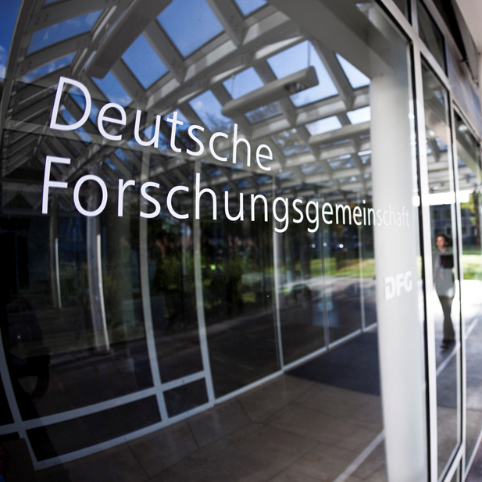
Links and Resources
Orientation for early-career researchers: www.dfg.de/research_careers
Individual Grants Programmes – A How-To Guide: www.dfg.de/en/research_funding/individual_grants_programmes
GEPRIS – database with all DFG-funded projects: gepris.dfg.de/en
Profiles of 25,000 German research institutes: www.gerit.org
General questions about research careers: info-researchcareers@dfg.de
Questions on eligibility: procedures-researchcareers@dfg.de
Contacts: www.dfg.de/en/dfg_profile/head_office
Videos: Faces: The Walter Benjamin Programme of the DFG and Faces: The Emmy Noether Programme of the DFG YouTube

