Slide 1
EXZELLENZ
VERBINDET –
BE PART OF A
WORLDWIDE NETWORK
Dr. Michelle Herte
Alexander von Humboldt Foundation
Selection Department
“Research in Europe”
Hochschule für Nachhaltige Entwicklung Eberswalde
18 April 2024

Slide 2
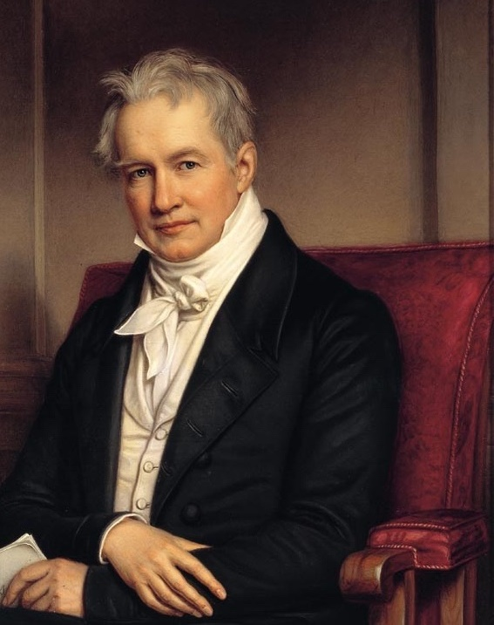

OUR ROOTS
Alexander von Humboldt (1769 – 1859):
explorer, universal genius, cosmopolitan and sponsor of excellent scientific talent
1953: Establishment of today’s Alexander von Humboldt Foundation, based in Bonn Bad-Godesberg
International network of academic cooperation, modelled on Humboldt

Slide 3
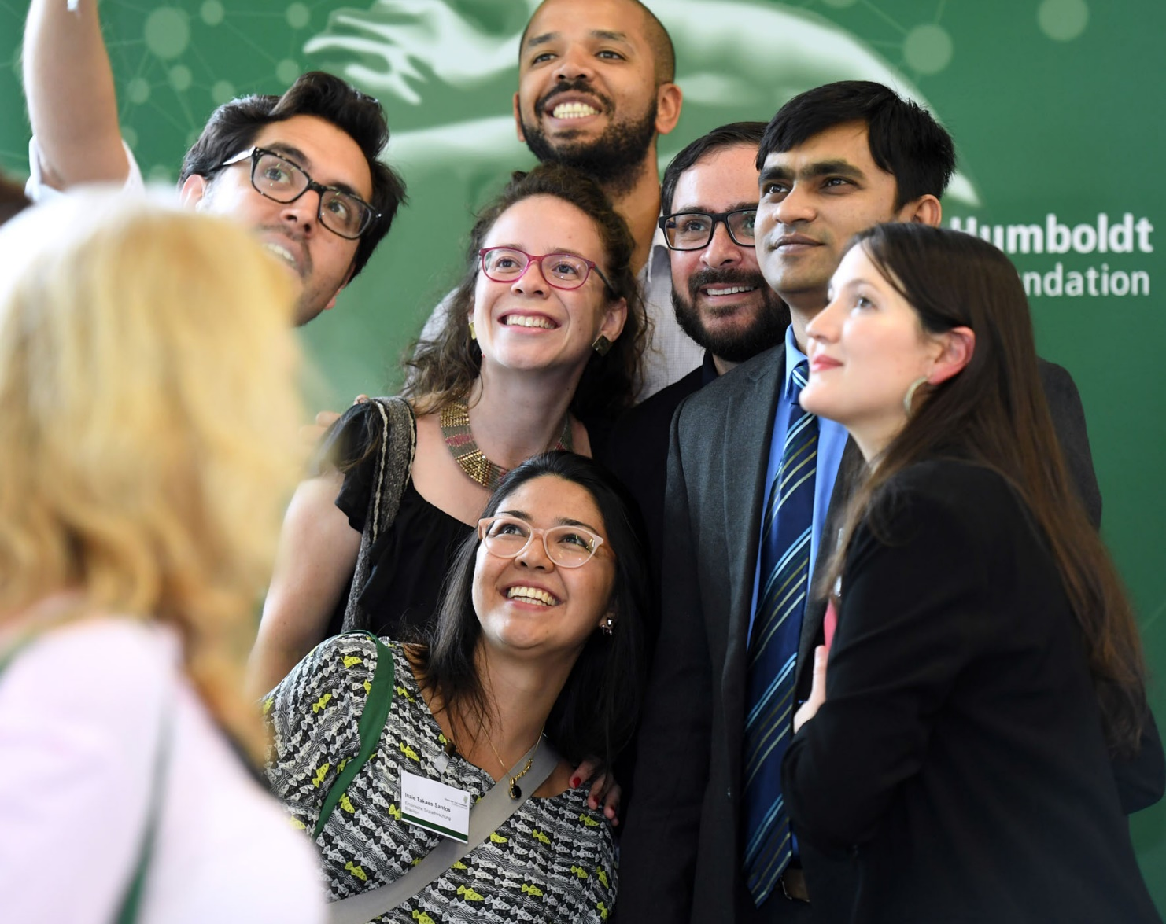
WHAT WE DO
  Academic collaborations between excellent international and German researchers
  Sponsorship throughout lifetime
  International understanding, diplomacy, scientific progress and development
  Internationalization of Germany as a research location
  A network of 30,000 alumni worldwide

Slide 4
OUR NETWORK
950
Awards and fellowships every year
Alumni in more than
140
countries
2300
Research stays in Germany every year

Slide 5
30000
Humboldtians across the world
59
Nobel laureates
40
Conferences and meetings across the world every year
109
Humboldt alumni associations worldwide

Slide 6
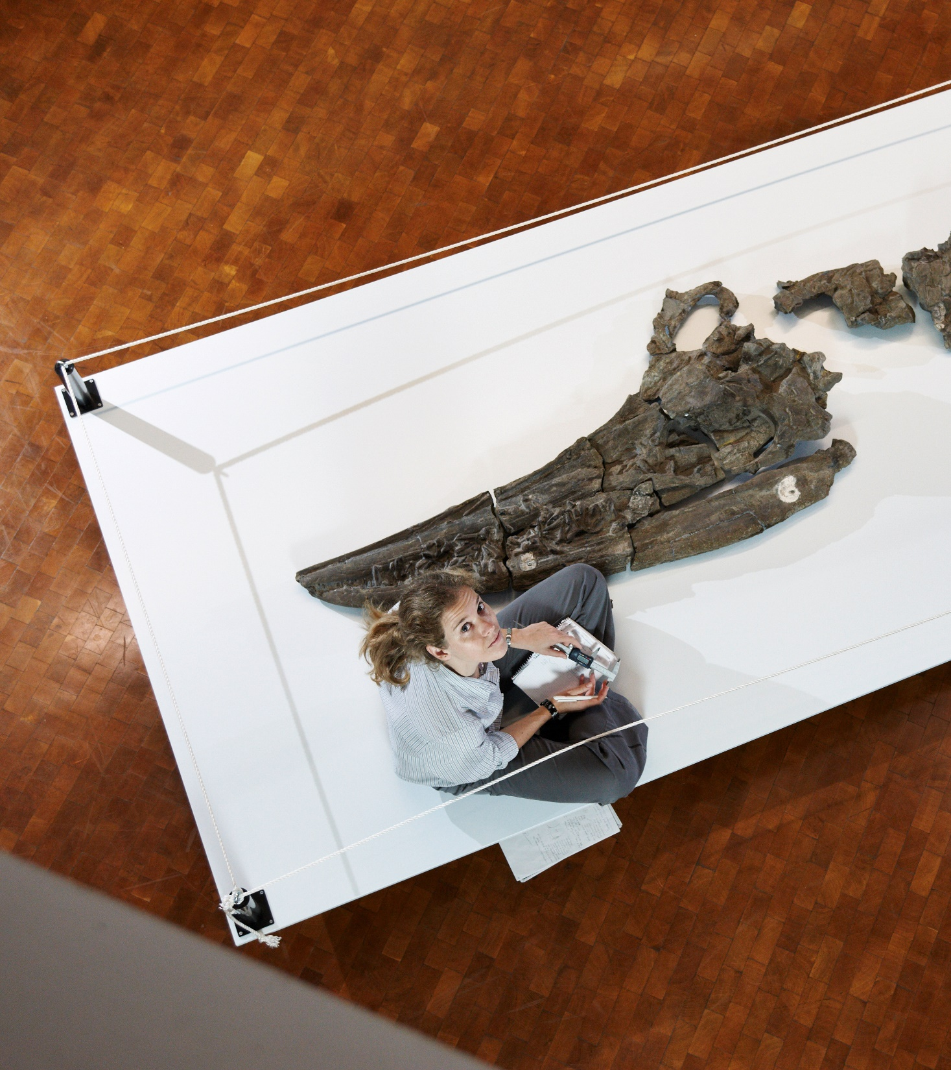
PRINCIPLES OF THE FOUNDATION
no quotas for countries or disciplines
main selection criterion: the applicant’s academic qualification
we support people, not projects.
independent scientific research, bottom-up and investigator-driven
flexible sponsorship options for different career stages and during the entire scientific career through Alumni sponsorship measures

Slide 7
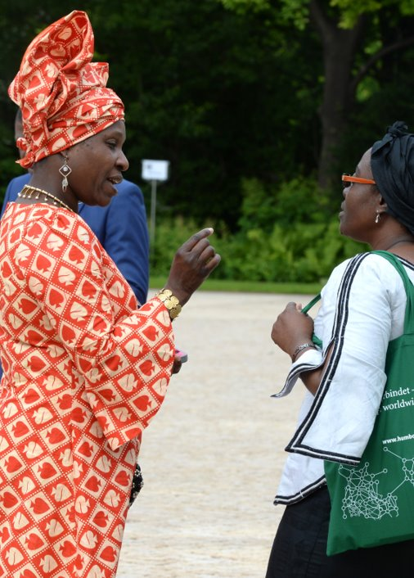
Equal Opportunities for Female Researchers
equal opportunities is an important issue for the Foundation
care work will be taken into account regarding career stages
transparency in the review and selection process
fellowship extension or interruption, allowances to support childcare
targeted counselling and provision of information

Slide 8
HUMBOLDT FOUNDATION FINANCING
Budget 2023*: approx. 163.3 mill. euros, 93 percent financed through federal funds
AA 36,1 %
BMZ 7,1 %
BMWK 1,5 %
EU 3,6 %
Others 3,0 %
BMBF 48,7 %
AA: Federal Foreign Office
BMBF: Federal Ministry of Education and Research
BMZ: Federal Ministry for Economic Cooperation and Development
BMWK: Federal Ministry for Economic Affairs and Climate Action
* according to the 2023 budget

Slide 9
Key sponsorship programmes at a glance
 | Academics from abroad | Academics from Germany
Postdoctoral researchers (up to 4 years after completion of doctorate) | Humboldt Research Fellowship Georg Forster Research Fellowship | Feodor Lynen Research Fellowship
Experienced researchers (up to 12 years after completion of doctorate) | Humboldt Research Fellowship Georg Forster Research Fellowship | Feodor Lynen Research Fellowship
(up to 18 years after completion of doctorate) | Friedrich Wilhelm Bessel Research Award
Internationally renowned academics | Humboldt Research Award Georg Forster Research Award Alexander von Humboldt Professorship
Up-and-coming researchers (until 15 years after completion of doctorate) and established academics as potential Scouts |  | Henriette Herz Scouting Programme

Slide 10

Research Fellowships
for exceptionally qualified academics from abroad and from Germany
10 | 17.04.2024

Slide 11
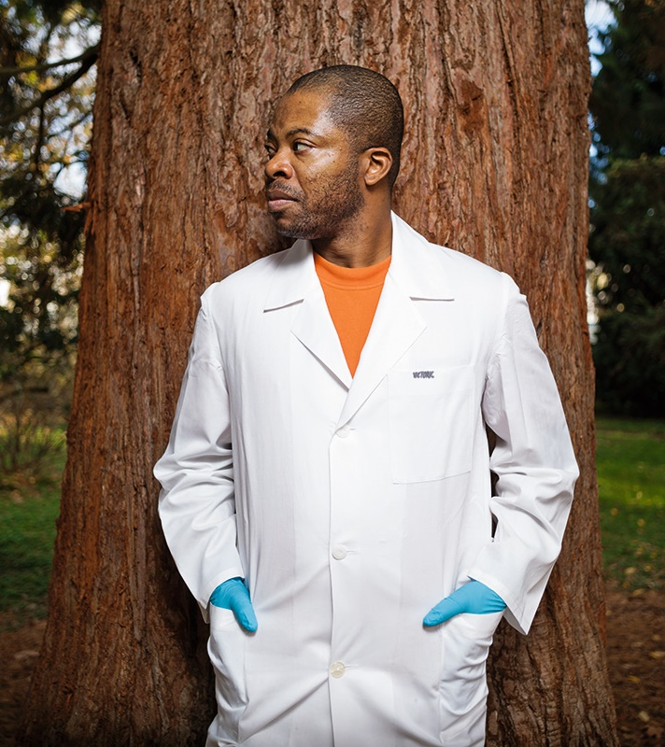
Research fellowships for research stays in Germany
For postdoctoral and experienced researchers
Humboldt Research Fellowship
Worldwide, all disciplines, no quotas
Postdocs: 6-24 months, doctorate completed <4 years ago
Experienced: 6-18 months (up to 3 stays), doctorate completed <12 years ago
Hosts: Any active academic at a research institution ​in Germany
Notes:
Subsidy: 800€ (natural and engineering sciences) /500 € (for humanities)

Slide 12
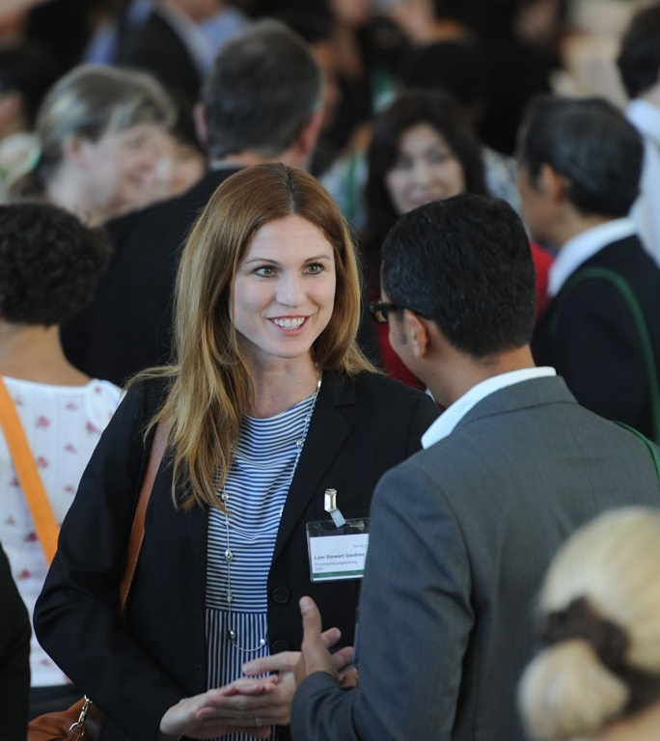
Research fellowships for research stays abroad
For postdoctoral and experienced researchers
Feodor Lynen Research Fellowship
Worldwide, all disciplines, no quotas
Postdocs: 6-24 months, doctorate completed <4 years ago
Experienced: 6-18 months (up to 3 stays), doctorate completed <12 years ago
Hosts: Members of the Humboldt Network abroad (host contribution negotiated individually)

Slide 13
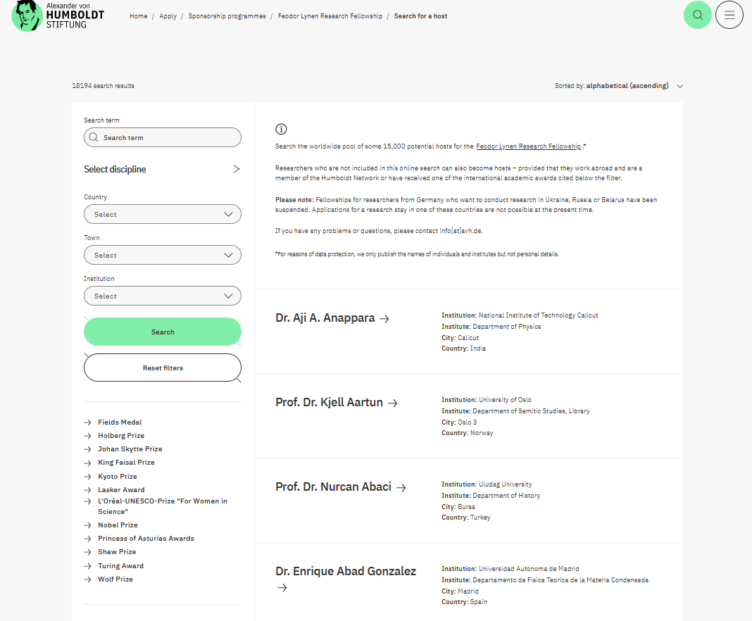
Feodor Lynen Research Fellowships
How to find an academic host? www.humboldt-foundation.de/ lynen-search-for-host

Slide 14

Research Fellowships for Japan and Taiwan
In the framework of the Feodor Lynen Programme, the Humboldt Foundation is responsible for the pre-selection of German post-doctoral researchers for the fellowships of the
Japan Society for the Promotion of Science (JSPS)
→ research stays lasting 6 to 24 months in Japan
and
National Science and Technology Council (Taiwan)
→ research stays lasting 3 to 12 months in Taiwan

Slide 15
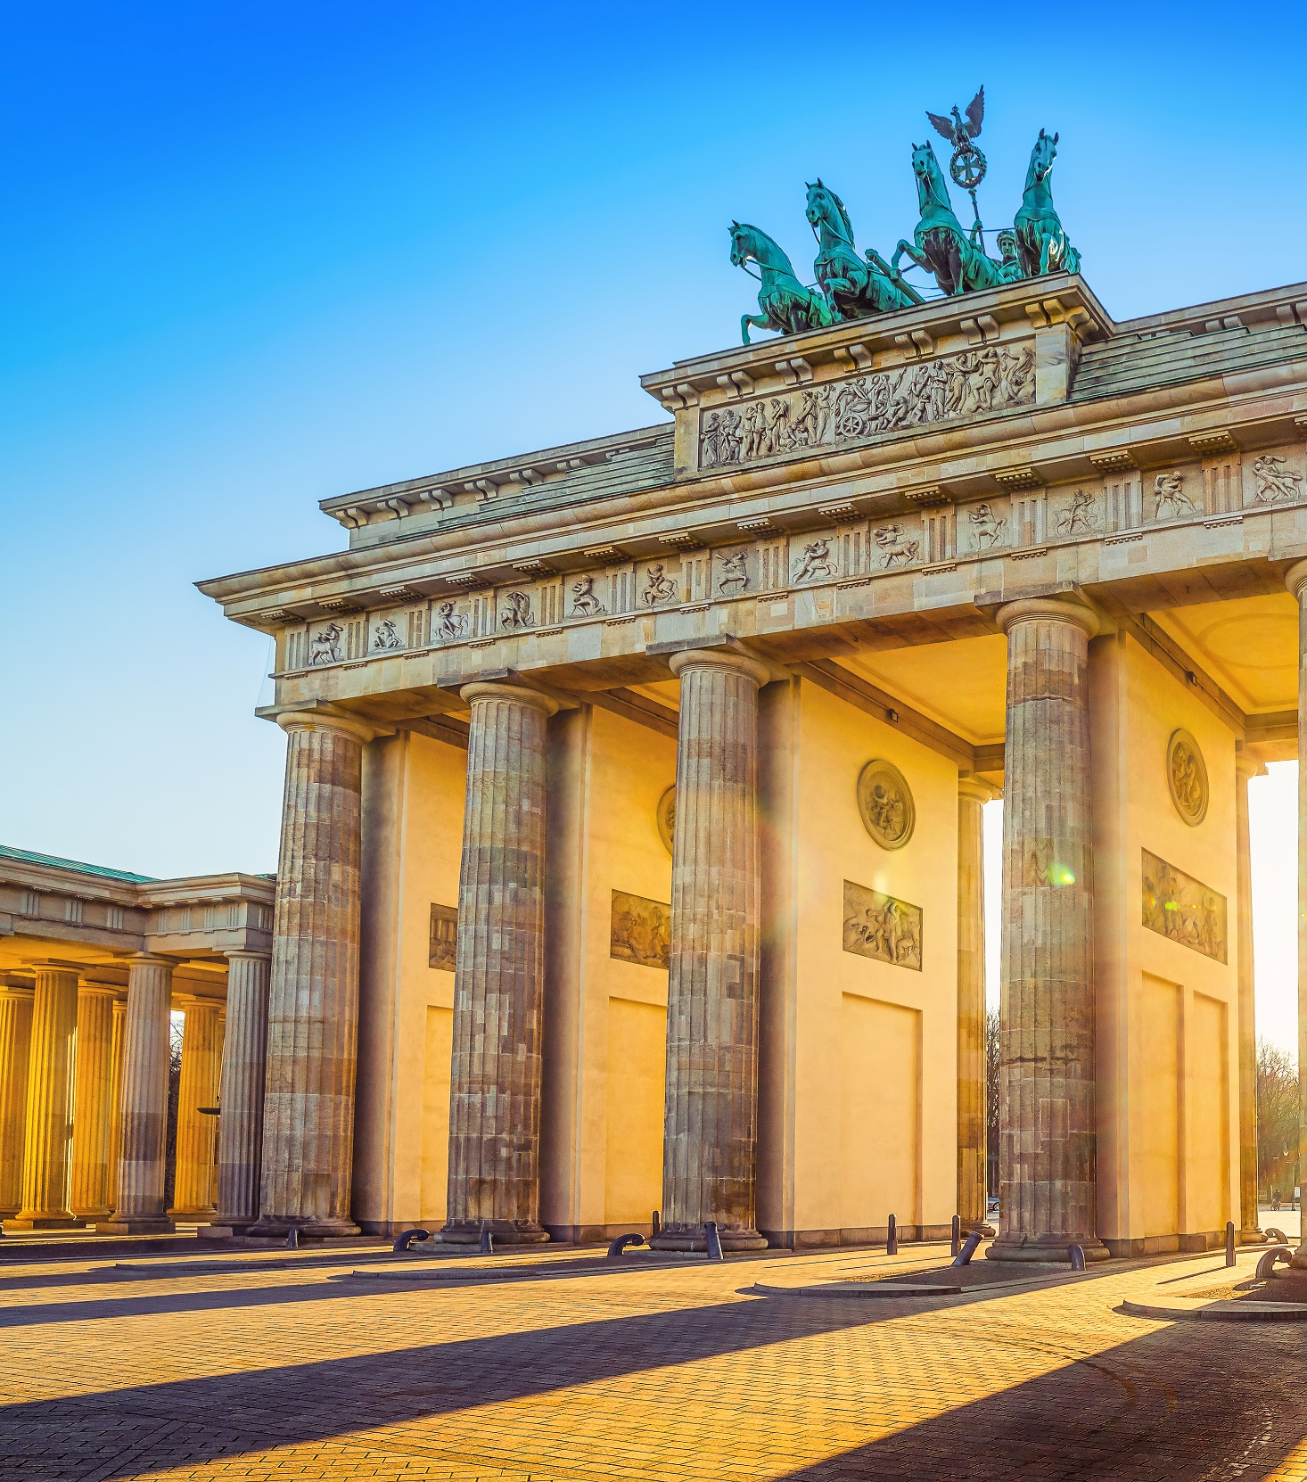
Humboldt Hosting
Profit from the Humboldt Foundation by welcoming Fellows as guest researchers in your team.
The Hosts
Any active academic at a research institution
in Germany
Support the applicant in the application process through a confidential host statement
Provide suitable research facilities and supports the Humboldtian in conducting a project
Receive a subsidy towards the research fellow‘s research costs

Slide 16

Henriette Herz Scouting Programme
The idea
Opening up a new way of accessing the Humboldt Research Fellowship in parallel with the standard application procedure
The Scouts (Henriette Herz Scouting Programme)
(Junior-)Professors (or comparable executive position) at a German institution,​ well-connected internationally​ and experienced in promoting junior researchers
Help to identify and attract excellent junior researchers, who do not apply for an AvH Fellowship themselves
Recommend up to three researchers from abroad to host at their institution (ex-post evaluation of the fellows 12 months after completion of fellowship)

Slide 17
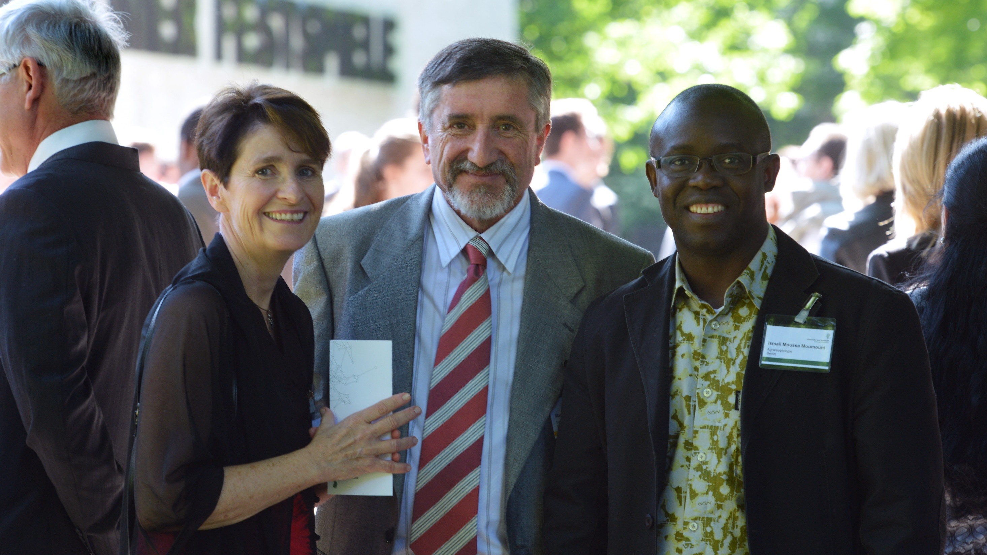
Research Fellowships
Benefits
17

Slide 18
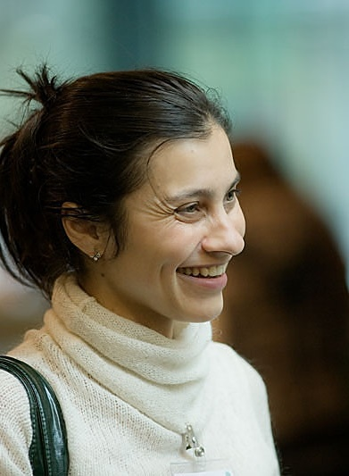
Benefits provided
Monthly fellowship amount:
Travel lump sum
Benefits for families
Language courses*
Allowance for research costs for the host institute*
Individual and personal advice and contact persons for those sponsored and their families
Humboldt Fellowship | Feodor Lynen Fellowship
Postdoc: €2,670 Experienced: €3,170 | Individually adapted (€1,750 basic amount + foreign allowance (adapted to host country and personal situation) + €250 for research costs) Fellowship calculator on website
(*not applicable to Feodor Lynen Fellowships)

Slide 19
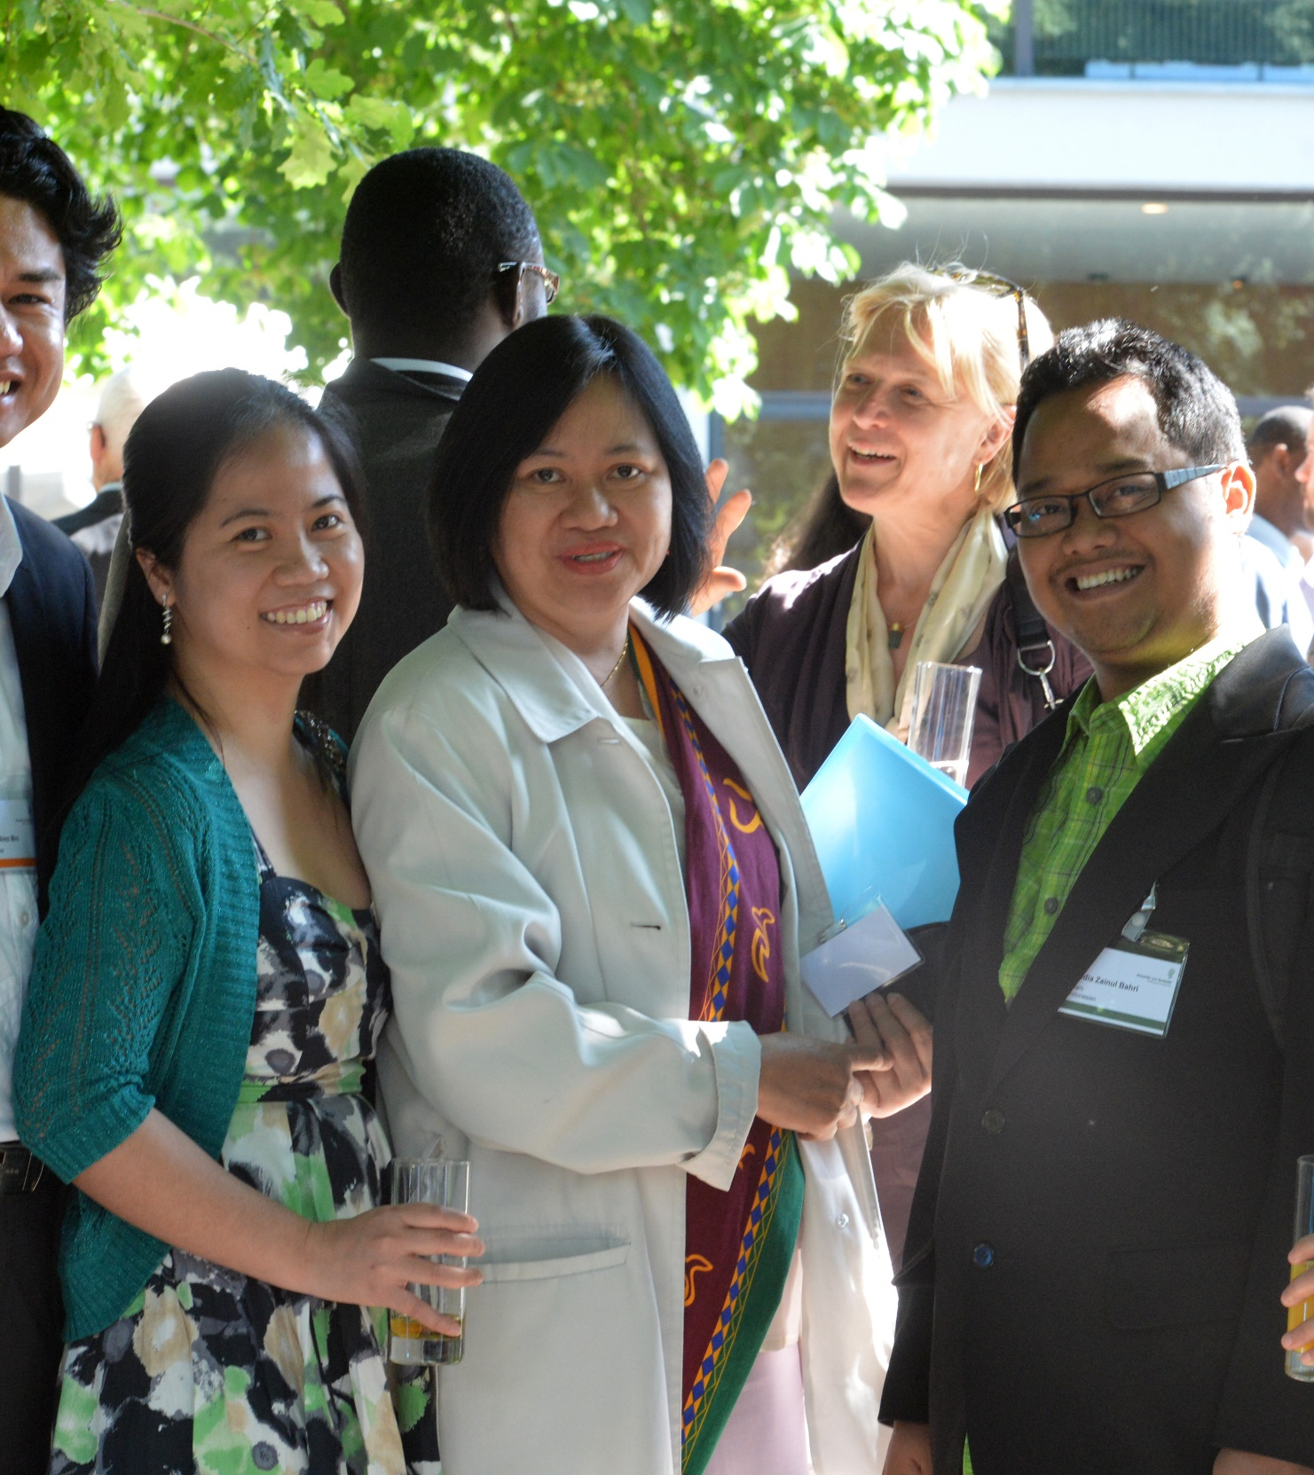
Benefits for families
Family allowance for marital partners
Flat-rate child allowance for every child under the age of 18 living in the same household as the fellow
Extension of the fellowship for
  up to 12 months if accompanied by at least one child under the age of 12
  up to 3 months if a baby is born during sponsorship period (maternity leave)
Feodor Lynen Fellowship: allowance for childcare costs as an alternative to an extension (can also be combined)

Slide 20
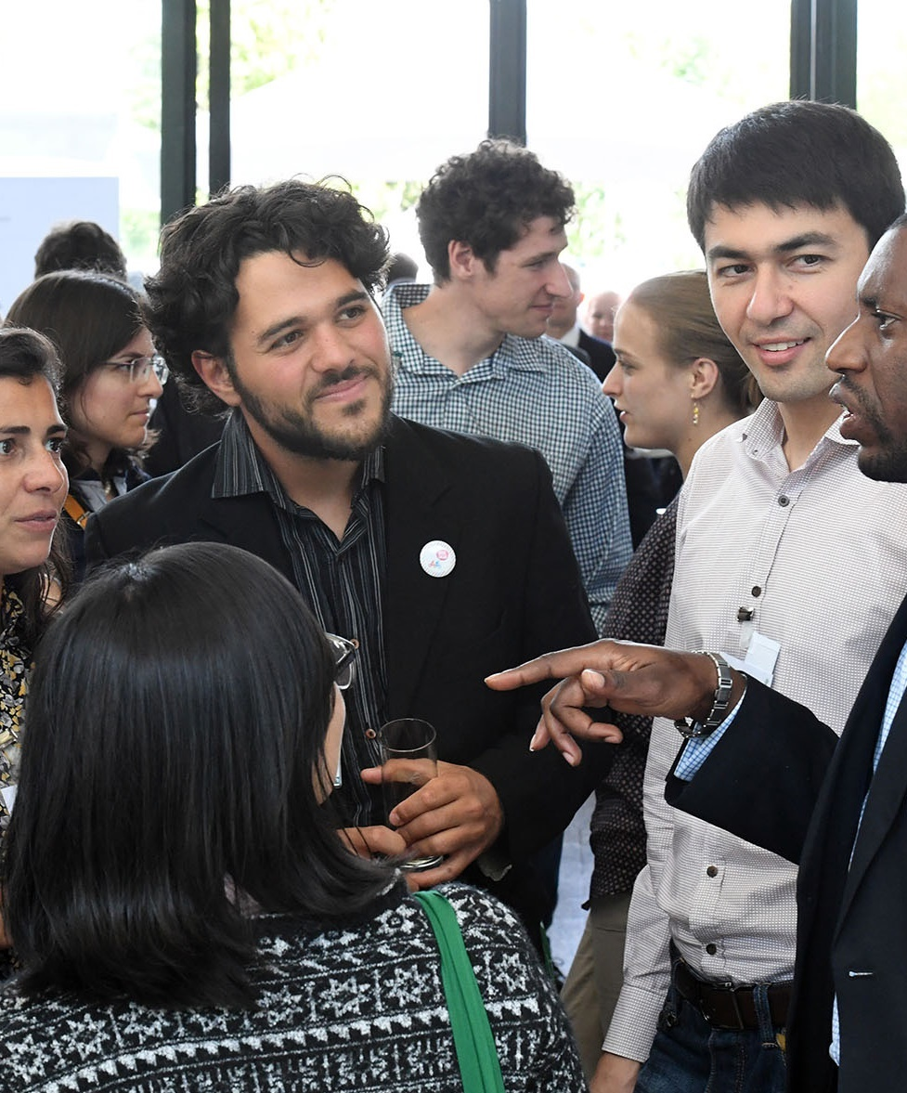
Once a Humboldtian – always a Humboldtian
Sponsorship option facilitating reintegration in Germany:
  Feodor Lynen Return Fellowships
Alumni sponsorship
  Short research stays abroad
  Invitation of Humboldtians to Germany
  Printing cost subsidies
Networking opportunities at
  Various Humboldt events
  Humboldt Alumni Associations

Slide 21

Application requirements and procedure
21

Slide 22
Application requirements
Postdoctoral researchers | Experienced researchers
above average doctorate academic publications agreement by academic host independent research proposal good knowledge of the language spoken in the host country or at least a very good knowledge of English | independent academic activity, e.g. as an assistant professor comprehensive list of academic publications with own, clearly defined academic profile agreement by academic host independent research proposal good knowledge of the language spoken in the host country or at least a very good knowledge of English

Slide 23
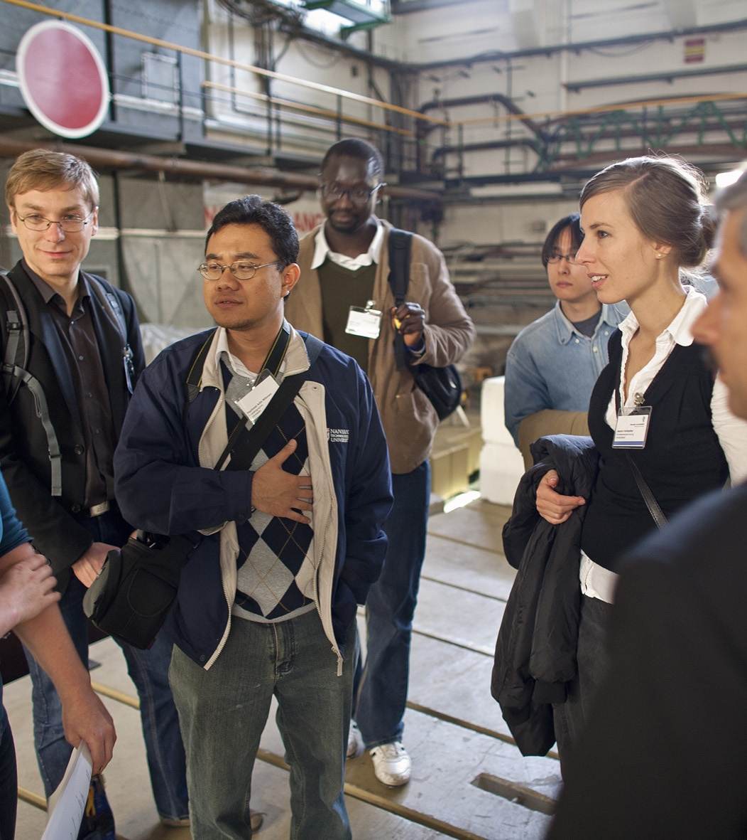
Up to 4/12 years after completion of Doctorate…?
Application possible if completion of doctorate within the next 6 months
Note for parents: Child-rearing periods in which you interrupted your academic career after the completion of your doctorate may be take into account with regard to the career stage
Other career breaks such as military or alternative service, to care for close relatives, due to long-term illness, for example, may also be taken into account

Slide 24

Researchers From Germany/Abroad...?
Humboldt Research Fellowship
Applicants living and/or working outside of Germany
<12 months in Germany within past 18 months
Not financed/employed by German institution in past 18 months
Feodor Lynen Research Fellowship
German citizens: if living and working in Germany, or
  In host country for <6 months within past 18 months
  In a different country for <5 years
Other nationalities: if already integrated into the German research system, intend to come back after the planned stay, have been in host country for <6 months in past 18 months

Slide 25
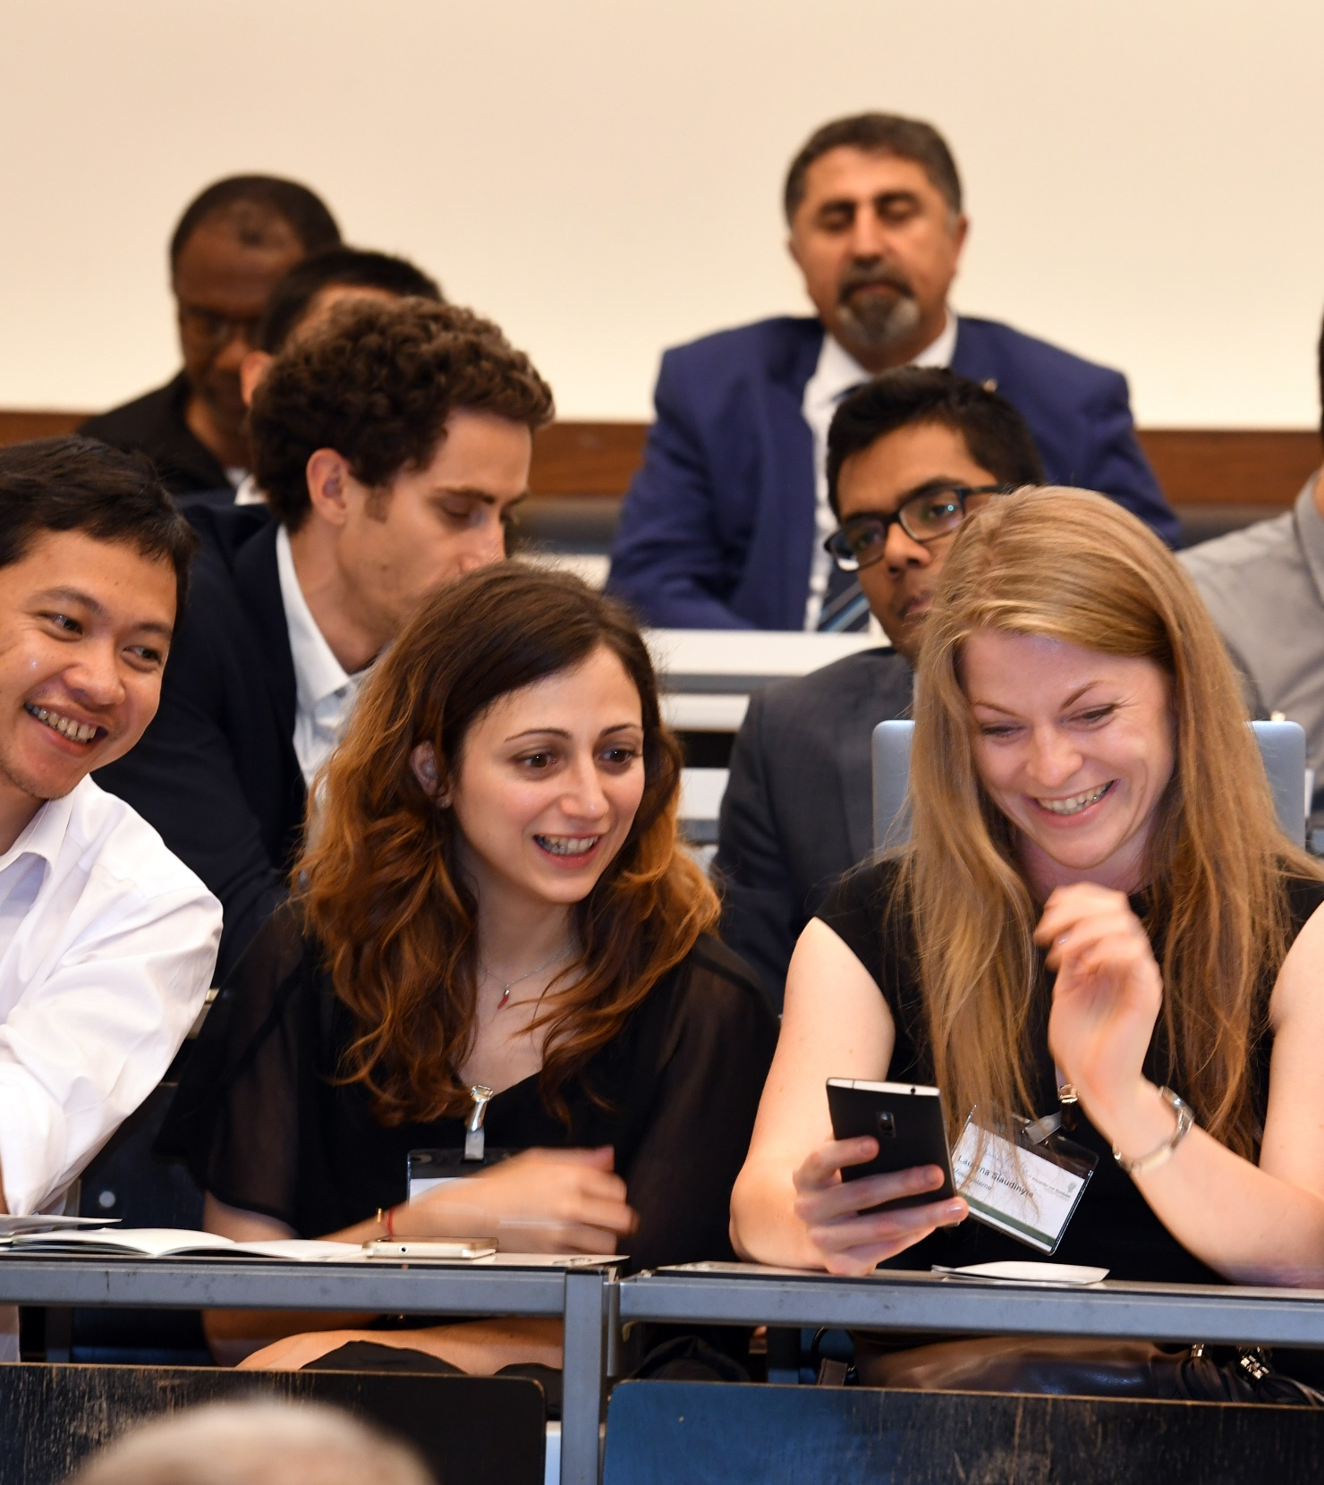
Application procedure
online applications at any time to the Foundation directly
assessment by independent peer reviewers
decision by independent, interdisciplinary selection committees
duration of procedure: approximately 4 to 7 months

Slide 26
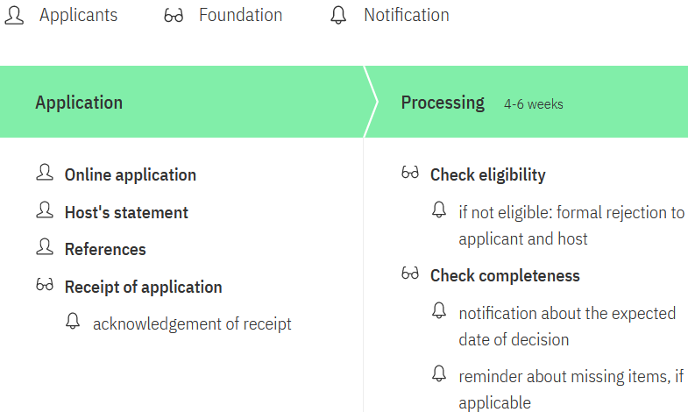
Selection Procedure I
26

Slide 27
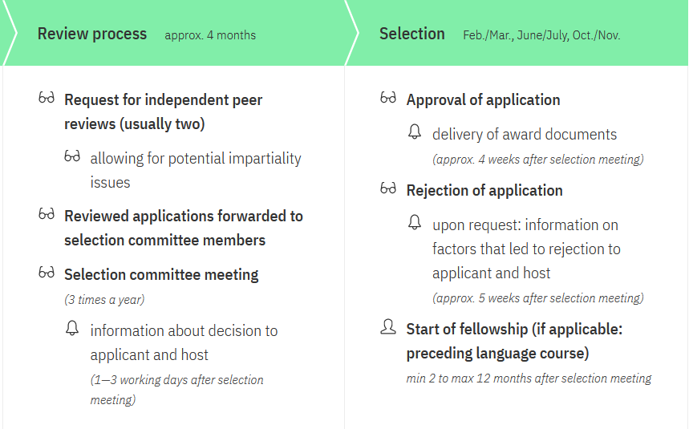
Selection Procedure II
27 | 17.04.2024
27

Slide 28

Assessment criteria for selection
academic record and academic performance to date, e.g. mobility, determination, scientific breadth, productivity – in relation to the career stage
quality of key publications – originality, the applicant’s contribution
originality and innovation potential of the suggested research outline – feasibility, prospects for academic development of applicants
the applicant’s future potential - further academic development, career prospects
    for experienced researchers additionally:
clearly visible independent research profile
28

Slide 29

Hints and Tips
prepare your application well in advance
take your time to find an adequate academic host
choose the appropriate time to submit your application (PhD (almost) completed? Prior stays in the host country?)
postdoctoral researchers should ensure that the key findings of their doctoral thesis are already published
the research outline should not be a direct continuation of the doctoral thesis or of the academic work carried out to date
choose the keywords to define your research topic and the key publications carefully

Slide 30
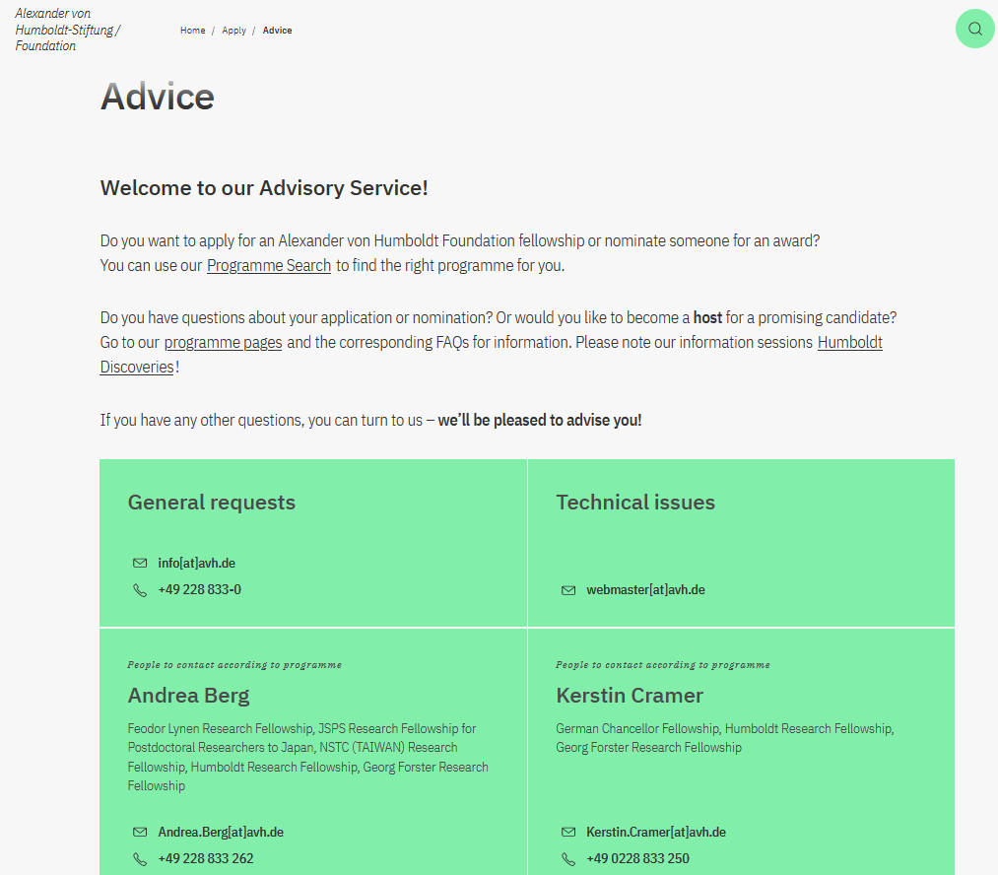
Advisory Service
Find the right contact person on our website:
https://www.humboldt-foundation.de/en/apply/advice

Slide 31
THANK YOU
Do you have any questions?
www.humboldt-foundation.de
info@avh.de
+49 228 833-0
@AvHStiftung
www.youtube.com/AvHStiftung

Slide 32


