Slide 1
Collaborative research in Horizon Europe for postdocs & PhDs
18 April 2024

Slide 2
Agenda
Introduction – Collaborative Research in Horizon Europe
Rules for Participation
Thematic Clusters & Work Programme
Strategic Approach to Participation
KoWi Services & Contact

Slide 3
Introduction

Slide 4
Horizon Europe: EU-Framework Programme for Research & Innovation 2021-2027
EUR 95,5 billion
Notes:
In the treaties on the functioning of the EU
Research in European consortia
Strengthening of the ERA
European Added Value
Targeted calls (e.g. new products & services, new knowledge, etc.

Slide 5
Characteristics of EU collaborative research funding
Varying funding amounts, 70-100% funding rate
At least 3 participants (consortium)
Open to the world
Top-down / work programmes
(Multi-)disciplinary
Project duration from 2 to 5 years
Application & exploitation
Intersectoral
Peer-review
Applied and basic research
Online proposal submission
Fixed deadlines

Slide 6
EU-funding: Challenges vs. opportunities
Visibility, Prestige &
Excellence
Complex structure
Promotion of young researchers
Strong competition
Internationalisation
Non-scientific requirements
Industrial cooperation
Notes:
Vor/Nachteile Koordination vs. Partnerschaft im Projekt
Publikationen
Sichtbarkeit
Verstetigung Stelle

Slide 7
Rules for Participation

Slide 8
Who can participate?
Any legal entity established worldwide, including legal entities from countries outside the EU or international organisations
Collaborative research: at least 3 different independent legal entities established in at least 3 different EU member states or associated countries
At least one of them established in a member state (exceptions in WP)
Projects with only one legal entity (e.g. CSA)
Restrictions may apply (e.g. MS only; entities controlled by third countries), to be defined in the WP
Notes:
Open to the world, IPR issues
For calls with deadlines in 2022 and beyond, once a project proposal is selected for funding following evaluations, consortium partners concerned by the eligibility criterion will have until Grant Agreement signature to confirm they have a GEP in place.
EMBL

Slide 9
Participation and funding in Horizon Europe
EU-Member States, incl. Overseas Territories (Member States)
Countries associated to Horizon Europe (Associated Countries): presently Albania, Armenia, Bosnia and Herzegovina, Faroe Islands, Georgia, Iceland, Israel, Kosovo, Moldova, Montenegro, New Zealand, North Macedonia, Norway, Serbia, Tunesia, Türkiye, Ukraine, United Kingdom
Third Countries: certain countries from Africa, Asia and Latin America
Industrialised Third Countries: e.g. Australia, Brazil, China, Japan, USA, a.o.
Financial support in exceptional cases:
Explicitly mentioned in topic
Participation necessary for project
List of eligible countries
Notes:
NZL nur Pillar 2 (ab 2023)
UK ab 2024 (außer EIC Fund)
Canada/Morocco transitional agreements (application but )
Drittstaaten, die Sondierungsgespräche führen: Japan, Kanada, Neuseeland, Südkorea
Aktueller Stand Assoziierungen im HE Programme Guide: https://ec.europa.eu/info/funding-tenders/opportunities/docs/2021-2027/horizon/guidance/programme-guide_horizon_en.pdf
Stand Juni 2022:
Assoziiert:
Albanien, Armenien, Bosnien und Herzegowina, Färoer, Georgien, Island, Israel, Kosovo*, Montenegro, Nordmazedonien, Norwegen, Republik Moldau, Serbien, Türkei, Tunesien, Ukraine
Transitional arrangements (sollen assoziiert werden und können sich auf Calls bewerben):
Morocco, United Kingdom (UK nicht zugelassen zum EIC Fund (which is the loan/equity instrument of the EIC)
Liste der förderfähigen Drittstaaten in General Annexes des WP! Betrifft sehr viele Staaten mit geringem und mittlerem Einkommen.

Slide 10
Thematic Clusters & Work Programme

Slide 11
Thematic clusters in Horizon Europe
Cross-thematic funding for solutions to global challenges
Thematic calls for proposals with specific objectives
Alignment with EU policy priorities (sustainability, climate protection, digitisation, jobs and growth) and Sustainable Development Goals (SDGs)
Focus on the expected impact of the funded research
Look beyond the Cluster’s title
Notes:
https://www.fh-swf.de/de/forschung___transfer_4/forschungsfelder/index.php

Slide 12
Cluster 6 – Food, Bioeconomy, Natural Resources, Agriculture and Environment
Budget: EUR 8.95 billion
Areas of Intervention:
Environmental Observation
Biodiversity and Natural Resources
Agriculture, Forestry and Rural Areas
Seas, Oceans and Inland Waters
Food Systems
Bio-based Innovation Systems in the Union's Bioeconomy
Circular Systems
© European Commission

Slide 13
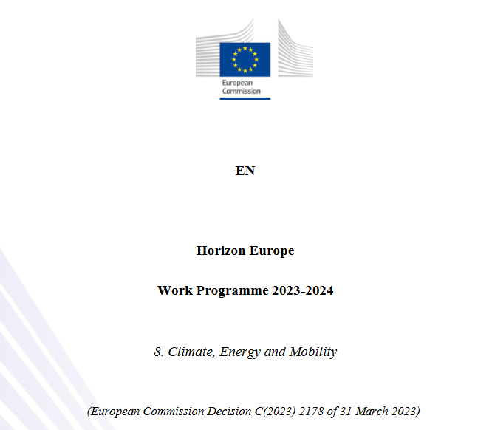
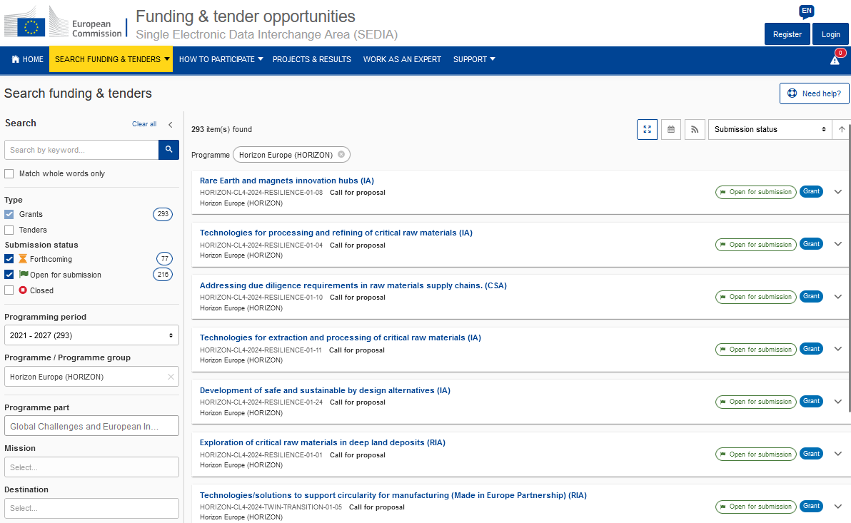
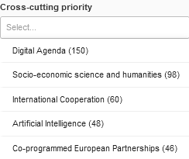
Work programme and calls 2023-2024
One Work Programme per Cluster
Covers two years;
Annual revision
Calls are published in Funding & Tenders Portal
Keyword search for topics
Quick search specific „priorities“ (e.g. International Cooperation, Artificial Intelligence, Social Innovation)

Slide 14
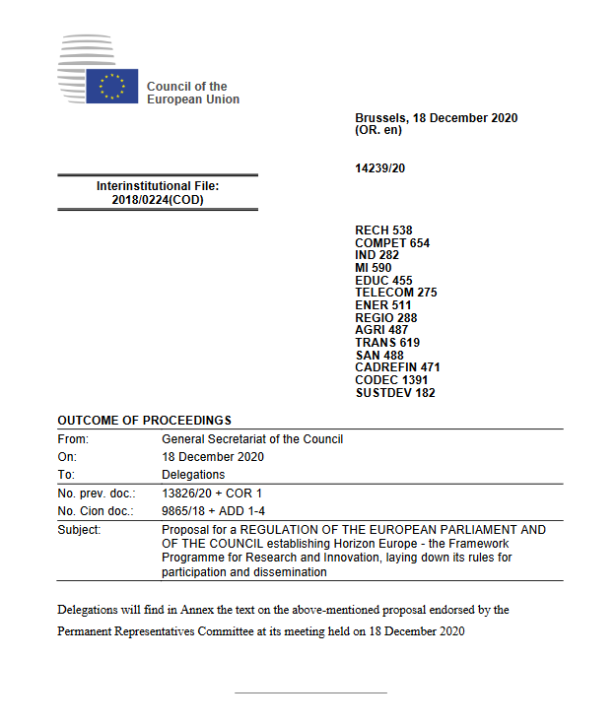
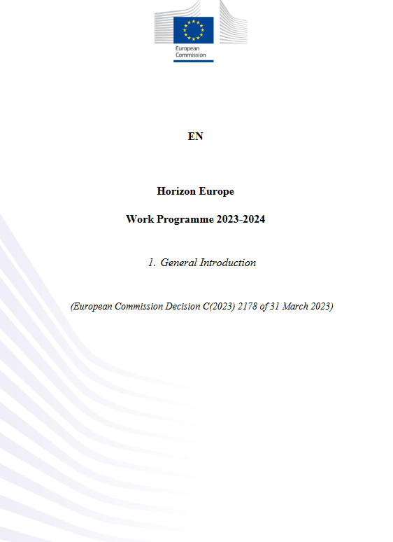
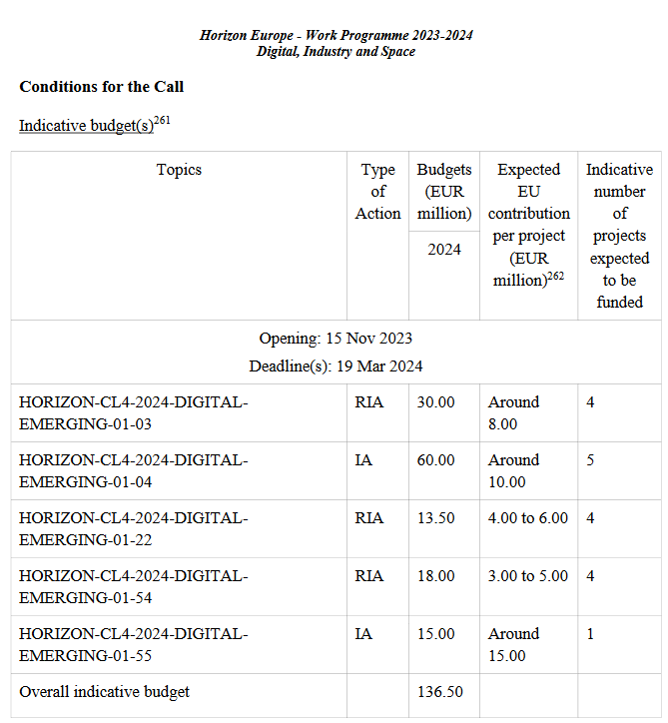
Horizon Europe Specific Programme
First Strategic Plan 2021 – 2024
Horizon Europe Work Programme 2023 – 2024
Calls for proposals
From programming to project
Project proposals
7 years
4 years
2 years
annual

Slide 15
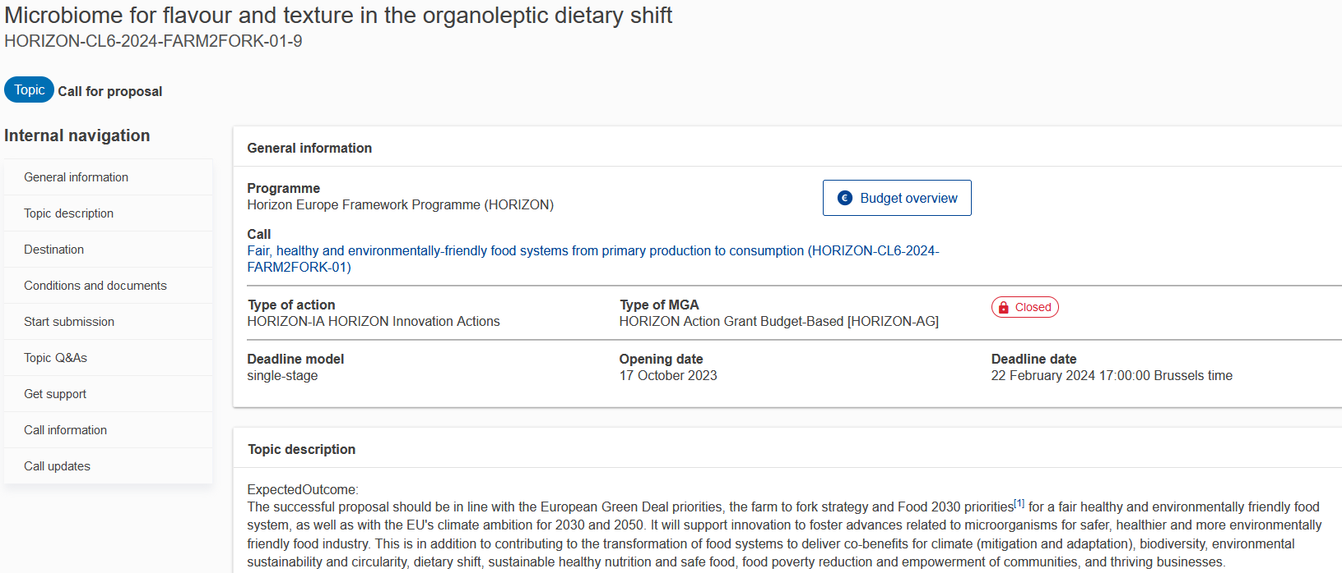
Call Topic Text: Example

Slide 16
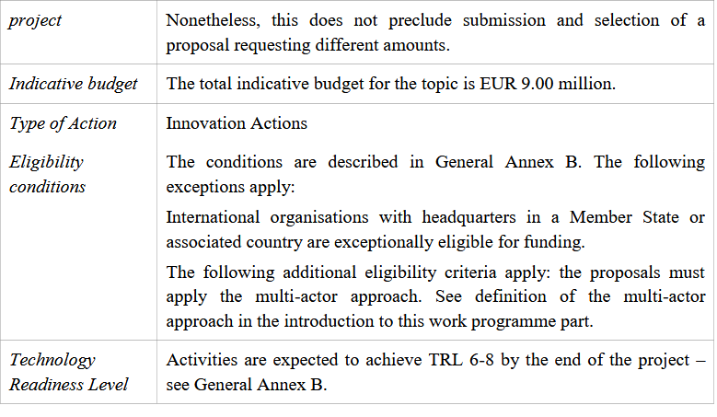
Call Topic Text Example

Slide 17
Strategic Approach to Participation

Slide 18
Getting Started
Collect information about Horizon Europe, projects in your area (CORDIS)
In current research team or in your research team/EU Office: get involved in a proposal
Make yourself visible:
engage in stakeholder platforms, networks, brokerage events, etc.
support ongoing projects: workshop attendance, surveys, etc.
Participate as expert evaluator
Service points on site
(e.g. EU-Referate)

Slide 19
Strategic Positioning
Take a strategic approach when planning your participation (What are my professional goals? At what point does EU funding suit best and/or complements other funding activities?)
Advisory board, workshops, etc. of existing projects
Task lead
Work package lead
Coordination
Project external
Project internal

Slide 20
Strategic Positioning
Take a strategic approach when planning your participation (What are my professional goals? At what point does EU funding suit best and/or complements other funding activities?)
Advisory board, workshops, etc. of existing projects
Task lead
Work package lead
Coordination
PhD
PhD (under supervision)
Early PostDoc
Early PostDoc (under supervision)
Experienced PostDoc

Slide 21
Find a Job/Being funded through a Collaborative Project
Check job postings on mentions whether funding comes from the EU and the Horizon Europe framework programme, although a mention is not always the case!
Funded through an EU project? Make the most of it!
Institutional Websites with Job Listings
Notes:
Take advantage of it if you are in one!

Slide 22
Horizon Europe Info Days
Yearly; watch recording on: https://www.youtube.com/euscienceinnovation
Information on current or futures calls and their topic content
Opportunities to ask questions to the competent ‘Science Officer’ of the EU-Commission
Brokerage events with pitches, for networking and identification of potential project partners
https://research-and-innovation.ec.europa.eu/events/horizon-europe-info-days_en

Slide 23
COST Actions for networking
Transnational cooperation in all areas of Science and Technology
Bottom-up calls open for all topics
Support of network activities for 4 years :
Meetings, Conferences, Workshops, Exchange of Scientific Staff, Summer Schools, Dissemination Measures
Institutions of at least 7 COST-Member States
Next Deadline (Cut-off date): 23 October 2024
Participation in existing networks possible
https://www.cost.eu/
Notes:
COST (European Cooperation in Science and Technology) is a funding organisation for research and innovation networks. Our Actions help connect research initiatives across Europe and beyond and enable researchers and innovators to grow their ideas in any science and technology field by sharing them with their peers. COST Actions are bottom-up networks with a duration of four years that boost research, innovation and careers.

Slide 24
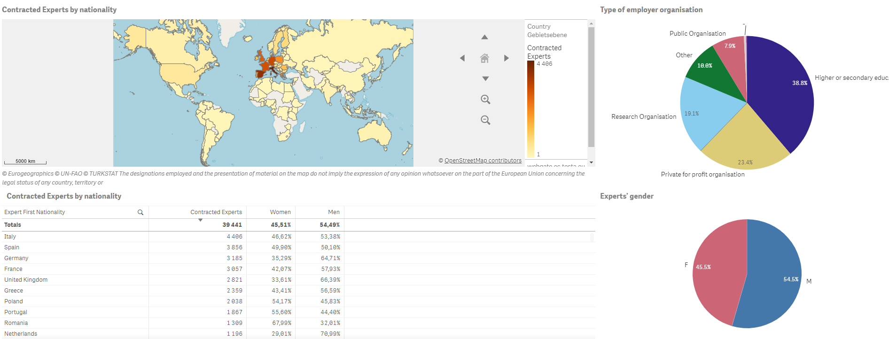
Evaluation: Contribute as an expert evaluator
Evaluate grant and tender proposals
Gain behind the scenes access to the evaluation process
Registration via the Funding and Tender Portal

Slide 25
KoWi Services & Contacts

Slide 26
Collaborative Research in Horizon Europe: KoWi-Services
KoWi as Guide/Navigator for Collaborative Research
Flexible
event formats
From thematic entry/beginning and proposal writing through to strategic advice
Taylor made events (e.g. on-site events, online events, etc.)
Advice
Initial consultation and strategic positioning
Thematic proposal advice with reference to/in cooperation with thematic NCP and EEN, if applicable
Legal and financial matters
Office infrastructure in Brussels & Bonn
Meeting rooms & guest offices in Brussels and Bonn (e.g. to prepare/hold project meetings and reviews)

Slide 27
KoWi contact persons Collaborative Research
Coordination
Victoria Reichl
Head of Team
+32-2-54802-20 victoria.reichl@kowi.de
Mareike Schmitt
Deputy Head of Team, Cluster 5 (Climate & Energy),
Cluster 6 (Food, Bioeconomy & Agriculture)
+32-2-54802-22 mareike.schmitt@kowi.de
KoWi advisors
Bettina Schelkle
Cluster 3 (Civil Security),
Cluster 4 (Industrial Technologies & Space)
+32-2-54802-13 bettina.schelkle@kowi.de
Sebastian Claus
Cluster 2 (Culture, Creativity and Inclusive Society)
+32-2-54802-18
sebastian.claus@kowi.de
Cristina Condovici
Cluster 4 (Digital), Cluster 5 (Mobility),
EIC (Pathfinder)
+32-2-54802-15
cristina.condovici@kowi.de
Martin Winger
European Policies
+32-2-54802- 21 martin.winger@kowi.de
Yvette Gafinen
Cluster 6 (Natural Resources and Environment) +32-2-54802-12 yvette.gafinen@kowi.de
Inga Benner
Cluster 1 (Health), EIC Pathfinder
Inga.benner@kowi.de

