Slide 1
What does it mean to join a Horizon Europe proposal consortium?
Preparing Multi-Actor Projects in a Co-creative Way – PREMIERE
Susanne v. Münchhausen (HNEE)
This document presents the authors’ perspective and not the position of the European Commission or its services.

Slide 2
Overview
Introduction
Motivation
Opportunities and challenges
Check list for engagement

Slide 3
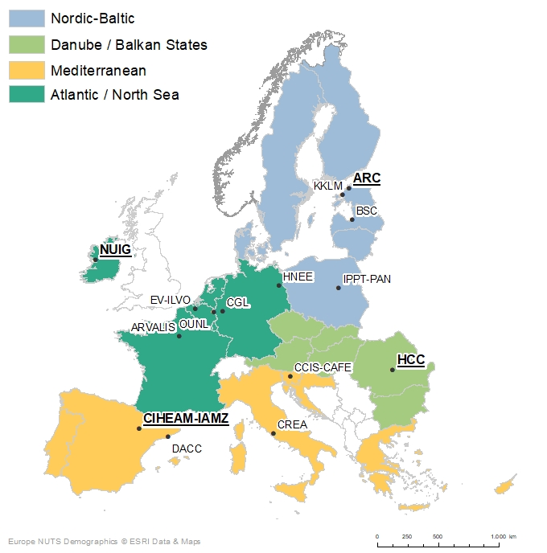
HNEE unit ‚Policy&Markets agri-food‘: Coordinator of the PREMIERE project
PREMIERE is a Horizon Europe Coordination and Support Action (CSA)
Type: Multi-Actor (MA) project
Partners: 15 diverse organisations from across Europe, based in 12 EU Member States
Duration: January 2023 – December 2027
Budget: approx. 5 million Euro
Twitter X: @premiere_eu
Homepage: www.premiere-multiactor.eu

Slide 4
PREMIERE‘s objective and output
PREMIERE aims to strengthen the implementation of the multi-actor approach, and provides support to those preparing multi-actor proposals.
PREMIERE services and material:
Online Academy including e-learning courses and multi-actor simulation games
Hands-on material with good practices for effective multi-actor co-creation
Brokerage events to connect with potential partners
Piloting of seed funding for OGs and other co-innovation actors to engage in EU multi-actor consortium

Slide 5
Key question:„What is my motivation to join an EU proposal consortium?“
Aquisition of new or additional funding
For my own position?
For team members or new staff?
For backoffice or any other ongoing work to be covered?
For working on new/further research or innovative ideas?
Envisaged career development
For my own reputation and international recognition?
For my international networking purposes?
For intercultural learning including e.g. my language skills?
For my project management and leadership skills?
Strategic development of the organisation or unit, and the addressing of societal challenges

Slide 6
Opportunities and challenges
Opportunities
Lots of learning
Personal growth
Recognition
Funding for new ideas
New contacts and relationships
Interesting new rules and contexts
…
Challenges
Lots of energy needed
Lots of additional work and responsibilities
Working in English
Unexpected groups and social settings
Exposition of own personality
Risk of frustration
Only engage when you are 100% motivated!

Slide 7
If you are determined to engage,…
Identify potential call topics in the work programme;
Identify potential coordinators and/or partners;
Contact the potential partners or coordinator(s) in a strategic/diplomatic way;
‚Sharpen‘ your own profile according to the call and the specific group when joining a consortium;
Deliver your contribution to the proposal steps or the project work as agreed (trust building!);
Look for additional information and support (e.g. from Kowi, NCP, university offices);
…

Slide 8
Check list when you engage …
in an intercultural, interdisciplinary and potentially multi-actor proposal or project consortium:
Promise only what you will be able to deliver;
Negotiate by asking questions;
Ask for an approapriate valuation/budget for your contributions (not too high as an academic and not too low as a practiconer);
Avoid putting yourself in the center or cultivating any own hierarchy feelings such as subordination or power plays; and
Make sure to remain flexible and supportive when questions or problems come up.

Slide 9
Thank you!
And if you want to learn more about the Multi-Actor Approach, please, contact us:
premiere@hnee.de
www.premiere-multiactor.eu
Follow us on X Twitter! @PREMIERE_EU

