Slide 1
CoBra
Tom Offrede
Humboldt-Universität zu Berlin
offredet@hu-berlin.de
cobra-network.eu
COnversational BRAins
GA n°859588 – H2020

Slide 2
CoBra Structure
Marie Skłodowska-Curie ITN (Innovative Training Network)
https://cobra-network.eu/
Conversational Brains:
15 PhD projects across 8 countries
Linguistics & Psycholinguistics
Neuroscience
Computer science

Slide 3
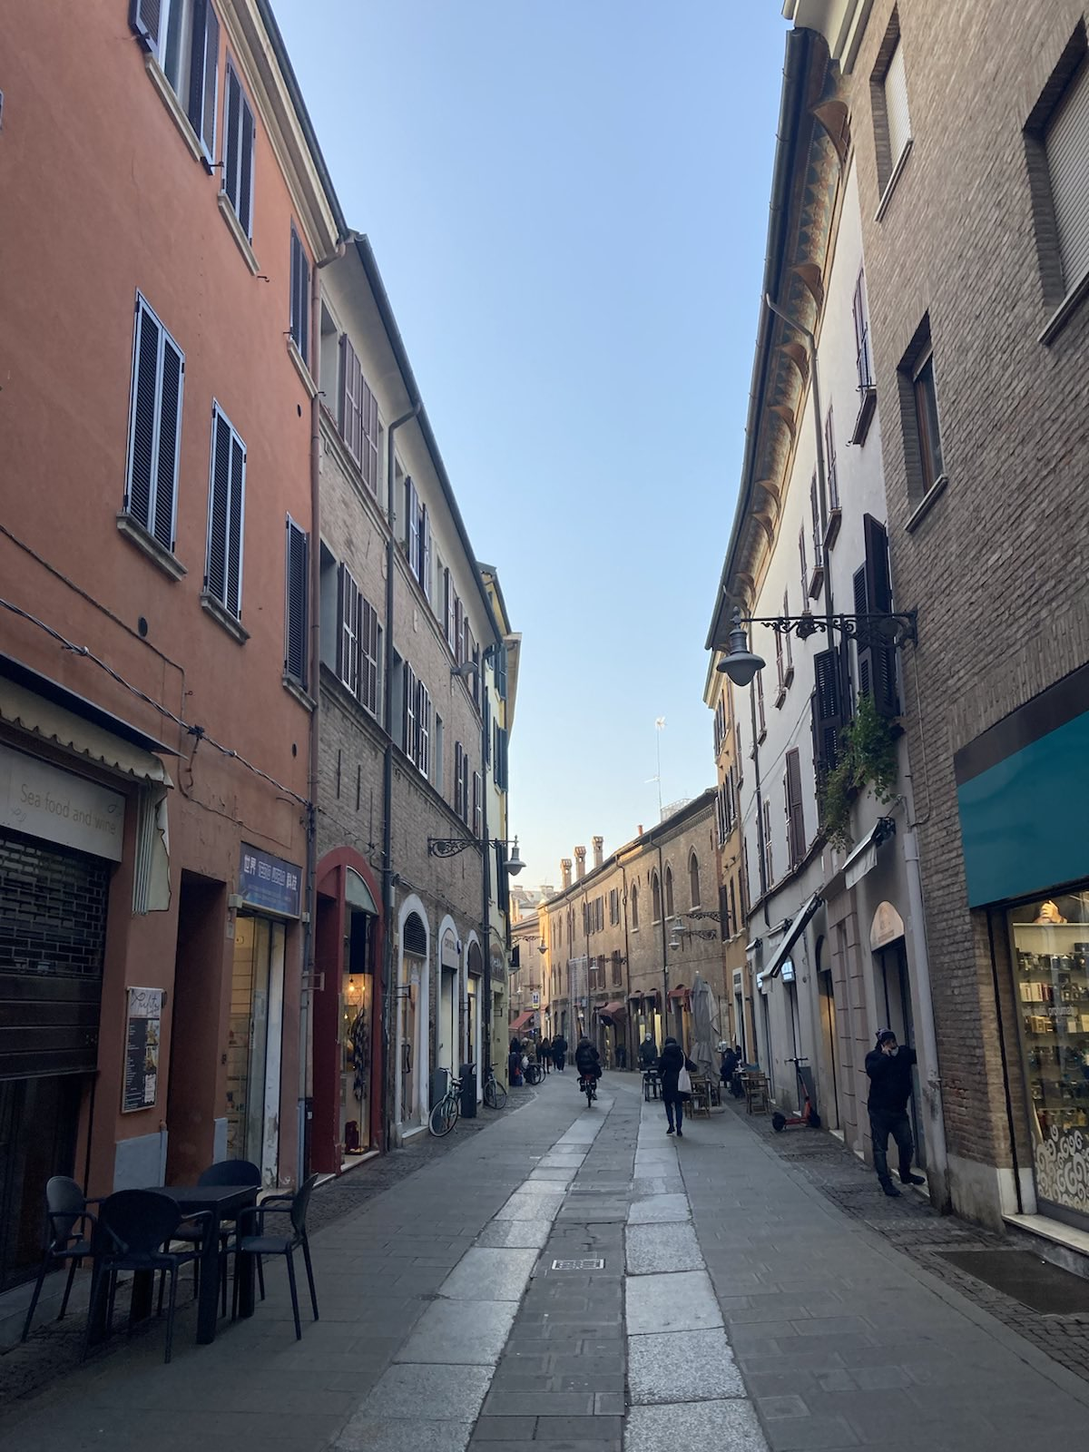
CoBra Structure
“Brain markers of between-speaker convergence in conversational speech”
“Endowing robots with high-level conversational skills”
“Communicative alignment at the physiological level”
Salary + Research & Training budget
Events
(Spontaneous) collaborations
Research visits

