Slide 1
European funding opportunities
for PhD candidates:
Marie Skłodowska-Curie
Doctoral Networks (MSCA-DN)
Laura Willems, KoWi
Eberswalde, 18.04.2024

Slide 2
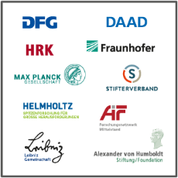
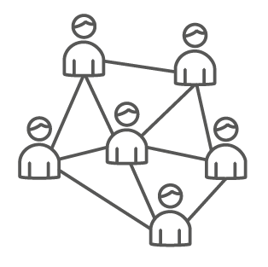
KoWi – EU Liaison Office of the German Research Organisations
Information, advice and training on EU research & innovation funding
One-Stop Shop for Horizon Europe
Service platform for our supporting association*
Funded by the German Research Foundation (DFG)
European network through offices in Bonn & Brussels
* Verein zur Förderung der europäischen und internationalen wissenschaftlichen Zusammenarbeit e.V.

Slide 3
Horizon Europe – Framework Programme for Research and Innovation (2021-2027)

Slide 4
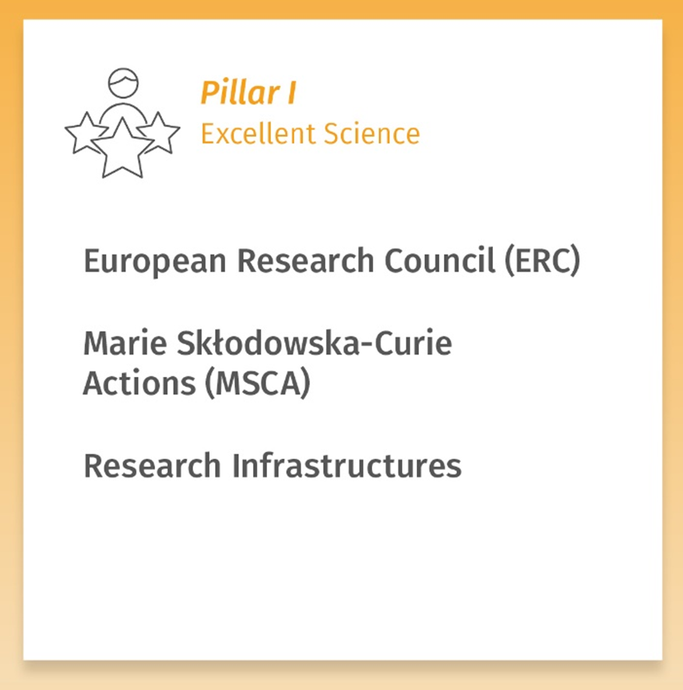
Marie Skłodowska-Curie Actions under Horizon Europe
Doctoral Networks
Postdoctoral Fellowships
Staff Exchanges
COFUND
MSCA & Citizens

Slide 5
What are the MSCA in a nutshell?
Fund excellent frontier research and breakthrough scientific ideas
Equip researchers with new knowledge & skills through mobility and exposure to different sectors and discipline

Slide 6
Doctoral Networks – Structured Doctoral Funding
What?
Training of young researchers in training networks across Europe
International knowledge transfer between institutions, sectors & disciplines
How?
Research-related and transferable competences
Involvement of the non-academic sector
Who?
At least 3 institutions from 3 different member states/associated countries

Slide 7
Doctoral Networks – Training Programme
Secondments
to Partner Organisations
Local Training
Scientific & Soft Skills
Training through Research
Individual projects
Network-wide Training

Slide 8
Advantages
Funded PhD positions for up to 3 years
All domains of research are covered (bottom-up approach)
Topic of the PhD project already defined → You can start very soon
Employment contract including social security benefits
100% working time on your project
Training within an international network
Contact to the non–academic sector and potential future employers

Slide 9
Conditions for taking part in a DN Project
You apply for vacancies in EU-funded DN projects
You do not hold a PhD
You can be of any nationality & age
You need to follow the MSCA Mobility Rule
Notes:
- Not eligible: Researchers who have successfully defended their doctoral thesis but who have not yet formally been awarded the doctoral degree
- The eligibility of the researcher is determined at the date of their first recruitment in the action & the status will not evolve in the course of the action, even if they are re-recruited at another beneficiary

Slide 10
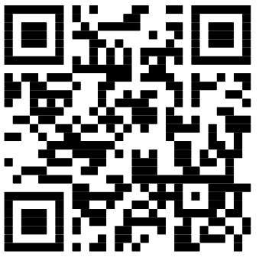
EURAXESS Job portal
Notes:
- Job offers and research consortia

Slide 11
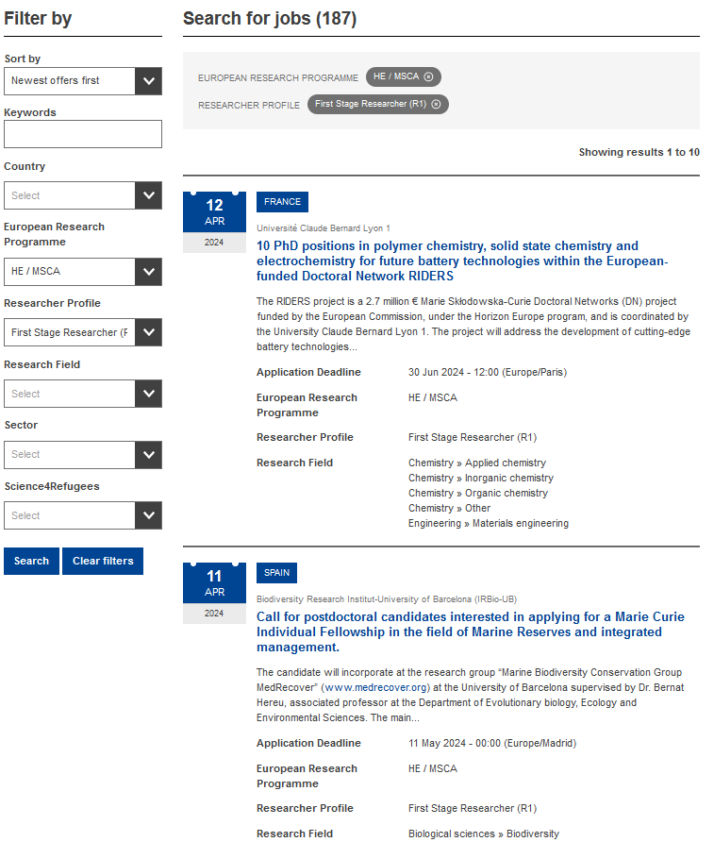
EURAXESS Job portal
Filter by country, programme, profile, research field

Slide 12
MSCA Mobility Rule
Fellows do not have lived or worked more than 1 year within the last 3 years in the potential host country
Not eligible for a fellowship in Germany!
Eligible for a fellowship in France and other countries
A French researcher has lived in Germany for the last 4 years

Slide 13
Contracts
EC/REA
Grant Agreement
Host Institution (MS/AC)
Work contract
Fellow
Notes:
- Work contract with HI, the EU contribution is transferred to the Beneficiary who recruits the researcher under an employment contract

Slide 14
MSCA in Horizon Europe
Gender Equality Plans
Eliminate gender inequalities in R&I → Policy priority of the EU Commission
Guidelines on Supervision
Recommendations for good supervision
MSCA Green Charter
Raise awareness of environmental sustainability & support the European Green Deal
Code of good practice implemented on best-effort basis

Slide 15
European Charter & Code
Reference framework for researchers and their recruitment
MSCA principles, e.g.:
Promoting career development
Transparency on recruitment process and selection criteria
Stability and permanence of employment
Strengthening the participation of women in research

Slide 16
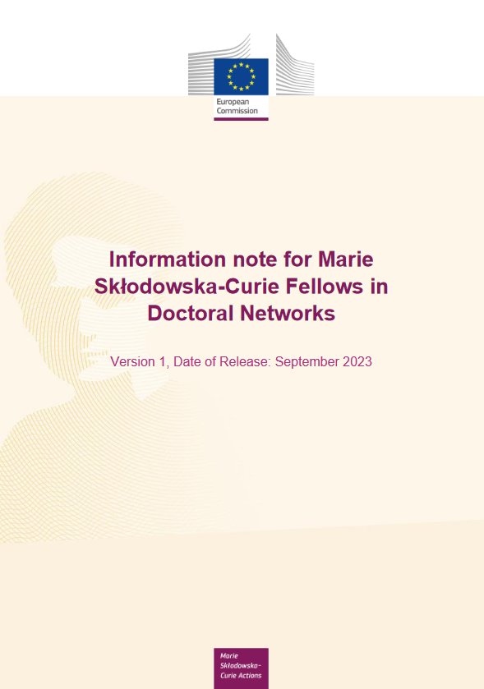
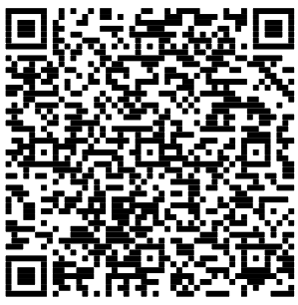
Information for DN Fellows
Your rights as a fellow
Allowances, secondments, IPR etc.
After your fellowship
Etc.

Slide 17
MSCA-DN Allowances
In EUR; Funding 100%, in gross | Research unit cost (person/month) |  |  |  |  | Institutional unit cost (person/month)
 | Living allowance * | Mobility allowance | Family allowance ** | Long-term leave allowance | Special-needs allowance | Research, training & networking costs | Management & Overhead
MSCA-DN | 3.400 | 600 | 660 | 4.000 *** | Depending on request | 1.600 | 1.200
* Application of the country correction coefficient: for Germany 98.3%.
** If applicable, can also be applied for after project start
*** If applicable (4.000 x % covered by the beneficiary)
Notes:
- Researcher unit costs: Budget allocated for the employment costs and other costs paid to the recruited researchers
- Institutional unit costs: Budget allocated for the costs of the work performed in the project and its execution

Slide 18
KoWi Services on MSCA
Information
Information events & seminars
Website, Newsletter, Social Media etc.
Advice
Advice for applicants (individually/small groups)
Advice on legal & financial project management
Training
Workshops on application & grant management
Workshops on legal & financial project management

Slide 19
Testimonial report
Thomaz Offrede, HU Berlin
MSCA Project CoBra

