Slide 1
Research in Europe (RiE)
Funding for PostDocs – MSCA Postdoctoral Fellowships,
European Research Council (ERC) Starting Grants
Eberswalde, 18.04.2024
Dominik Maas, KoWi

Slide 2
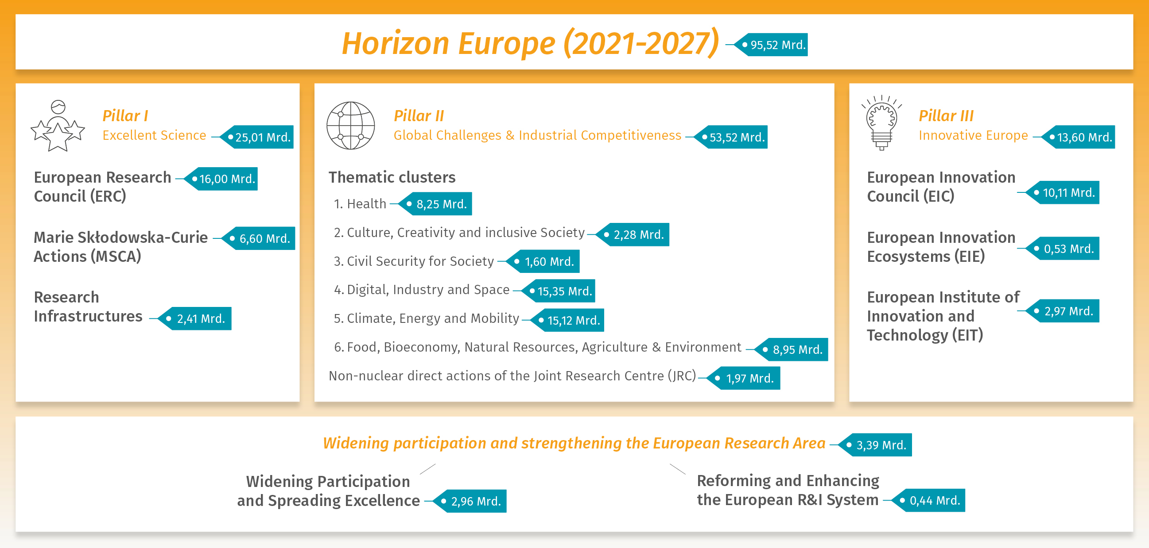
Horizon Europe – Framework Programme for Research and Innovation (2021-2027)

Slide 3


Pathways of Funding
ERC-Consolidator Grant
PostDoc 7 – 12 years after PhD
ERC-Starting Grant
PostDocs 2 -7 years after PhD
MSC-Postdoctoral Fellowship
PostDocs up to 8 years after PhD
ERC-Synergy Grant
Collaborative projects of 2-4 PIs
MSC–SE/DN
Doctoral training and staff exchanges in a research network of institutions

Slide 4
Marie Sklodowska-Curie Actions

Slide 5
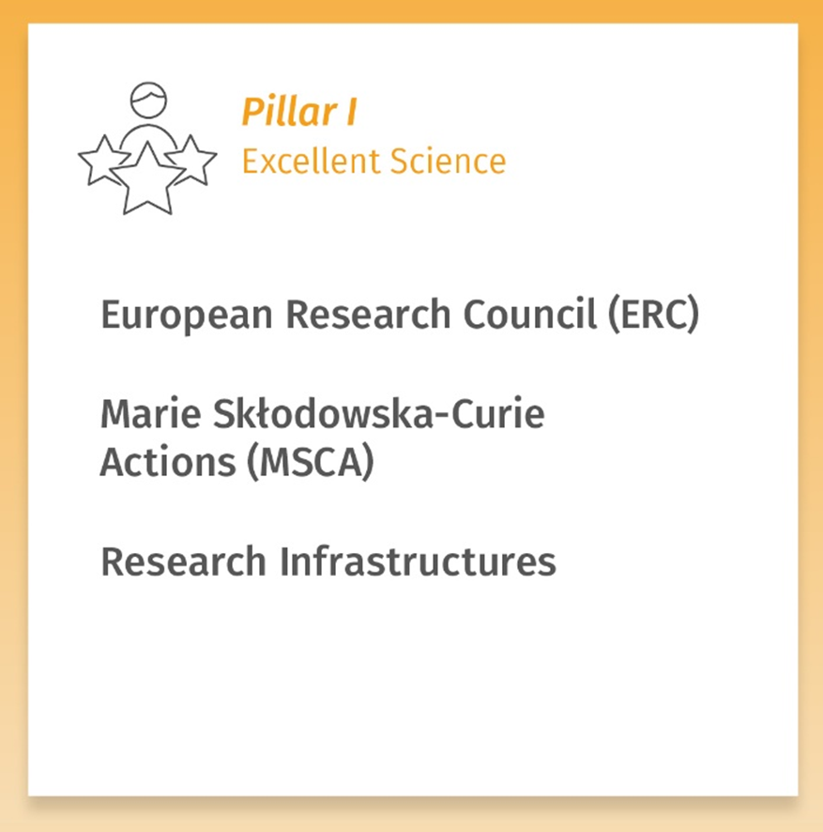

Marie Skłodowska-Curie Actions under Horizon Europe
Doctoral Networks
Postdoctoral Fellowships
Staff Exchanges
Co-funding of regional, national and international programmes (COFUND)
MSCA and Citizens
Notes:
- MSCA: Fund excellent R&I, equip researchers with new knowledge and skills through mobility and exposure to different sectors and discipline
- DN: Develop and implement doctoral programs by partnerships of organizations from different sectors in Europe and beyond

Slide 6
Marie Skłodowska-Curie Postdoctoral Fellowships – Aims
Strengthening the European Research Area (ERA)
  Encouraging people to embark on research careers in Europe
  Foster excellence through implementation of research project
Enhancing mobility and collaboration
  International
  Interdisciplinary
  Inter-sectoral
Promoting the researchers‘ career development
  Providing training for key competences in science and industry (training on research & transferable skills) -> employability
  Creating fair and attractive working conditions

Slide 7






MSCA - Mobility Rule
Fellow has lived or worked ≤ 12 months within the last 3 years in the potential host country
Not eligible for a Fellowship in Germany!
Eligible for a Fellowship in France and other countries
A French researcher has lived in Germany for the last 4 years

Slide 8

Postdoctoral Fellowships – Global and European Postdoctoral Fellowships
Global Postdoctoral
Fellowships
European Postdoctoral Fellowships

Slide 9
European Postdoctoral Fellowships - Research Project in Europe (MS / AC)
Eligibility
  Postdoctoral researchers with up to 8 years* of research experience after PhD (full-time) of any nationality
  Mobility rule: may not have lived / worked more than 12 months within the last 3 years in host country
Funding
  Implementation of an independent research project at any public or private research institution in Europe (MS or AC)
  1-2 years project
  Worldwide secondments for up to 1/3 of the fellowship duration
  Optional: additional placement of up to 6 months in non-academic sector in Europe
Application
  Fellow writes individual application jointly with Host Institution
  → proposal (10 pages) is submitted jointly with supervisor in the Funding & Tender Opportunities Portal: https://ec.europa.eu/info/funding-tenders/opportunities/portal/screen/home
*Periods outside research and career breaks as well as periods in a TC can be reduced (only applies to citizens of an EU MS or AC, or "long-term residents").

Slide 10
Global Postdoctoral Fellowship – Research Project in Third Country (TC) and Europe
Eligibility
  Postdoctoral researchers with up to 8 years* of research experience after PhD (full-time)
  Nationality of a MS / AC or at least 5 years of residence in MS /AC ("long-term residents")
  Mobility rule: may not have lived / worked more than 12 months within the last 3 years in host country (refers to outgoing phase)
Funding
  Implementation of an independent research project at any public or private research institution
  1-2 years in non-associated TC (outgoing phase) + 1 year mandatory return phase in MS /AC
  Worldwide secondment for max. 1/3 of the of the fellowship duration (outgoing phase)
  Optional: additional placement of up to 6 months in non-academic sector in Europe
Application
  Fellow writes individual application jointly with Host Institution
  → proposal (10 pages) is submitted jointly with supervisor in Funding & Tender Opportunities Portal: https://ec.europa.eu/info/funding-tenders/opportunities/portal/screen/home
*Periods outside research and career breaks as well as periods in a TC can be reduced (only applies to citizens of an EU MS or AC, or "long-term residents").

Slide 11
MSCA Postdoctoral Fellowships - financing
In EUR; Funding 100%, in gross | Research unit cost (person/month) |  |  |  |  | Insitutional unit cost (person/month)
 | Living allowance* | Mobility allowance | Family allowance** | Long-term leave allowance | Special-needs allowance | Research, training and networking costs | Management & Overhead
Postdoctoral Fellowships | 5.080 | 600 | 660 | 5.680*** | Depending on request | 1.000 | 650
Units expected to increase in WP 2025 + higher CCC for Germany
*Application of the country correction coefficient: for Germany 98.3%.
** If applicable, can also be applied for after project start
*** If applicable (4.000 / 5.680 x % covered by the beneficiary)

Slide 12
Evaluation Criteria and Panels
8 Main Evaluation Panels
  Chemistry (CHE)
  Social Sciences and Humanities (SOC)
  Economic Sciences (ECO)
  Information Sciences and Engineering (ENG)
  Environment and Geosciences (ENV)
  Life Sciences (LIF)
  Mathematics (MAT)
  Physics (PHY)
Excellence
(weighting: 50%)
Impact
(weighting: 30%)
Implementation
(weighting: 20%)

Slide 13
Success Rates 2023
 | Proposals retained for funding | Success rate
EF | 1.110 | 15,7 %
GF | 139 | 16,7% (2022: 21 %)

Slide 14
MSCA Call 2024
Action | Call opening | Deadline
Postdoctoral Fellowships | 10 April 2024 | 11 September 2024

Slide 15
European Research Council (ERC)

Slide 16
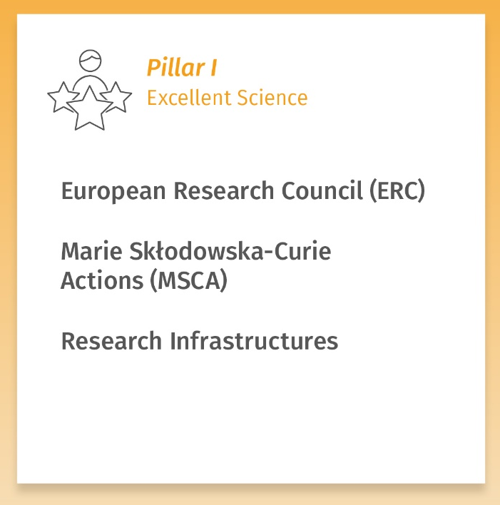
ERC Funding Schemes
Starting Grants
2-7 years after PhD
Consolidator Grants
7-12 years after PhD
Advanced Grants
10 years track record
Synergy Grants
Teams with 2-4 PIs
Proof of Concept
Preparing ideas from ERC Grants for the market

Slide 17
ERC Underlying Principles
European funding of basic research („frontier research“)
Development of funding schemes is science-driven (Scientific Council)
Open to all fields of research: bottom-up, investigator-driven, annual calls for proposal
Open for researchers of any age and nationality
→ Scientific excellence is the sole criterion for evaluation!

Slide 18
ERC Funding Modalities
Funding of individuals: Principal Investigator (PI) + project
Support for researchers to start or consolidate their own independent research team in Europe (MS or AC)
Funding: 100 % + 25 %
  All direct project costs: salary of PI and project team (partly/full), travel expenses, consumables, publication costs (incl. Open Access), research-related costs, equipment costs (within the limits of depreciation rules), subcontracts
  Additional financing of indirect costs: 25 % overhead

Slide 19
ERC Starting Grants – Overview
Target group
  2 - 7 years after PhD defence (extensions possible in exceptional cases; special rules for MD)
Funding
  Max. EUR 1.5 million for max. 5 years (all direct project costs, e.g. salary of PI and team members)
  Exception: + EUR 1 million for major equipment, major fieldworks/ experimental costs or for PIs from Third Countries
Host institution
  In EU Member State or Associated Country
Time commitment
  ≥ 50% (≥ 50% in Europe)
Procedure
  Single submission of full proposal, two-step evaluation (incl. Interview)
Call 2024
  Deadline: 24 October 2023

Slide 20
Extended Eligibility
Calculation of the eligibility time window:
  Time elapsed between date of defence and 1 January of the call year
Prolonged eligibility for documented parental leave
  Mothers 18 months per child
  Fathers documented time or leave taken
Other reasons after PhD:
  Documented elapsed time for long-term illnesses
  Clinical training (4 years maximum)
  National oder civil service
  For damage caused by natural disasters
  For asylum procedures

Slide 21
ERC Success rates 2018-2023
Funding scheme | 2018 | 2019 | 2020 | 2021 | 2022 | 2023
Starting Grants | 12.7 % | 13.3 % | 13.3 % | 11.7 % | 13.9 % | 14.8 %
Consolidator Grants | 12.2 % | 12.3 % | 13.2 % | 12 % | 14.4 %
Notes:
StG2017 in NCP Report 13,4%

Slide 22

Information and Consulting

Slide 23

KoWi Services on MSCA & ERC
(For ERC in cooperation with the EU Bureau of the BMBF as National Contact Point for ERC)
Information
Information events and workshops
KoWi Newsletter
NCP ERC Newsletter and FAQs
Advice
Individual advice and support for applicants
Tailored advice for small groups
Advice on legal, financial and project management aspects
Training
Workshops on application and grant management
ERC Interview trainings for Starting and Consolidator Grants in Bonn + on-site support in Brussels

Slide 24
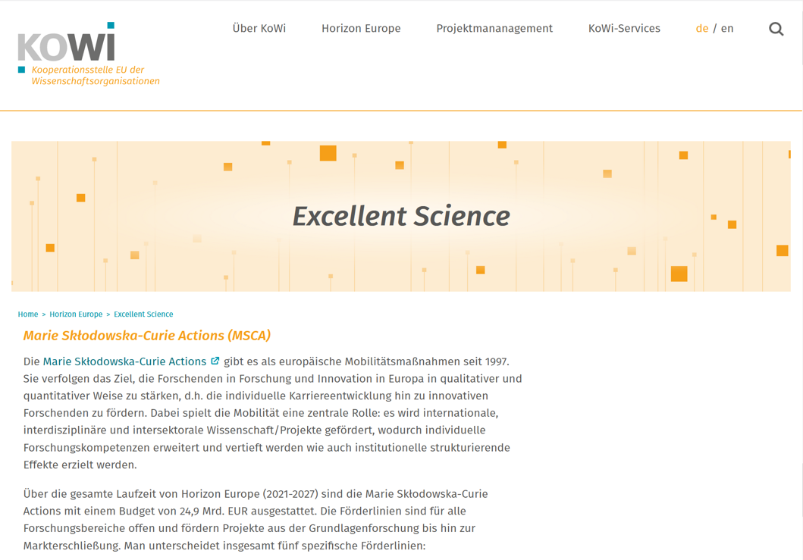
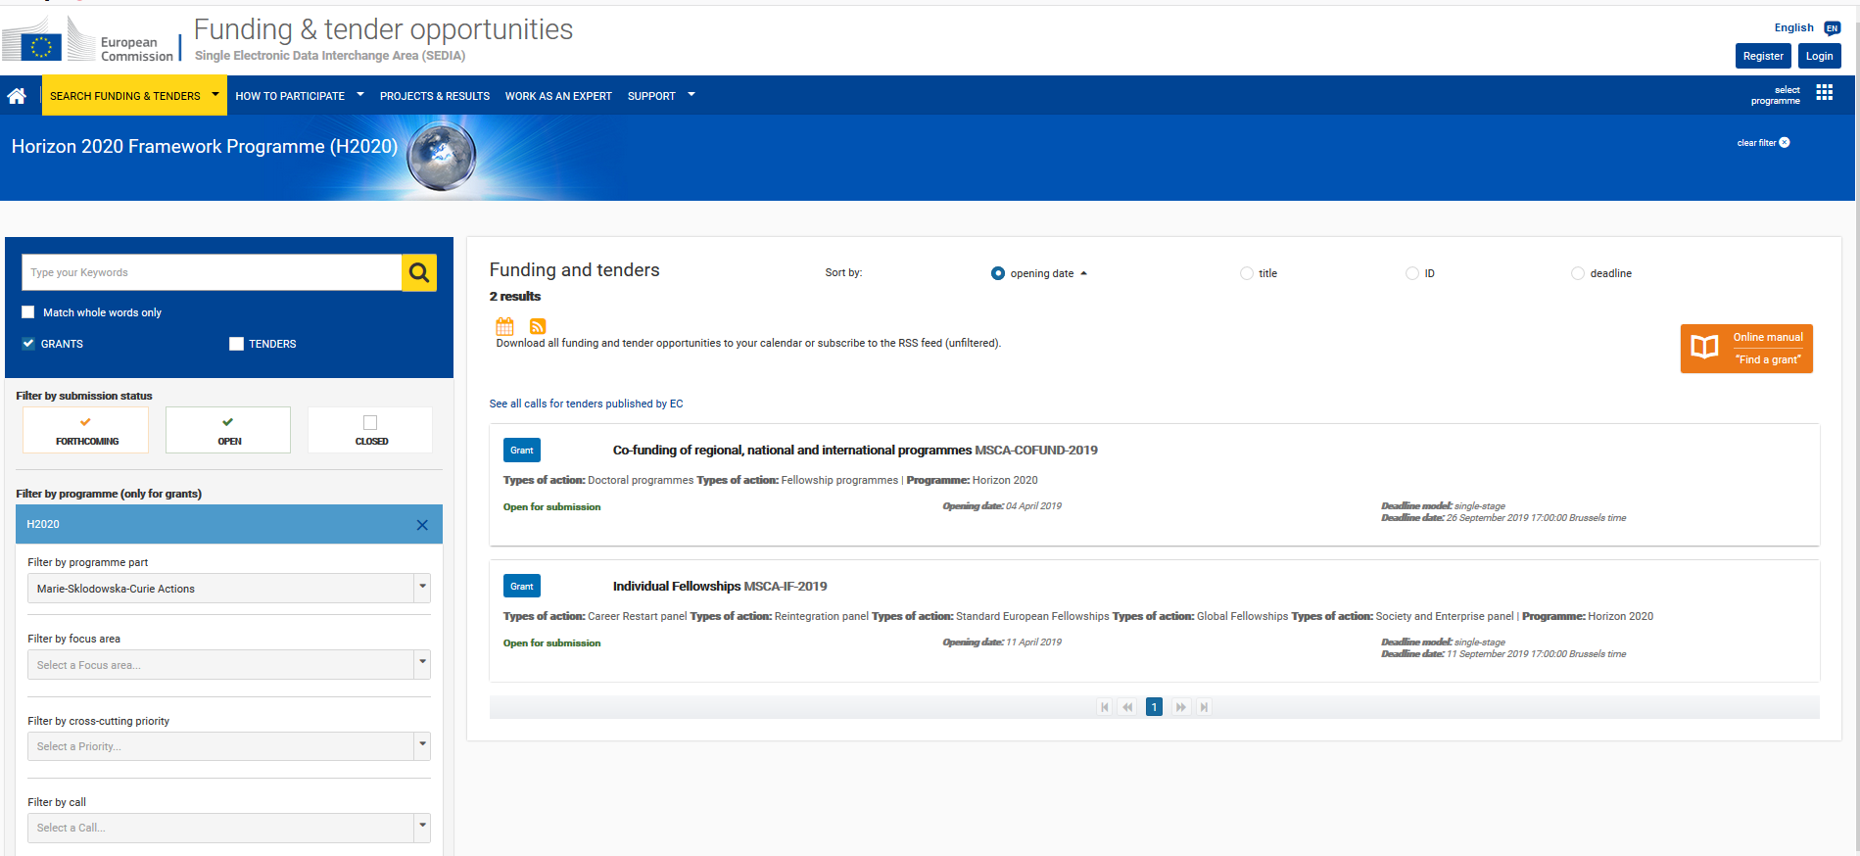
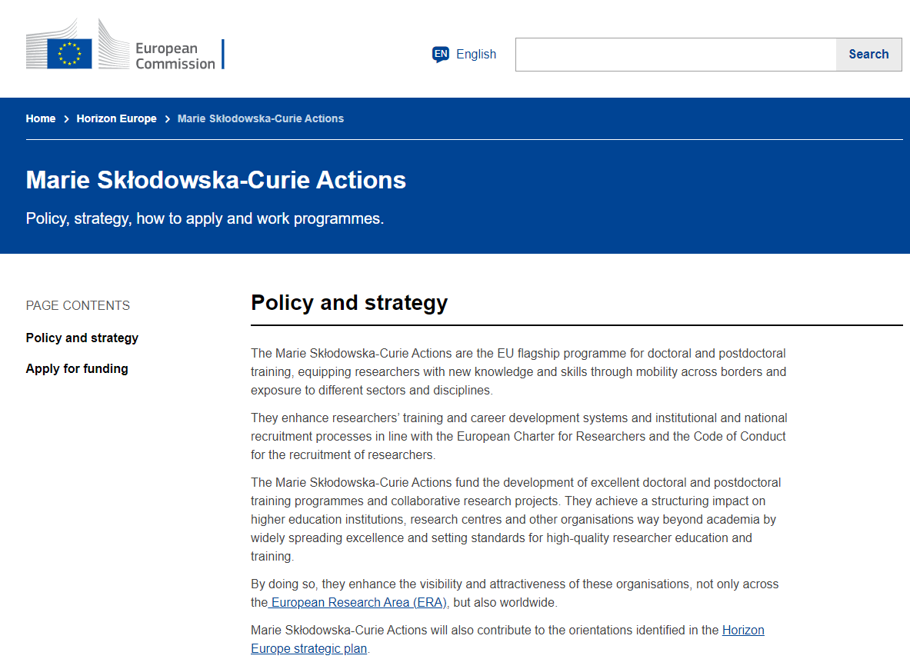
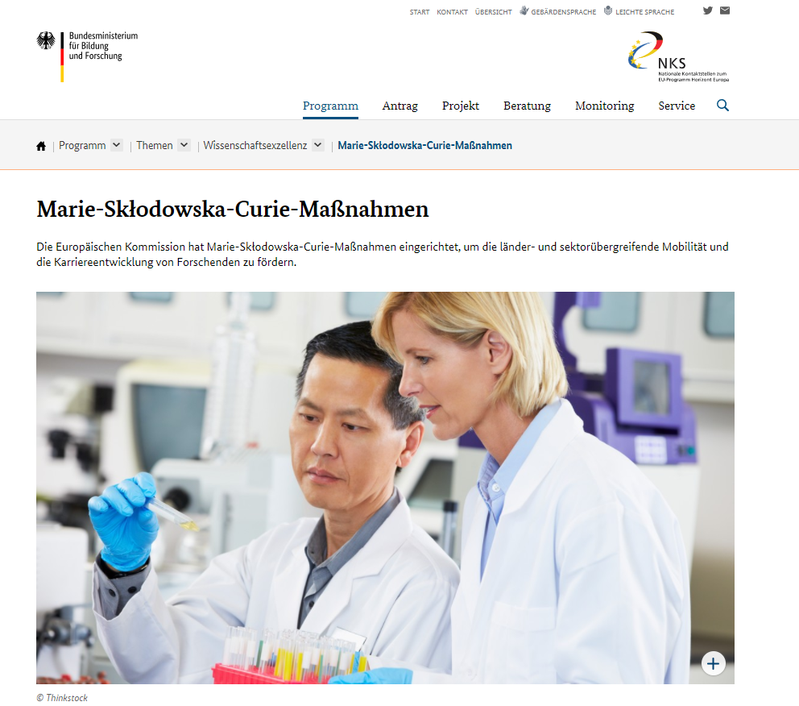
Information online
Funding & Tenders Portal
KoWi Website
European Commission
NCP MSCA

Slide 25
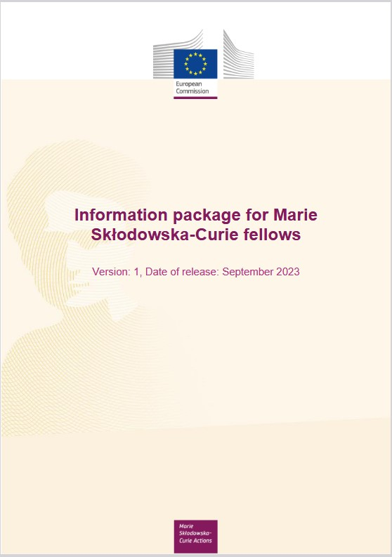
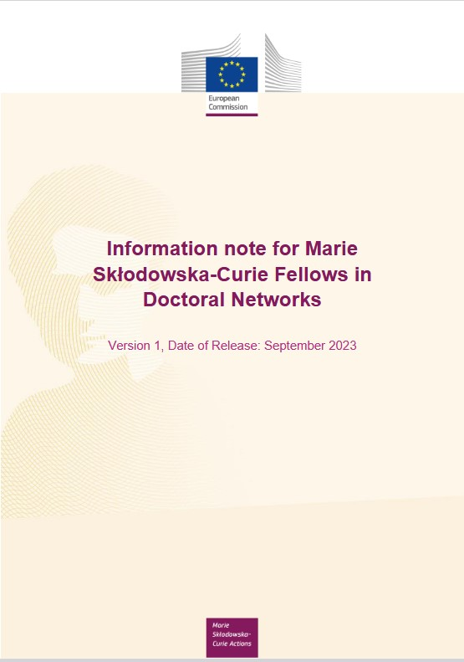
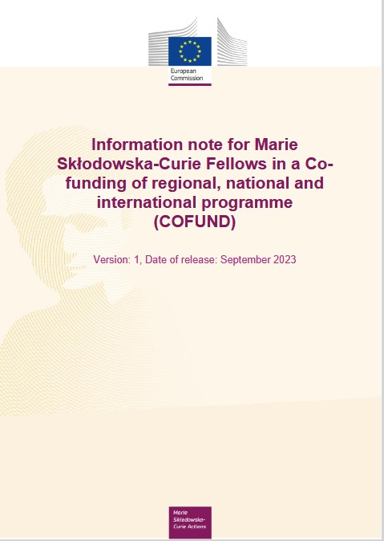
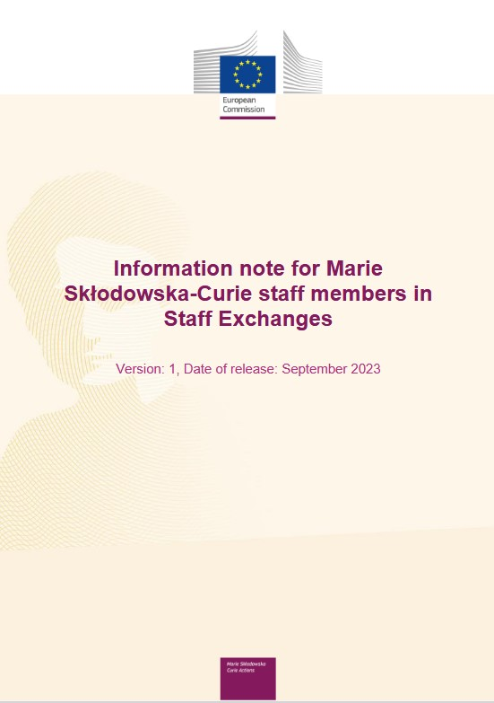
Further information documents
Information package for Marie Skłodowska-Curie fellows
Information note for Marie Skłodowska-Curie DN fellows
Information note for Marie Skłodowska-Curie COFUND fellows
Information note for Marie Skłodowska-Curie staff members in Staff Exchanges

Slide 26


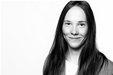
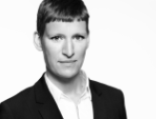

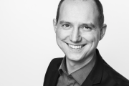


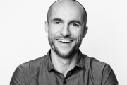

Contact Persons ERC/MSCA
Coordination
Dr. Kristina Wien
Head of team
+49-228-95997-15
kristina.wien@kowi.de
Isabel Herzhoff
Head of team
+49-228-95997-14
isabel.herzhoff@kowi.de
KoWi Team
Laura Willems
MSCA
+49-228-95997-23
laura.willems@kowi.de
Sarah Henkel
MSCA
+49-228-95997-21
sarah.henkel@kowi.de
Dunja Hofmann
MSCA & ERC
+49-228-95997-26
dunja.hofmann@kowi.de
Dominik Maas
MSCA & ERC
+49-228-95997-13
dominik.maas@kowi.de
Byron Schirbock
MSCA & ERC
+49-228-95997-27
byron.schirbock@kowi.de
Katharina Spannhake
MSCA & ERC
+49-228-95997-17
katharina.spannhake@kowi.de
Martin Winger
ERC
+32-2-54802-21
martin.winger@kowi.de
Project management:
Sebastian Claus
Yvette Gafinen
Cristina Condovici
Sarah Henkel

