Slide 1

Welcome to
“Research in Europe”
Dominik Maas, KoWi Office Bonn

Slide 2
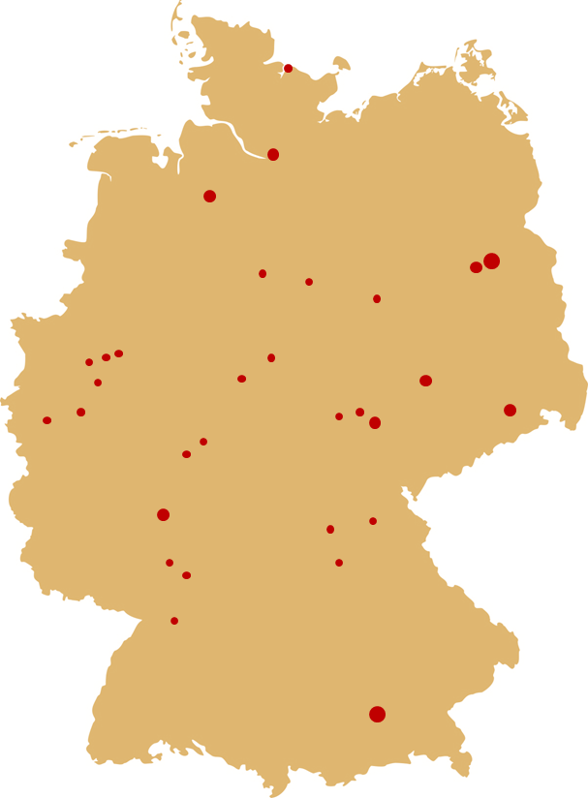
Research in Europe – A success story since 2002
2002, 2005 & 2016 Berlin
2002 & 2011 Mainz
2002 & 2013 Tübingen
2002 & 2018 Bochum
2003 Kassel
2003 Jülich
2003 & 2006 Dresden
2004, 2008 & 2012 München
2004 Marburg
2004, 2014 & 2023 Bremen
2005 Erfurt
2005 Dortmund
2006 Karlsruhe
2006 & 2016 Hamburg
2006 Bamberg
2007 Gießen
2007 & 2018 Jena
2007 Braunschweig
2007 Köln
2008 Kiel
2009 & 2015 Leipzig
2009 Heidelberg
2010 Duisburg-Essen
2010 Erlangen-Nürnberg
2011 Hannover
2012 & 2017 Magdeburg
2014 Weimar
2015 Göttingen
2017 Mannheim
2019 Bayreuth
2019 Stuttgart
2021 München (virtually)
2021 Karlsruhe (virtually)
2022 Potsdam (virtually)
2022 Siegen
2023 Göttingen
2024 Eberswalde

Slide 3
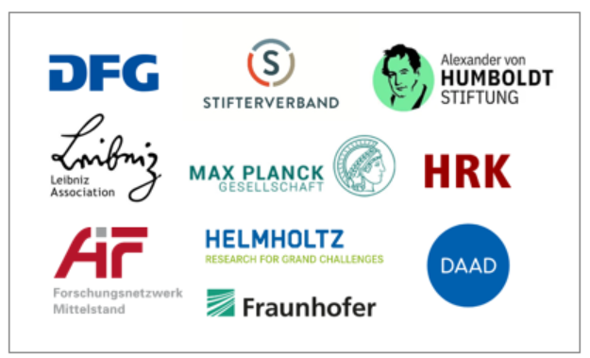
Why do we offer this event?
KoWi = “European Liaison Office of the German Research Organisations” with two Offices (Bonn & Brussels)
Joint service platform of all German research organisations & universities/universities of applied sciences
Mandate: information, advise and training on EU research funding
We work together with the members of our association to create linkages between national and EU funding

Slide 4
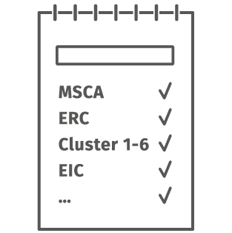

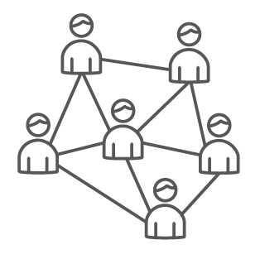

Aims of “Research in Europe“
Inform you about research funding opportunities at national and EU level
Provide you with insights on the variety of possibilities for early career researchers
Present an overview on the research funding organisations
Provide orientation on whom to contact

Slide 5
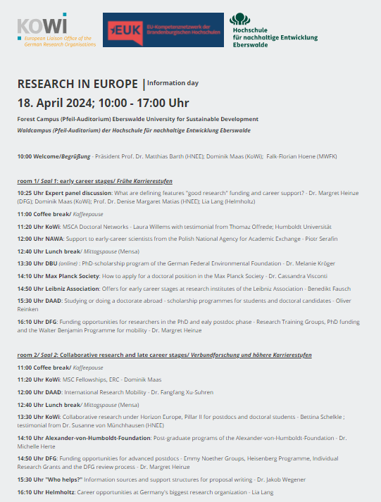
Today’s agenda

Slide 6
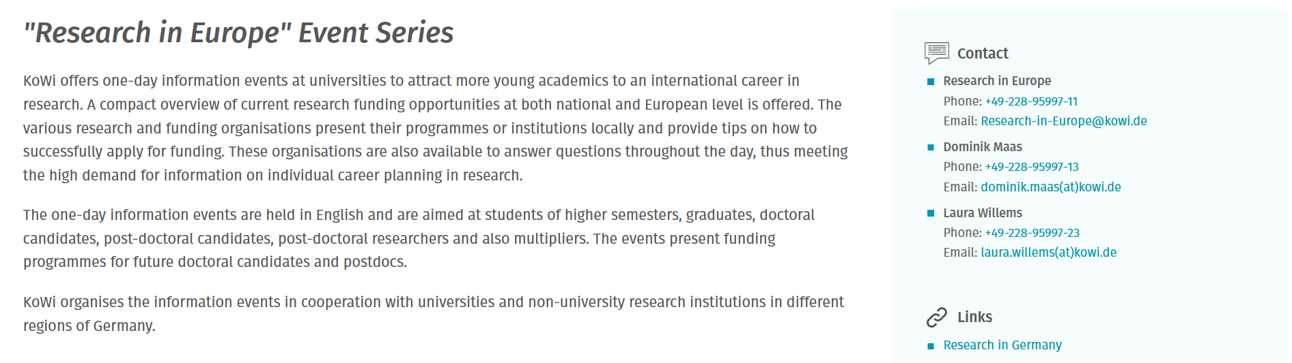
Presentations online after the event
https://www.kowi.de/en/kowi/services/training-events/research-in-europe/research-in-europe.aspx

Slide 7






Many opportunities at the national level

Slide 8

What does European research funding mean for you?
Financial support:
Horizon Europe = the current EU Framework Programme for Research and Innovation
One of the largest public research funding programmes worldwide (€95.5 billion for 2021-2027)

Slide 9

What does European research funding mean for you?
… but not only financial support:
EU policies aim to improve your research conditions:
support mobility and future networks
employment instead of stipends
worldwide collaboration

Slide 10
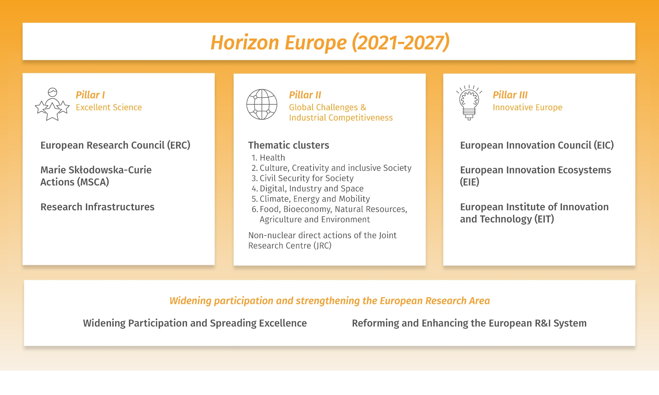
Horizon Europe- EU Framework Programme for Research and Innovation

Slide 11

KoWi helps you ...
... to find a suitable funding scheme in Horizon Europe
... to prepare your EU-application by giving feedback on your proposal and answering your questions including ethical, financial and project management issues
... working together with the funding office at your research organisation

Slide 12

KoWi-Services
Information
Information events
KoWi-Newsletter: www.kowi.de/aid-newsletter
NKS ERC Newsletter and FAQs: www.nks-erc.de
Advice
Individual application feedback and support
Small group advice
Project- und Finance Management
Training
Applicant and Grant Management Workshops
ERC Interview Training
National Contact Point (NCP) for the European Research Council (ERC)
in cooperation with the EU Bureau of the BMBF
Contacts: www.nks-erc.de

Slide 13



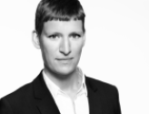






Contact Persons ERC/MSCA
Coordination
Dr. Kristina Wien
Head of team
+49-228-95997-15
kristina.wien@kowi.de
Isabel Herzhoff
Head of team
+49-228-95997-14
isabel.herzhoff@kowi.de
KoWi Team
Laura Willems
MSCA
+49-228-95997-23
laura.willems@kowi.de
Sarah Henkel
MSCA
+49-228-95997-21
sarah.henkel@kowi.de
Dunja Hofmann
MSCA & ERC
+49-228-95997-26
dunja.hofmann@kowi.de
Dominik Maas
MSCA & ERC
+49-228-95997-13
dominik.maas@kowi.de
Byron Schirbock
MSCA & ERC
+49-228-95997-27
byron.schirbock@kowi.de
Katharina Spannhake
MSCA & ERC
+49-228-95997-17
katharina.spannhake@kowi.de
Martin Winger
ERC
+32-2-54802-21
martin.winger@kowi.de
Project management:
Sebastian Claus
Yvette Gafinen
Cristina Condovici
Sarah Henkel

