Slide 1
Welcome to Research in Europe!

Slide 2
Organisational aspects
Coffee 11:00 to 11:20
Lunch 12:40 to 13:30 (cash payment only…)
Info tables accessible throughout the event, except lunch break
Shuttle to the train station: at 16:35; for registered persons only
…. Enjoy the event!!

Slide 3
Greetings
Prof. Dr. Mattias Barth
President of HNEE
Dominik MaaS
KoWi – Liaison Office of the German Research Organisations
Falk-Florian Hoene
Ministry of Science, Research and Culture Land Brandenburg

Slide 4
Panel Discussion
What are defining features of „good“ research funding and career support?
Dr. Margret Heinze
DFG
Support to Early Career Stages
Dominik Maas
KoWi
ERC-Program
Prof. Dr. Denise M. Matias
HNEE
Ecosystem-Based Transformation Management
Lia Lang
Helmholtz-Gemeinschaft
Scientific Careers and Talent Manager
Chair: Prof. Alexander Pfriem
HNEE, Vice-President for Research and Transfer

Slide 5
Coffee Break
Lectures continue 11:20!

Slide 6
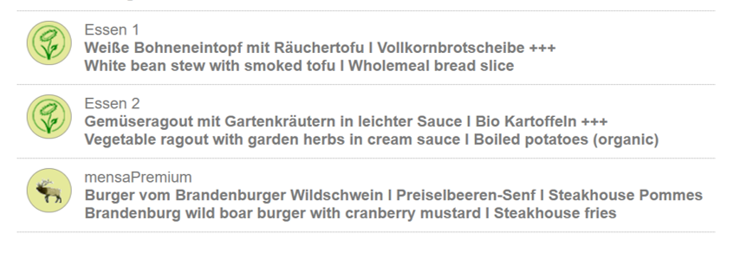
Lunch Break
Lectures continue 13:30!

